Slide 1


Primary funding is provided by
The SPE Foundation through member donations
and a contribution from Offshore Europe
The Society is grateful to those companies that allow their professionals to serve as lecturers
Additional support provided by AIME
Society of Petroleum Engineers Distinguished Lecturer Program
www.spe.org/dl

Slide 2

Modern Perforating Techniques:
Key to Unlocking Reservoir Potential
Andy Martin
Schlumberger
Society of Petroleum Engineers Distinguished Lecturer Program
www.spe.org/dl

Slide 3
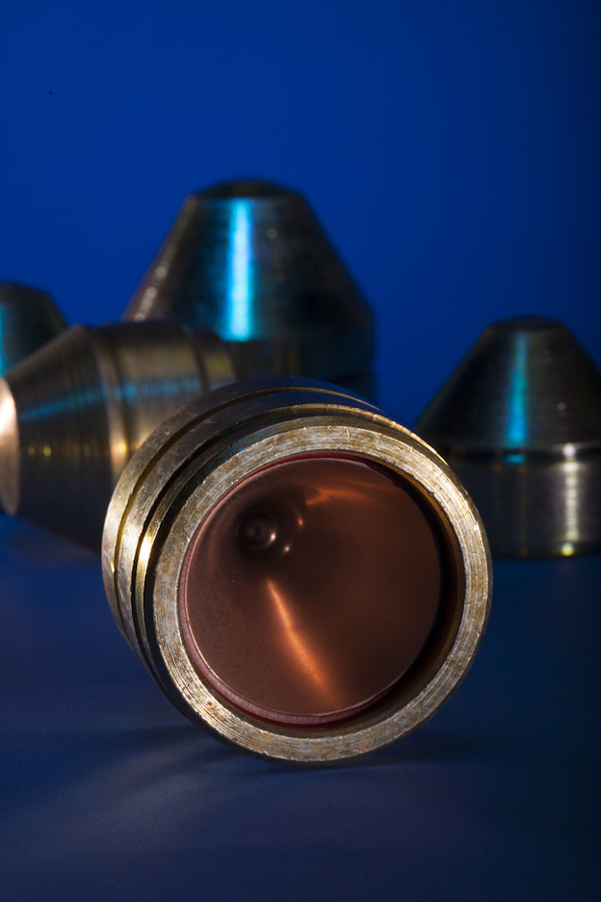
Presentation Outline
Introduction: Perforating for Productivity
Perforation Clean-up
Increasing Shot Density
Increasing Penetration
Keeping Perforations Clean
Summary
Shaped charges

Slide 4
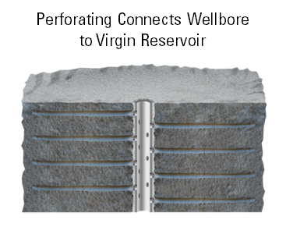
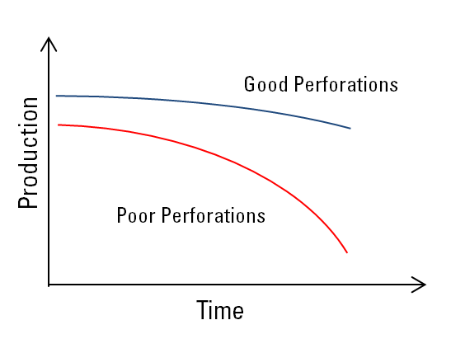
Perforating For Productivity
Connects well to reservoir
45 million shaped charges shot per year
Perforating sub-optimal in 95% of operations
20% to 50% production lost
Modern techniques unlock a reservoir’s full potential
Notes:
Jet perforating has its origins in the military and was first adopted to oil industry use after the second world war. The process is relatively simple in that shaped charges loaded in perforating guns are detonated opposite the target formation. Hyper-velocity jets of powdered metal and gas create holes in the casing, cement by pushing aside material. It is a pressure event. Often the focus in the industry is on the hardware and explosive load rather than the technical detail of the perforation process. Ignoring the detail can lead to poor well performance or failure of other completion processes such as gravel packing, acidizing or hydraulic fracture initial. This presentation focuses on perforating for productivity and does not cover the techniques for other completion processes. The plot on the right shows the benefits of getting the perforation process right. Not only does production improve from day one, but clean perforations also reduce unwanted problems occurring during the life of the well such as scale, wax, production below bubble point etc.

Slide 5
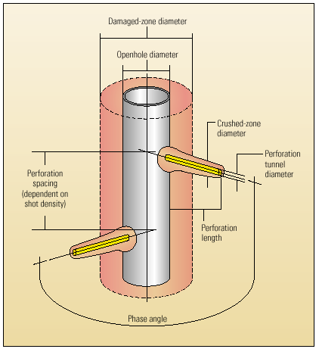
A Review of Fundamentals
Semi-analytic model*
Gun/shaped charge: length, diameter, shot density (spf), phase angle
Damage: near wellbore, perforation
Recent modifications: accurate penetration model, accurate clean up model
Damaged zone
Open hole
Crushed zone
Diameter
Shot density (spf)
Length
Phase angle
*SPE 18247 “Semi-analytical Productivity Models for Perforated Completions” Karakas and Tariq presented in 1988
Notes:
The model that is used to predict the performance of a perforated completion is that proposed by Karakas and Tariq (SPE 18247). They ran 2-D and 3-D finite element models to predict the pressure drop through a perforated completion. The model allows the user to examine the impact of phase angle, shot density, formation damage around the wellbore, perforation length and perforation damage. It includes the influence of permeability anisotropy and well deviation. A recent thesis by Susan Moloney (Imperial College, London, UK) using modern CFD software concluded that the Karakas and Tariq model is reasonably accurate. Some modifications have been made for horizontal wells (Craig Graham Schlumberger) which was outside the limits of the model. There is also more recent work on perforation geometry and single shot perforation damage models that are discussed later.

Slide 6
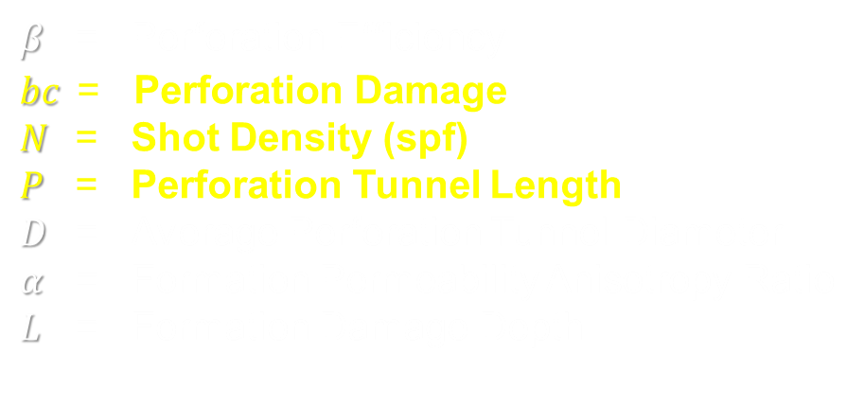
Simplification of Karakas and Tariq
$$β=\left(P−L\right)N^{3/2}D^{1/2}α^{−5/8}{bc}_{}^{−1}$$
$β$ = Perforation Efficiency
$$bc \text{ = } \text{Perforation} \text{Damage}$$
$N$ = Shot Density (spf)
$P$ = Perforation Tunnel Length
$D$ = Average Perforation Tunnel Diameter
$α$ = Formation Permeability Anisotropy Ratio
$L$ = Formation Damage Depth
*SPE 38148 “A Simple Method for Estimating Well Productivity” Brooks presented in 1997
Notes:
We can run perforation analysis programs to examine the trade off between various perforation parameters. However, it is useful to review a simplified model proposed by Brooks (SPE 38148). Brooks suggested that a perfect set of perforations would have infinite shot density and infinite phasing. In effect we are simply excavating a large chunk of reservoir rock from behind the casing out to the limit of penetration. We increase the effective wellbore radius and so reduce the local pressure drop. Brooks came up with a formula that we can use to prioritize the various perforating parameters. The most important one is to obtain clean perforations, followed by shot density, penetration beyond the formation damage. The diameter of the perforation tunnels is of secondary importance unless we have high flow rates and suffer from turbulent effects.

Slide 7

Simplification of Karakas and Tariq
$$β=\left(P−L\right)N^{3/2}D^{1/2}α^{−5/8}{bc}_{}^{−1}$$
Clean perforations $bc$ : Static Underbalance (SUB), Dynamic Underbalance (DUB)
Increase shot density $N$ : Higher spf guns; Double Shoot
Shoot beyond formation damage $P−L$ : Deeper Penetrating Shaped Charges
Notes:
We can run perforation analysis programs to examine the trade off between various perforation parameters. However, it is useful to review a simplified model proposed by Brooks (SPE 38148). Brooks suggested that a perfect set of perforations would have infinite shot density and infinite phasing. In effect we a re simply excavating a large chunk of reservoir rock from behind the casing out to the limit of penetration. We increase the effective wellbore radius and so reduce the local pressure drop. Brooks came up with a formula that we can use to prioritize the various perforating parameters. The most important one is to obtain clean perforations, followed by shot density, penetration beyond the formation damage. The diameter of the perforation tunnels is of secondary importance unless we have high flow rates and suffer from turbulent effects.

Slide 8
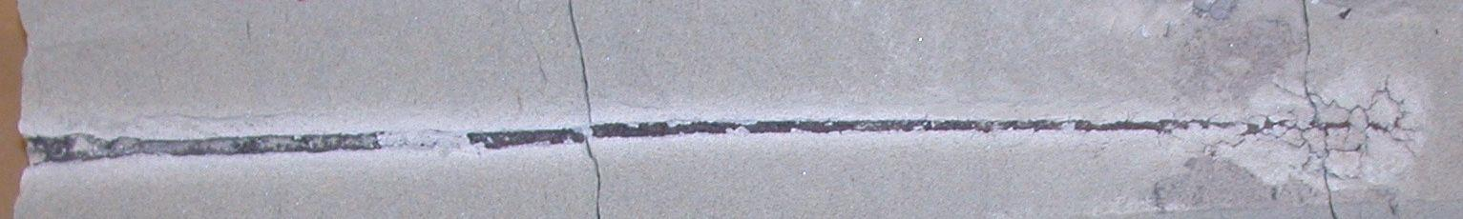
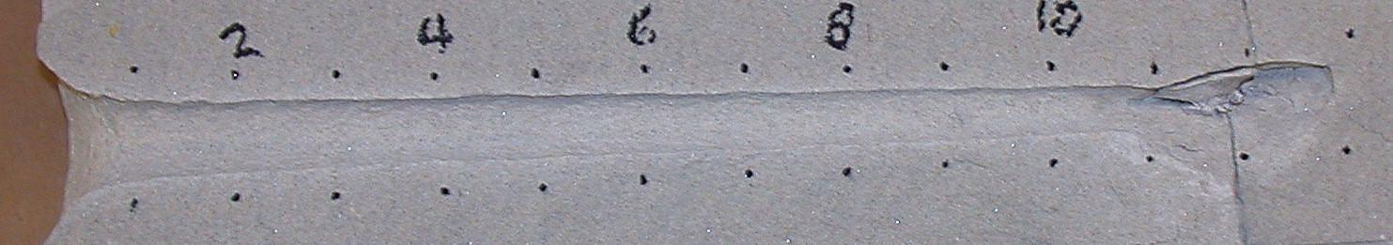
Obtaining Clean Perforations
Perforating crushes rock
Typical Perforation
Ideal Perforation
Notes:
Perforating is a violent process and when we create a perforation tunnel, the rock is crushed and remains inside the tunnel until we start to flow the well. It takes extreme flow rates to break through this damage, but in an ideal world, we would like to remove all the damaged rock to leave a perfectly clean perforation tunnel.

Slide 9
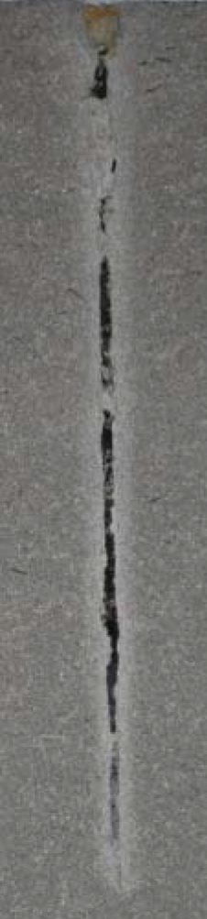
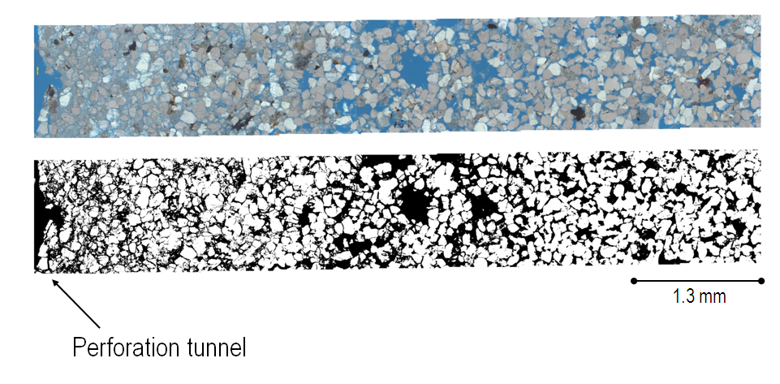
Crushed Zone
Crushed zone
Virgin rock
Plugged perforation
Reduces production or injection
Weaker than the virgin rock
Removed by a sharp drop in pressure
1.3 mm
Loose
debris
Crushed
zone
Virgin rock
Increase
Rock
strength
Porosity
Permeability
0
Distance from center of perforation tunnel
*SPE 122845 “New Fundamental Insights into Perforation Induced Formation Damage” Heiland presented in 2009
Notes:
Let’s have a look in more detail at the nature of the damage inside a perforation tunnel. We have a crushed zone. We know that the crushed zone affects both production and injection. Julianne Heiland studied the crushed zone in fine detail and showed that for a sandstone, it is typically about ½-in. thick, it is weaker than the virgin rock and the permeability is less than the virgin permeability. In fact both the strength and permeability vary across the damaged zone. The thickness of the permeability damage is slightly less than that of the strength reduction. This is good and useful to know. It means that if we can fail and remove the weak crushed zone, we can guarantee that we will also remove the impairment to production.
The fill or debris in the middle of the tunnels is loose and high permeability. It is easily removed by strong flow. This is good news for a producer. However, for an injector it is disastrous. The fine material acts almost as a lost circulation material and can plug off the pore throats in the formation. It can easily prevent injection. So it is even more important for injectors to not only fail the crushed zone but also to remove as much of the debris inside the perforation tunnel as possible.

Slide 10
Tunnel Debris
Crushed zone
Virgin rock
Plugged perforation
Reduces injection rates
Loose, weak material
Removed by surge flow
1.3 mm
Loose
debris
Crushed
zone
Virgin rock
Increase
Rock
strength
Porosity
Permeability
0
Distance from center of perforation tunnel
*SPE 122845 “New Fundamental Insights into Perforation Induced Formation Damage” Heiland presented in 2009
Notes:
Let’s have a look in more detail at the nature of the damage inside a perforation tunnel. We have a crushed zone. We know that the crushed zone affects both production and injection. Julianne Heiland studied the crushed zone in fine detail and showed that for a sandstone, it is typically about ½-in. thick, it is weaker than the virgin rock and the permeability is less than the virgin permeability. In fact both the strength and permeability vary across the damaged zone. The thickness of the permeability damage is slightly less than that of the strength reduction. This is good and useful to know. It means that if we can fail and remove the weak crushed zone, we can guarantee that we will also remove the impairment to production.
The fill or debris in the middle of the tunnels is loose and high permeability. It is easily removed by strong flow. This is good news for a producer. However, for an injector it is disastrous. The fine material acts almost as a lost circulation material and can plug off the pore throats in the formation. It can easily prevent injection. So it is even more important for injectors to not only fail the crushed zone but also to remove as much of the debris inside the perforation tunnel as possible.

Slide 11

Options for Perforation Cleanup
Surging
Static
Underbalance
Dynamic
Underbalance
Notes:
There are three techniques used today for perforation clean up. The most common one that has been around for years is static underbalance. This is where the well pressure is below the reservoir pressure. It became more popular with the advent of TCP operations. There are several papers on static underbalance by Bell, King, Crawford, Tariq and Behrmann. We still use Behrmann’s equations from his 1995 paper SPE 30081 to estimate the static underbalance required to clean up perforations and also to estimate the damage remaining if the underbalance is not high enough. The next technique is surging. This again has been around for a while. An atmospheric chamber is opened up to drop the well pressure quickly. It is more commonly used as a stand alone technique for gravel pack completions. A separate work string is often used as a surge chamber.
Both surge and static underbalance have failings. Often results are not as expected. Also we find that overbalanced or on-balanced perforating sometimes gave good results. At the end of 1990’s fast pressure gauge data gave us clues as to why this happened and what we were missing. Walton et al SPE 71642 showed that in the first few hundred milliseconds after perforating there are a lot of transient pressure events occurring in the wellbore. These are caused by gas from the explosive expanding outside the gun and pressuring up the well. When this happens, static underbalance is eliminated and only effective when the gases dissipate and cool down. The static underbalance becomes weaker and what the perforations “see” is not the same as what was planned. Walton discovered that guns could be designed in a different way to actually work for us and to create an instantaneous underbalance. When the design is such that the guns fill very quickly rather than pressuring up the well, the pressure outside drops creating a dynamic underbalance. Initial wellbore condition, gun loading and completion design play a role. It is now possible to design dynamic underbalance operations even with open perforations and even when the well is initially overbalanced.
Even though this was discovered more than 10 years ago, not many wells are perforated with dynamic underbalance today. More should be.

Slide 12
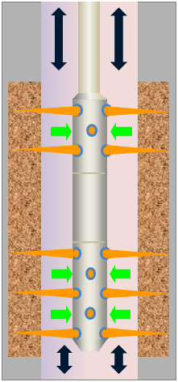
Wellbore Dynamics
Guns and spacers act as pressure sinks
Pressure waves in wellbore
Waves clean perforations
Waves also generate shock
Notes:
Today we can model the pressure events that happen when a gun is detonated. We can do this for both gun underbalance (when the detonation pressure is less than the wellbore pressure) and gun overbalance (when the detonation gases generate a pressure higher than the wellbore pressure). Guns and spacers act as pressure sinks generating pressure waves that travel at the speed of sound in the wellbore. The model predicts how these waves interact between the guns and string and also how they interact with the reservoir. From this we can predict gun shock or loading on the string, packer, cable. In this presentation we limit the discussion to the transient pressure events that lead to perforation clean up.

Slide 13
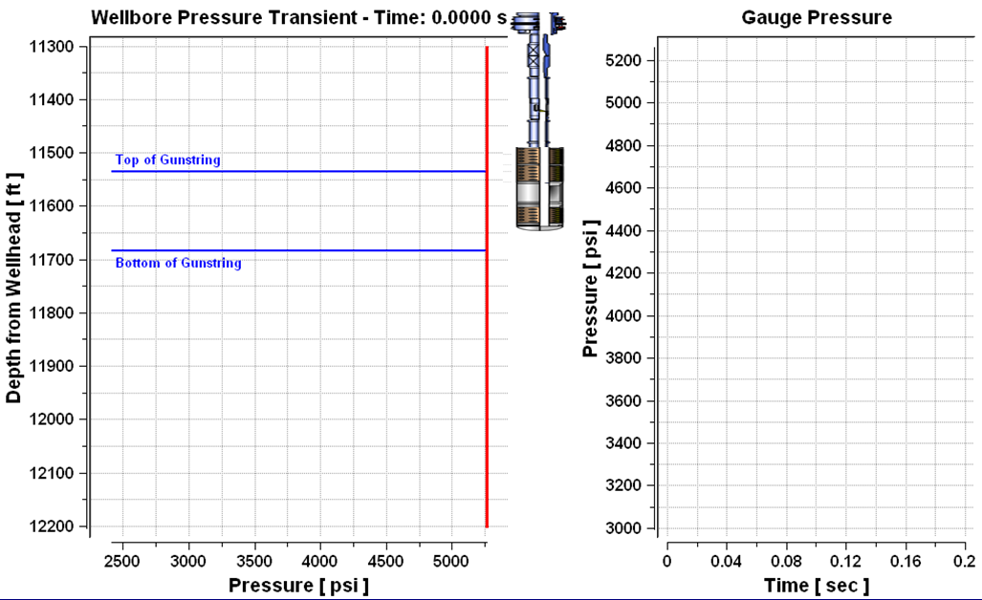
Wellbore Dynamics Model
Notes:
This animation is an output directly from the model. In this example we show a TCP gun string run below a packer. The left hand plot shows the pressure sink generated when the guns fire and the propagation of the wave in the wellbore. You can see the deflections when the wave hits the bottom of the well and when it hits the packer. The plot on the right shows what a pressure gauge would record. The gauge would be either above the guns or below. (The gauge position is specified as an input in the software.) Of importance to us is the amplitude and duration of the underbalance.

Slide 14
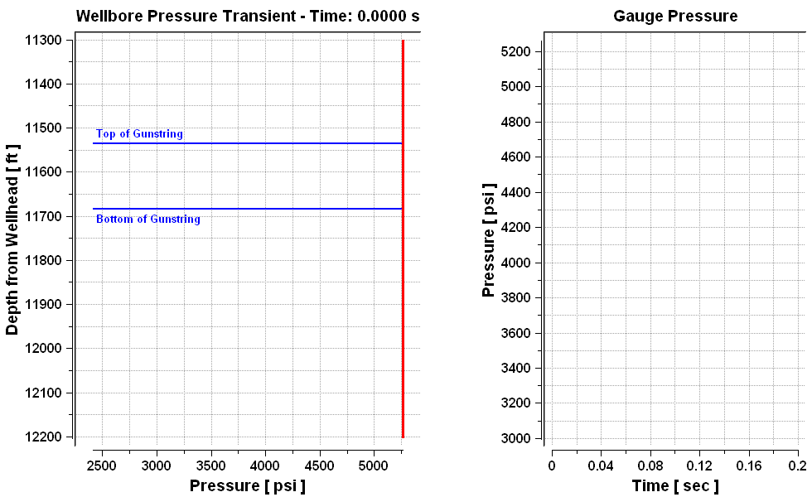



Wellbore Dynamics Model
Notes:
This animation is an output directly from the model. In this example we show a TCP gun string run below a packer. The left hand plot shows the pressure sink generated when the guns fire and the propagation of the wave in the wellbore. You can see the deflections when the wave hits the bottom of the well and when it hits the packer. The plot on the right shows what a pressure gauge would record. The gauge would be either above the guns or below. (The gauge position is specified as an input in the software.) Of importance to us is the amplitude and duration of the underbalance.

Slide 15
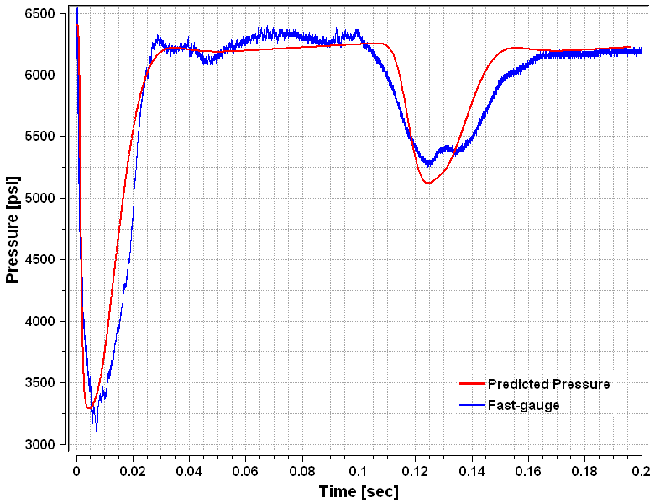
Measured Data vs Model
Implosion chamber*
Fast recording pressure gauge
Pressure amplitude and time match
Second pressure drop is reflection from a plug
Reflected wave
Pressure (psi)
Rapid gun filling
Predicted pressure
Fast-gauge pressure
Time (sec)
How do we link this pressure response to perforation clean up?
*SPE 144080 “Controlled Well Implosions Show that Not All Damage is Bad—A New Technique to Increase Production from Dmaged Wells” Busaidy presented in 2011
Notes:
To show that the model really does predict the wellbore response, we show a recording taken from a fast gauge hung below a perforating gun. When the gun fires the pressure in the wellbore drops rapidly as the design is such that the detonation pressure is less than the wellbore pressure and so the gun fills rapidly. The pressure recovers after about 30 ms in this case. At about 120 ms we see a reflected wave which is from some change in completion. This could be from a packer or TD. Given the speed of sound and travel time we can estimate the distance to the reflection boundary.
There is a good match between model and gauge data. What we would like to do now is to somehow couple the pressure response to perforation clean up. The next slides will show how we looked at this experimentally.

Slide 16
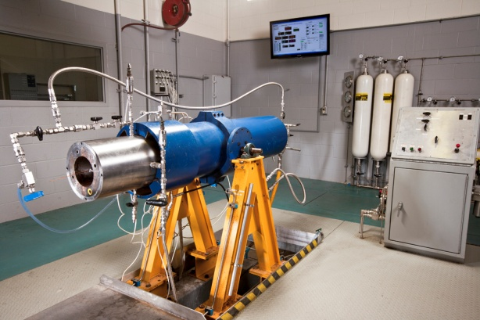
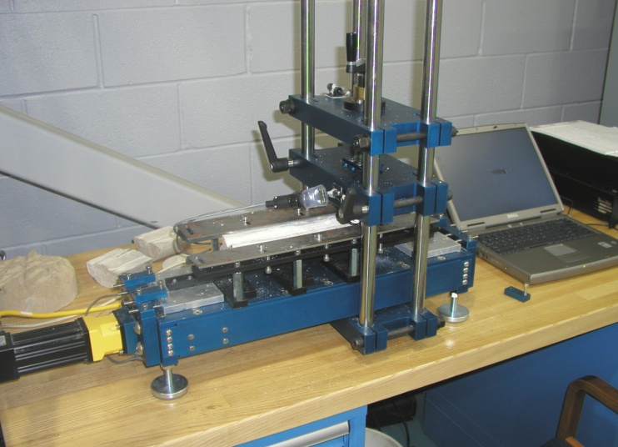
API RP19B Section 4 Research Facilities
Section 4 Pressure Vessel
Scratch Tester
Core Flow measurement
Rock UCS measurement
Notes:
We have a research facility where we can take a rock sample and subject it to downhole conditions inside a pressure vessel. One of the vessels is shown on the left. Often called an API RP19B section 4 test. The vessel simulates the wellbore, the reservoir conditions and enables flow through the core simulating the reservoir.
On the right we show what we cal la scratch tester. This is a way of determining the strength of a rock by measuring the force required to cut a grove. As you can see, a rock has variable strength even over a short section of core.

Slide 17
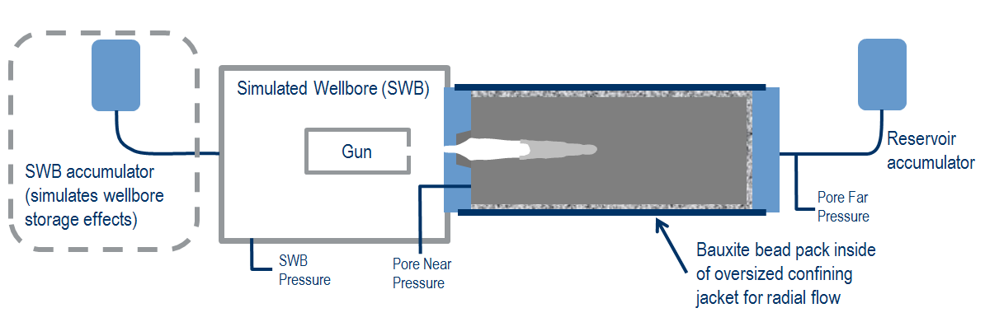
Dynamic Underbalance Experiments
Section 4 Schematic
Simulated welllbore
(SWB)
Reservoir
accumulator
Gun
SWB accumulator
(simulates wellbore
Storage effects
Pore far
pressure
Bauxite bead pack inside
oversized confining
jacket for radial flow
SWB
pressure
Pore near
pressure
Simulated Wellbore (SWB) < Gun pressure
SWB recovery controlled by flow from reservoir and/or SWB accumulators
Pressure (psi)
Short duration DUB
Long duration DUB
Time (s)
Notes:
The diagram shows what the section 4 vessel looks like. We have the core sample connected to a reservoir accumulator. The core has a bead pack to allow flow both radially and axially into the core. The pack is encased in a rubber sleeve to isolate the core from the confining pressure. At the front of the core is a steel plate and cement to simulate casing and cement and to initially isolate the core from the wellbore. The wellbore contains a gun module and single shaped charge. We can simulate a real wellbore by hooking this section up to another accumulator.
By varying the gun module, wellbore pressure and both reservoir and wellbore accumulator response, we can change the magnitude and duration of dynamic underbalance we apply to the core. As we can then flow through the core, we can measure directly the impact of changing dynamic underbalance parameters on perforation clean up.

Slide 18
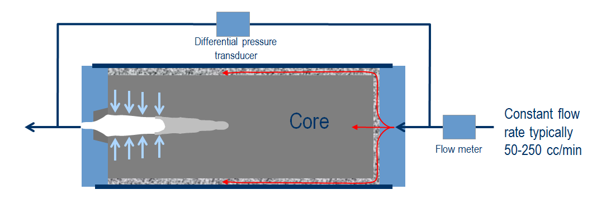
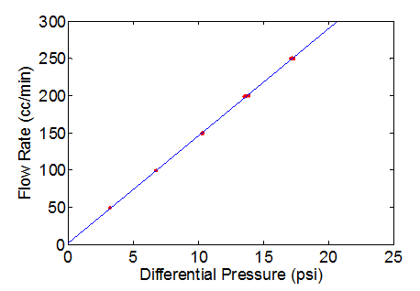
Flow Measurements
Differential pressure transducer
Constant flow
rate typically
50-250 cc/min
Flow meter
Stable flow (injection and production)
PI from slope of differential pressure vs flow rate
Flow rate (cc/min)
Differential pressure (psi)
Notes:
We measure productivity by flowing through the core. We can step the flow rates and measure pressure drop across the core for each flow. We do this for both production and injection ensuring that we have repeatable, steady flow each time. A plot of flow rate vs differential pressure will give us Productivity Index or Injectivity Index.

Slide 19
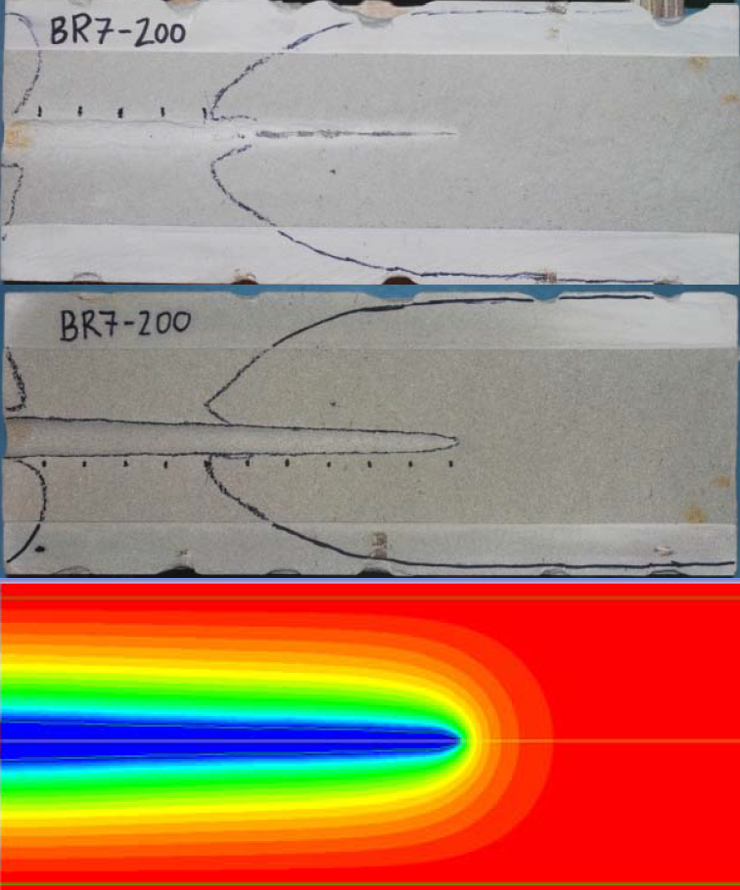
Core Flow Efficiency (CFE)
Ratio measured PI to theoretical PI
CFE ranges from 0.05 to 1
Clean perforation tunnel has CFE of 1
CFE of 0.05 typical of overbalanced perforating
Original
Scrubbed
Model
Notes:
To calculate a core flow efficiency, we need to know what the ideal flow rate will be through the perforation tunnel. We do this by determining the perforation geometry by artificially cleaning out the perforation tunnel and taking careful measurements of length and diameter. These dimensions are then used in CFD to calculate the theoretical flow. From the theoretical flow and actual flow we can calculate CFE.

Slide 20

Single Shot Skin Model
Kc/K model
Kc/K model assumes impaired flow along entire length
Lc/L model assumes flow through open tunnel but no flow through plugged tunnel
Conventional model (Kc/K)
Kc is permeability of crushed zone and K virgin rock
Lc/L model
New model (Lc/L)
Lc is the clean tunnel length and L the total tunnel length
Notes:
The conventional model for pressure drop across a perforation tunnel assumes flow through a crushed zone with constant permeability Kc and constant thickness tc. The assumption is that the flow is along the entire tunnel length. From experiments, we observe that this model is not correct. It does not match what we see. A more realistic model is of a tunnel with an open length Lc as shown below. Flow is only through the open length.

Slide 21
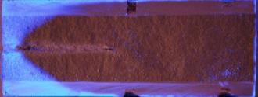
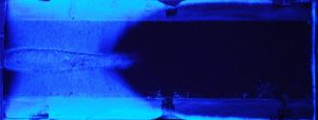
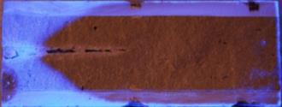
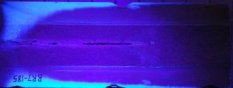
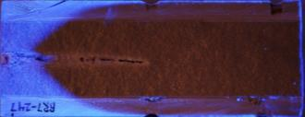
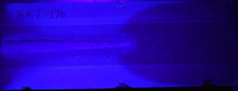
Flow Visualization Experiments
Bright blue region shows fluorescent dye invasion
Fluid only flows into clean perforation tunnel
Lc/L is a better model of perforation clean-up
Notes:
To show this more dramatically, we used fluorescent dye in our experiments. The dye clearly shows the flow path. When the tunnel is plugged or only partially clean, we can see that the flow is only into the clean part of the tunnel. When the tunnel is much cleaner, the flow path is into the whole length of the tunnel. As we can measure CFE and measure clean tunnel length, we find that there is a direct match. So we can say that a CFE of 60% comes from a tunnel with 60% effective length or 60% clean up.
So from experiments linking magnitude and duration of DUB, we have a link to CFE or Lc/L. We can use this now in our modified Karakas and Tariq model.

Slide 22
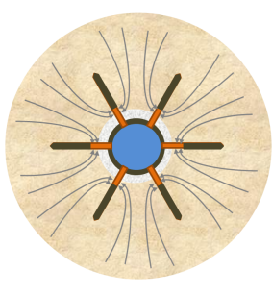
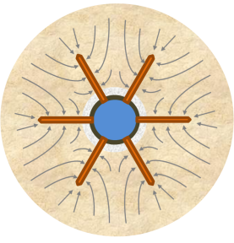
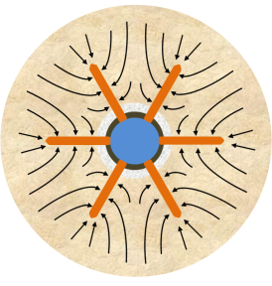
Why is This Important?
Kc/K does not predict skin which could lead to the wrong selection of guns or technique
Lc/L is more realistic and gives more accurate predictions of skin
Partial clean-up
Lc/L model
Partial clean-up
Kc/K model
Clean, open tunnel
Notes:
Why is this important? On the right we show flow into a perfectly clean set of perforations. CFE is 100%. In the middle we show the Kc/K model. Flow is impaired but we still have flow through the whole tunnel length. On the left we show the Lc/L model. As you can see, the flow is restricted to only the front of the perforation tunnel. Now if we have damage around the wellbore, the flow will be severely restricted. So we expect a large pressure drop. We see this in the real world and we know that the Kc/K will not show this. So the danger of working with a wrong model, is that we will design the wrong perforating job. We might end up selecting the wrong gun or wrong technique.

Slide 23
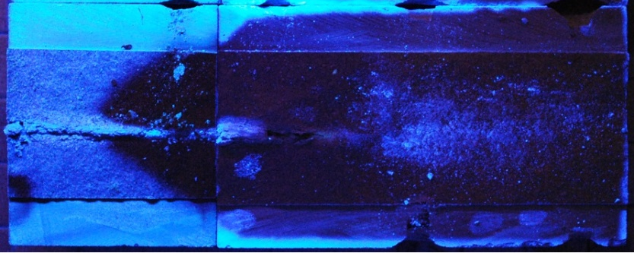
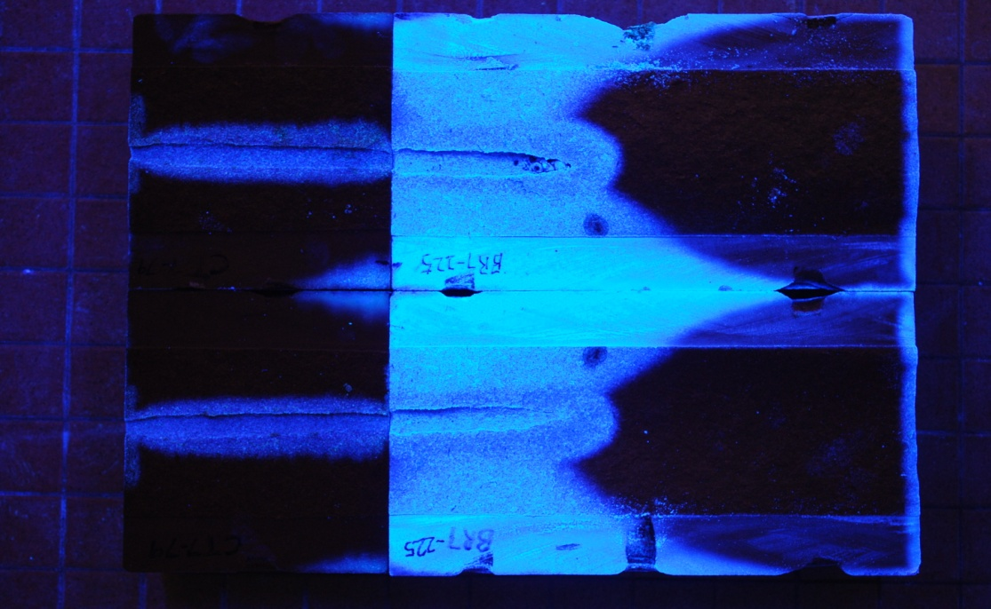
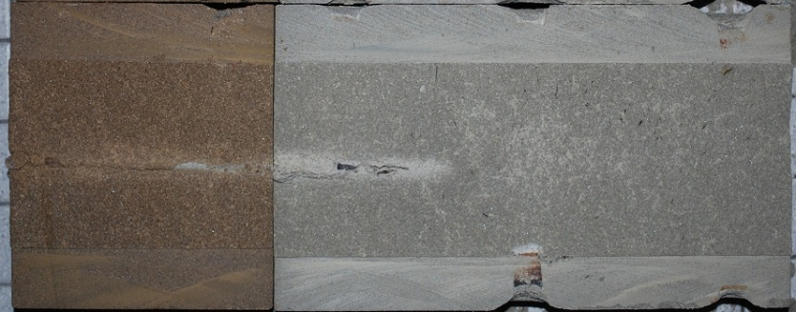
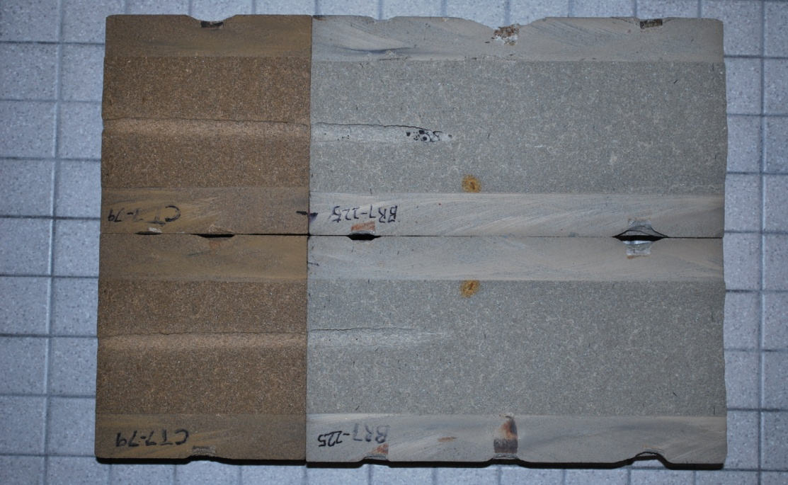
Deep & Clean Perforations
Lc
L
Lc = L
Drilling damage:
low permeability
Virgin rock:
high permeability
Low
permeability
High
permeability
On the left Lc is short so flow has to go through formation damage simulated by low permeability rock
On the right the perforation is clean (Lc = L) so flow is through the perforation tunnel avoiding the damage
Notes:
Recent visualization experiments show that the Lc/L concept is a better way to describe a perforation tunnel when there is a damaged zone to shoot through. We simulate damage using two outcrop cores of different permeability: 6” of Carbon Tan 20 mD; 12” of Berea 130 mD. We used a 2 7/8” (PowerJet Omega 2906) shaped charge that will shoot through the damage by more than 50%. In one set up we simulated partial dynamic underbalance (short recovery of 100 ms and 2000 psi DUB). With the second set up we used the same shaped charge but set up the system so that we achieved full dynamic underbalance clean up (100 ms recovery and 3000 psi DUB). With dye-flow visualization, we can clearly see that flow flows into the first few inches of the plugged perforation through the low permeability rock (Lc = 3”). However, when the perforation tunnel is perfectly clean, the flow path is through the portion of the perforation tunnel beyond the damaged low permeability zone. The flow follows the path of least resistance. These two examples show that it is important to shoot deeper, beyond any formation damage, but also important to have clean perforation tunnels.

Slide 24
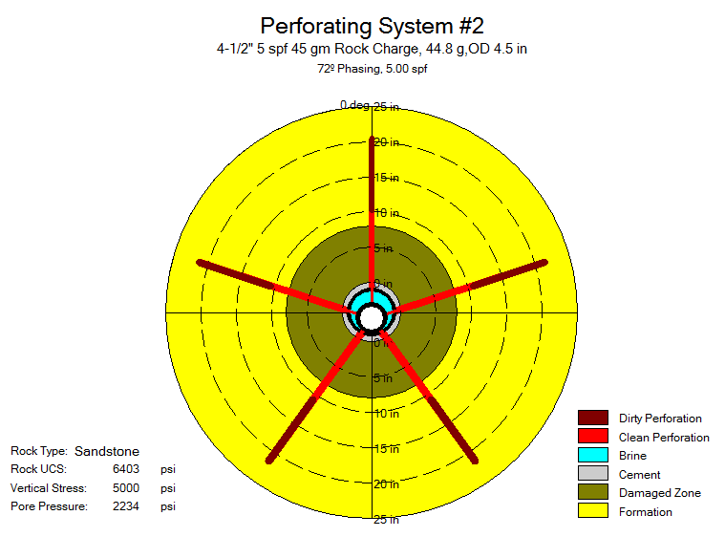
4 ½” Gun, 5 spf, Large Charge
Penetration with clean tunnel length
Shooting through the formation damage
Notes:
As an example, 4 ½” guns can be loaded with two sizes of shaped charges. One is a large high explosive load shaped charge usually containing in the range of 38 to 45 gm of explosive. The maximum number of shaped charges that can fit inside the carrier is 5 spf. This is limited by the physical size of the shaped charge. We can fit smaller shaped charges into this gun at a higher shot density. Typically we use a shaped charge containing about 20 gm of explosive that fits at 12 spf. The effective phase angle of the two systems is usually 60 or 72 deg for the larger charge and 45 deg for the smaller one. The larger shaped charge will shoot deeper into the formation. But will the production be higher? Remember Brooks equation. Once penetration goes beyond the formation damage, then perforation efficiency can be improved by increasing shot density. The trade off between shot density and penetration can be shown graphically in the sensitivity plot shown. Here we show Productivity Ratio (the ratio of production from a perforated completion compared to undamaged open hole) versus the effective shot density. The red curve is the 5 spf gun and blue curve 12 spf. The red curve is above the blue because of the impact of penetration on productivity. However, if we compare 5 spf (red) and 12 spf (blue), we can see that the productivity ratio is higher by about 10%. This is vital information to have. Choosing a 12 spf system will deliver 10% more production. What is the cost benefit? The perforating system may be slightly more expensive, but the bulk of the cost of perforating is tied up in the completion of the well and rig time. Further examination of this plot shows that increasing the shot density of the 5 spf system can deliver further production. But how do we do that? We can shoot the same interval twice to give us an effective shot density of 10 spf. This will improve the productivity ratio a further 5%. Double shooting is a technique that has been successfully used. It is easy to do on Wireline, but will double the number of perforating runs. It is also feasible to double shoot on TCP, but more complicated and involves repositioning the string. An option not usually considered is to shoot first with Wireline and then follow up with TCP.
In summary, the focus should be on increasing shot density whenever possible and sensitivity models will show the benefit. Note that this becomes more important in highly laminated formations.

Slide 25
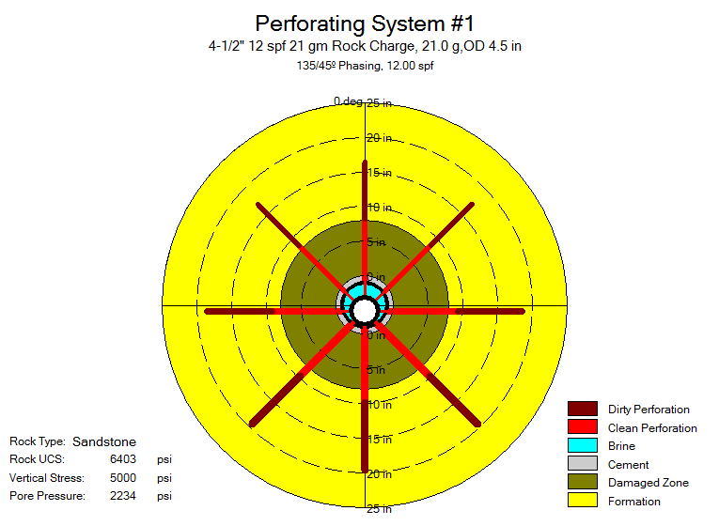
4 ½” Gun, 12 spf, Small Charge
Penetration with clean tunnel length
Shooting through the formation damage
Which system will give the best production?
Notes:
As an example, 4 ½” guns can be loaded with two sizes of shaped charges. One is a large high explosive load shaped charge usually containing in the range of 38 to 45 gm of explosive. The maximum number of shaped charges that can fit inside the carrier is 5 spf. This is limited by the physical size of the shaped charge. We can fit smaller shaped charges into this gun at a higher shot density. Typically we use a shaped charge containing about 20 gm of explosive that fits at 12 spf. The effective phase angle of the two systems is usually 60 or 72 deg for the larger charge and 45 deg for the smaller one. The larger shaped charge will shoot deeper into the formation. But will the production be higher? Remember Brooks equation. Once penetration goes beyond the formation damage, then perforation efficiency can be improved by increasing shot density. The trade off between shot density and penetration can be shown graphically in the sensitivity plot shown. Here we show Productivity Ratio (the ratio of production from a perforated completion compared to undamaged open hole) versus the effective shot density. The red curve is the 5 spf gun and blue curve 12 spf. The red curve is above the blue because of the impact of penetration on productivity. However, if we compare 5 spf (red) and 12 spf (blue), we can see that the productivity ratio is higher by about 10%. This is vital information to have. Choosing a 12 spf system will deliver 10% more production. What is the cost benefit? The perforating system may be slightly more expensive, but the bulk of the cost of perforating is tied up in the completion of the well and rig time. Further examination of this plot shows that increasing the shot density of the 5 spf system can deliver further production. But how do we do that? We can shoot the same interval twice to give us an effective shot density of 10 spf. This will improve the productivity ratio a further 5%. Double shooting is a technique that has been successfully used. It is easy to do on Wireline, but will double the number of perforating runs. It is also feasible to double shoot on TCP, but more complicated and involves repositioning the string. An option not usually considered is to shoot first with Wireline and then follow up with TCP.
In summary, the focus should be on increasing shot density whenever possible and sensitivity models will show the benefit. Note that this becomes more important in highly laminated formations.

Slide 26
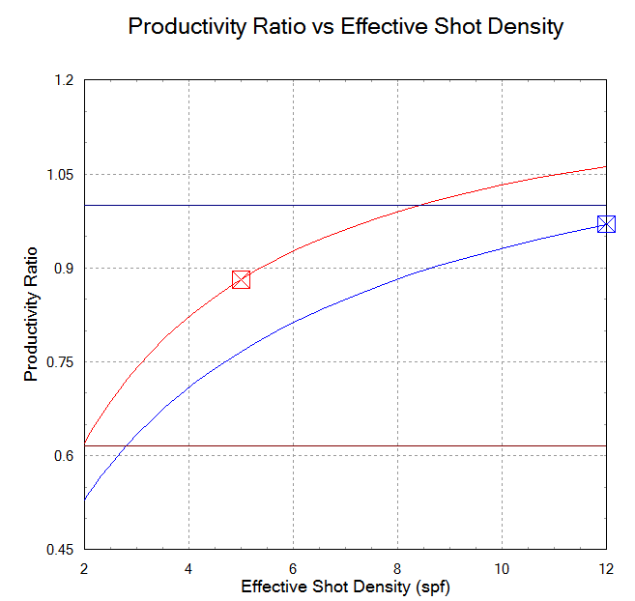
Shot Density Dominates
12 spf, 135 deg
Penetration of a shaped charge for different strength rocks under different confining pressure (see SPE 151846)
5 spf, 72 deg
Penetration with the smaller charge is less, but the productivity is higher
Shoot the 5 spf system twice, to get higher productivity and more than 12 spf system
Notes:
As an example, 4 ½” guns can be loaded with two sizes of shaped charges. One is a large high explosive load shaped charge usually containing in the range of 38 to 45 gm of explosive. The maximum number of shaped charges that can fit inside the carrier is 5 spf. This is limited by the physical size of the shaped charge. We can fit smaller shaped charges into this gun at a higher shot density. Typically we use a shaped charge containing about 20 gm of explosive that fits at 12 spf. The effective phase angle of the two systems is usually 60 or 72 deg for the larger charge and 45 deg for the smaller one. The larger shaped charge will shoot deeper into the formation. But will the production be higher? Remember Brooks equation. Once penetration goes beyond the formation damage, then perforation efficiency can be improved by increasing shot density. The trade off between shot density and penetration can be shown graphically in the sensitivity plot shown. Here we show Productivity Ratio (the ratio of production from a perforated completion compared to undamaged open hole) versus the effective shot density. The red curve is the 5 spf gun and blue curve 12 spf. The red curve is above the blue because of the impact of penetration on productivity. However, if we compare 5 spf (red) and 12 spf (blue), we can see that the productivity ratio is higher by about 10%. This is vital information to have. Choosing a 12 spf system will deliver 10% more production. What is the cost benefit? The perforating system may be slightly more expensive, but the bulk of the cost of perforating is tied up in the completion of the well and rig time. Further examination of this plot shows that increasing the shot density of the 5 spf system can deliver further production. But how do we do that? We can shoot the same interval twice to give us an effective shot density of 10 spf. This will improve the productivity ratio a further 5%. Double shooting is a technique that has been successfully used. It is easy to do on Wireline, but will double the number of perforating runs. It is also feasible to double shoot on TCP, but more complicated and involves repositioning the string. An option not usually considered is to shoot first with Wireline and then follow up with TCP.
In summary, the focus should be on increasing shot density whenever possible and sensitivity models will show the benefit. Note that this becomes more important in highly laminated formations.

Slide 27
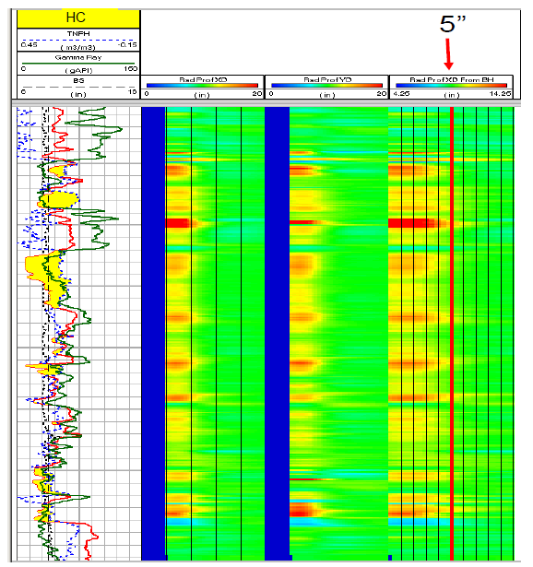
How Deep is Enough?
Sonic radial profiling measures the depth of altered sonic velocities
Interpreted as damage and low permeability regions
Shoot about 50% beyond or 8 in. total
*SPE 112862 “Dipole Radial Profiling and Geomechanics fro New Wellbore Alteration Detection to Improve Productivity in a Matured Field ” Subbiah presented in 2008
Notes:
The question often asked is how deep is deep enough? We know that we need to shoot beyond formation damage, but how do we measure this? Resistivity logs will help us understand fluid invasion. Mud filtrate will seep into the porous rocks before a sound filter cake is built up. This may change the relative permeability of the reservoir rocks, so some companies advocate shooting beyond the invasion zone. SPE 101082 shows an example of an invasion profile determined by Shell. Advanced sonic tools can measure the change in sonic velocities around the wellbore and at different depths into the surrounding rock. SPE 112862 shows an example where the altered zones are clearly visible (darker red colours). These are interpreted as severe damage out to a depth of about 5”. So from log data we can determine, as a minimum, how far we need to shoot. So do we just chose a shaped charge from API RP 19B section 1 concrete data? No, we need to know the penetration in rock under downhole conditions.

Slide 28
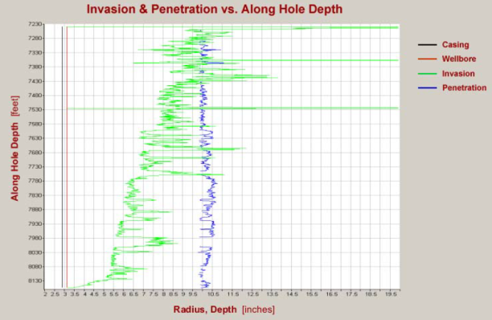

How Deep is Enough?
Shell estimate invasion along the well and want to perforate beyond the invaded zone
API section 1 concrete penetration $≠$penetration in stressed rock
*SPE 101082 “Optimized Perforation—From Black Art to Engineering Software Tool” Bell presented in 2006
How do we calculate penetration today?
Notes:
The question often asked is how deep is deep enough? We know that we need to shoot beyond formation damage, but how do we measure this? Resistivity logs will help us understand fluid invasion. Mud filtrate will seep into the porous rocks before a sound filter cake is built up. This may change the relative permeability of the reservoir rocks, so some companies advocate shooting beyond the invasion zone. SPE 101082 shows an example of an invasion profile determined by Shell. Advanced sonic tools can measure the change in sonic velocities around the wellbore and at different depths into the surrounding rock. SPE 112862 shows an example where the altered zones are clearly visible (darker red colours). These are interpreted as severe damage out to a depth of about 5”. So from log data we can determine, as a minimum, how far we need to shoot. So do we just chose a shaped charge from API RP 19B section 1 concrete data? No, we need to know the penetration in rock under downhole conditions.

Slide 29
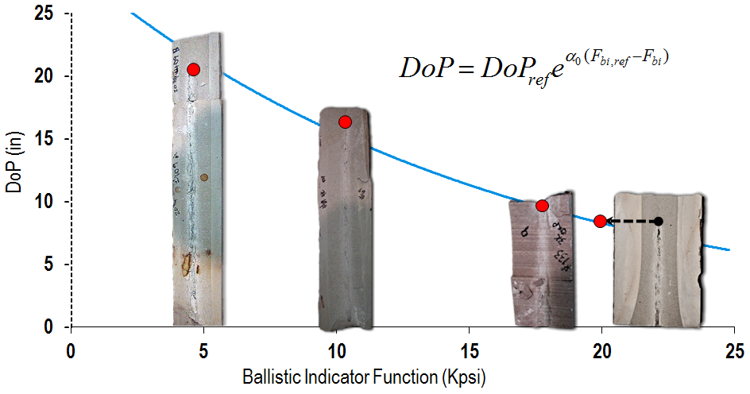
Calculating Penetration
Depends on target strength or Ballistic Indicator Function* (F_{bi})
F_{bi} of rock type, strength and confining stress
Shaped charge characterised across a range of F_{bi}
Model predicts down hole penetration
*SPE 151846 “Stressed Rock Penetration Depth Correlation” Harvey presented in 2012
Notes:
Penetration depends on the type of rock (Sandstone, Carbonate), strength of that rock (unconfined compressive strength) and the confining stress that the rock is under. In the mide 1990’s there was a trend away from testing shaped charges in rock and a focus on concrete. There were various reasons for this. However, more recently the focus has flipped back to testing in stressed rock as the industry realized that the conversion models between concrete and rock were no longer valid. It is also well known that it is possible to custom design a shaped charge and optimize its performance for a particular rock. So it is now vital to characterize a shaped charge over a range of rocks and stresses. The plot shows the characteristics of a 3 ½” shaped charge. Rock strength and stress are combined into a function called the Ballistic Indicator Function. References can be found in SPE 151846 showing the influence of stress (confining pressure, porosity and pore pressure) and rock strength. We should be clear, that the behavior of rocks under impact of hyper velocity metallic jets is not the same as the behavior under quasi-static stress such as hydraulic fracturing. Hence some of the definitions of stress are not the same as Geomechanic definitions.
The graphs shows penetration in a weaker rock such as Castle Gate, under moderate confining pressure (4000 psi) is about 22 “. In Berea sandstone at moderate pressure the penetration is about 17”. On the far right are two rock stress combinations. One is Berea sandstone confined at 20,000 psi and the other is a hard rock, Nugget Sandstone, confined at 4000 psi. The penetration is about the same at 7 to 8”.
At much higher strengths penetration does not go to zero, but asymptotes out to a minimum value.
For our new models, we can describe the curve with a reference depth of penetration (DoP ref) and a reference exponent (alpha zero). So now we can predict downhole penetration knowing the rock type, rock strength, stress and porosity.
Just to repeat, references to the penetration model now used can be found in SPE 151846.

Slide 30
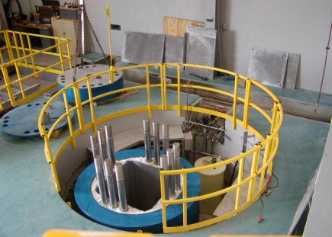
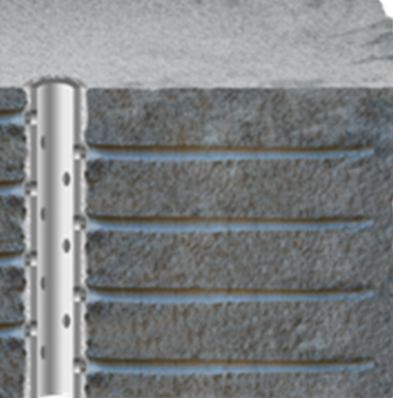
Keeping Perforations Clean
Tri-axial stress frame experiments*
Perforate a block of rock under stress with various static underbalance conditions
Measure flow from each individual perforation
*SPE 28554 “Block Tests Model the New Wellbore in a Perforated Sandstone” Mason presented in 1994
Notes:
In the 1980’s a series of large block experiments were conduced by Schlumberger with a consortium of companies including BP, Oxy and Elf. The idea was to measure the flow from individual perforations under various conditions and to look at the impact of killing the well after perforating. Common practise at the time was to shoot with 500 psi underbalance and then kill the well to remove the guns.
The experiment used large blocks of Berea sandstone roughly 28” cubes. A hole was drilled in the block and cased and cemented. A small 2” guns loaded with 6 shots was fired into the block. As a reminder, Berea sandstone is often used because the rock properties are reasonably homogenous. Rock strength is about 7000 psi, porosity about 18% and permeability about 100 mD.

Slide 31
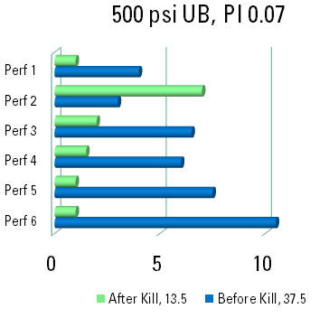
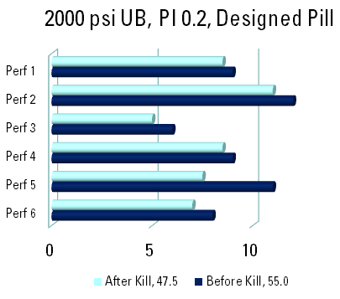
Big-Block Experiment Results
Large variation in flow from individual perforations
PI is higher with higher static underbalance
Killing the well is bad
Notes:
Results of two of the experiments are shown here. Lets look at the 500 psi underbalance test first. The flow from each individual perforation was measured using a straddle assembly. The blue bars show the flow rates recorded. What was surprising to the investigators was that there was such a large variation in flow between the six perforations even in a homogenous rock over only a short interval (about 20” was perforated). Shot six was flowing at about 3 times the rate of shot 2. Are these differences expected in the real world? The total flow rate was measured at 37.5 cc/s. Next the well was killed and then put back on production and the flow rates measured again. Total production dropped to 13.5 cc/s, a loss of about 65% of the production. The best perforations suffered the worst damage It appears that the easiest path for the kill pill to follow was into the cleanest perforations. So it appears that killing the well is bad. However, the investigators wanted to try and improve the kill pills.
A second experiment had a similar set up except that the block was perforated with 2000 psi static underbalance. Note that the Productivity Index calculated for the first test was 0.07 BOPD/psi and was almost 3 times that on the second experiment. Note that the flow rate measured was higher and that there seems to be less variation in flow from individual perforations. We can conclude that higher static underbalance is better in terms of cleaning up more of the perforations.
A new kill pill design was used. This was better but still 15% of the production was lost.

Slide 32

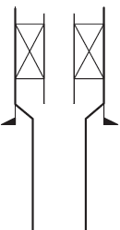

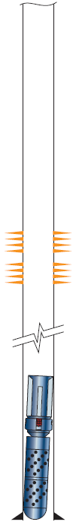
How to Keep Perforations Clean
Do not kill the well. Incompatible fluids can plug perforations and lose production (SPE 28554)
Drop guns into sump (IPTC 14300, SPE 74351, SPE 28916)
Recover guns under pressure (SPE 74422, SPE 72134, SPE 38183)
Use designed kill fluids (SPE 94596)
Clean up after perforating using implosion chambers (SPE 144080)
Guns anchored before upper completion run. They automatically drop when detonated.
Notes:
The results of these experiments led to the development of, what we call Completion Without Killing or No Kill solutions. If we perforate on Wireline with surface pressure equipment, we do not need to kill the well to recover the guns. So this is one technique we can use. With long gun strings run on TCP, we can drop the guns into the sump. Several auto-release drop tools have been developed over the years. One example is shown. This is an anchor that can be run below the upper completion. When the guns are fired, the anchor slips automatically retract allowing the guns and anchor to drop in the sump. The well does not need to be killed. If no sump is available, long gun strings can be recovered to the surface without killing the well. One technique involves using a specially modified BOP stack that allows guns to be connected or disconnected under pressure. Another technique involves stacking guns downhole on a platform or anchor and then recovering them one at a time. A third technique uses a downhole valve that can be closed once the guns are recovered above the valve. Then the wellhead pressure is bled off so that the guns can be removed from the well. All these techniques have been used over the last 15 to 20 years, but there is scope for increased use today.
As the experiments showed, kill fluids can be designed in a way that is less damaging. Solids-based and solids-free fluids are used with completions today. This is were the main focus lies with completion design in terms of reducing formation damage. A well designed kill pill should deliver a return permeability of 85%. Still not perfect, but better. In many reservoirs, this does not have that much impact of production. It is possible to combine kill fluids with modern perforating technniques such as dynamic underbalance perforating. Experiments demonstrate how best to combine the two (SPE 94596).
A more recent development is to use dynamic underbalance to clean up existing perforations. Guns are loaded only with special punchers to open up the gun body quickly creating an implosion. The implosion drops the pressure rapidly in the wellbore right in front of the perforations. This rapid drop in pressure sucks out debris. SPE 144080 describes the operation on existing wells in Libya. The case study shows production log before and after the implosion gun was used.
Any of the above techniques can be combined to deliver the optimum system. For example, in tight gas wells it is advisable not to kill the well after perforating as liquid to alter the relative permeability. It is also best to have a high static underbalance, so that the hydro-static head does not prevent the well from flowing. A combination of dynamic underbalance and high static underbalance can be built into the perforating design by using a valve to isolate the rathole from the tubing (SPE 86543).

Slide 33
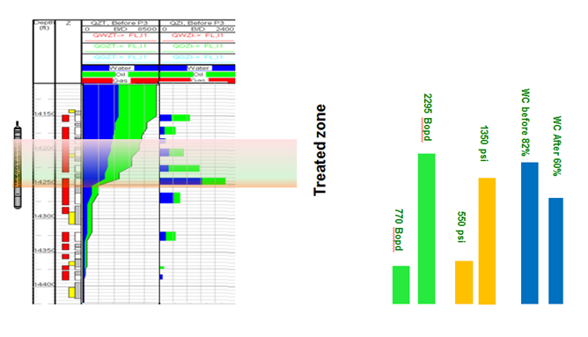
Summary
Perforating provides the connection between the well and the reservoir
By using the techniques discussed in this presentation we should be able to unlock the full potential of reservoirs resulting in more production
*SPE 144080 “Controlled Well Implosions Show that Not All Damage is Bad—A New Technique to Increase Production from Damaged Wells” Busaidy presented in 2011
Notes:
We have seen that perforating impacts reservoir production and that we can design better perforating operations that improve performance to unlock the full reservoir potential. We need deep penetration beyond any damage, and the perforations must be clean. We can improve performance by using high shot density guns. Finally we should avoid undoing all that good work by not killing the well. These practices are good for natural producers, but can also impact other operations such as acidizing, fracturing and gravel pack completions. Old wells should be treated with just as much care. Why do we not service old wells by cleaning out existing perforations or reperforating? Just like we service our cars.

Slide 34

Your Feedback is Important
Enter your section in the DL Evaluation Contest by completing the evaluation form for this presentation
Visit SPE.org/dl
Society of Petroleum Engineers Distinguished Lecturer Program
www.spe.org/dl
34

