Slide 1
Uncertainty Assessment Using Reservoir Simulation Models – Practical Guidelines
Anil Ambastha
Chevron Nigeria Limited
March 31, 2014

Slide 2
Outline
Introduction to experimental design (ED)
Selection of uncertain parameters and their ranges
Response or tracking functions (or variables)
Uncertainty assessment using ED
Development of multiple history-matched models – A case study
Uncertainties for forecasting situations
Concluding remarks
ED is a practical way to assess uncertainty
using reservoir simulation models.

Slide 3
ED Introduction - Setting the Stage
Each “empirical” relationship requires data from “experiments”
SWIR = a – b log (k)
log (k) = a + b φ
RF = 0.114 + 0.272 log (k) + 0.256 S_{wi} – 0.136 log (μ_{o}) – 1.538 φ – 0.00035 h
y = a_{o} + (a₁ x₁ + a₂ x₂ + …) + (a₁₂ x₁ x₂ + a₁₃ x₁ x₃ + …) + (b₁ x₁² + b₂ x₂² + ….)
x₁, x₂ etc. may be complex transforms (log, sin, exp, etc.) of the underlying Variable
More complex the relation => More coefficients to evaluate => More experiments needed to generate required data

Slide 4
ED Introduction - Basic Terms
Parameters (Variables, Factors) – Uncertain x’s
Levels (Ranges) of Parameters – Values x’s can assume
Response variable – y to either optimize (minimize) or evaluate via regression.
Response equation (Proxy equation, Surrogate function) – Equation for y as a function of all x’s with all coefficients evaluated via data from experiments.
Can sample this equation via Monte Carlo simulation after specifying probability distribution functions for all x’s
Experimental Design – Systematic, statistical method to uncover relationship between y and x’s that cannot be reasonably handled by “One-Variable-at-a-Time” (OVAT) approach.

Slide 5
ED Introduction - Experimental Design Methods
For K factors at L levels:
Plackett-Burman (1946) design - Experiments in multiple of 4 (e.g., 12 experiments to screen upto 11 factors)
Center-point case adds one more experiment.
Folded Plackett-Burman design - Twice as many experiments as the original Plackett-Burman design
Full Factorial design - L^{K} experiments
7 factors at 3 levels each = 3⁷ = 2,187 experiments
Solution – Use D-Optimal or Box-Behnken Design
Plackett-Burman and D-optimal designs are sufficient.

Slide 6
Selection of Uncertain Parameters and Their Ranges
Capture all important uncertainties (Use G&G and PE Knowledge)
Screen for “heavy-hitters” using Plackett-Burman Design .
Develop “realistic” ranges for parameters
Not too wide and not too narrow
Avoid “anchoring” effect
Keep recovery mechanism and/or study objectives in mind to select relevant parameters
Do not just stop at 7 or 11 uncertainties.

Slide 7
Typical Ranges for Relative Permeability Parameters based on Corey Equation Representation for Water-Wet System
Parameter | Typical Range
k_{rocw} (with k_{base} = k_{absolute} in line with earth models) | 0.7-1
k_{rwro} | 0.05-0.5
k_{rgro} | 0.1-0.7
S_{orw} (or S_{org}) | 0.1-0.35
S_{gc} | 0-0.05
n_{w} (n_{ow}, n_{og} or n_{g}) | 1.5-5
Land’s constant (if residual saturations are modeled using Land’s equation) | 2-5
SWIR of earth model is NOT a separate parameter!!!

Slide 8
Response or Tracking Functions (or Variables)
OOIP (when “static” parameters, OOWC, OGOC, and/or PVT affecting OOIP are involved)
Cumulative oil production at the end of history
Breakthrough times for selected wells
Mean square error (MSE) functions for simulated vs. actual:
static pressure difference
RFT (MDT) pressure difference (if available)
water cut (or WOR) or cum. water production difference
producing GOR or cum. gas production difference
Data QC - Key to select “representative” data to develop response functions/variables

Slide 9
Response Function – Unintended Consequences (Simplified Data from Chen and Oliver, SPE 164902)
MSE = Sum over data points [(Simulated data – Observed data)^2/(Data error variance)]
Data error standard deviation = 2 bar and 100 m³/day for RFT pressure and oil rate, respectively
Two observed data points:
RFT pressure = 250 bar, oil rate = 4,000 m³/day
Two answers for error = (simulated data – observed data):
RFT error = 20 bar (8%), oil rate error = 400 m3/day (10%)
RFT error = 8 bar (3.2%), oil rate error = 1,000 m3/day (25%)
One value for MSE = 116
Combine various items in one error function at your own risk!

Slide 10
Uncertainty Assessment Using ED
Develop initial set of parameters and their ranges for “pressure and saturation matching”, history-match (HM) error files and tracking variables.
Use Plackett-Burman design to screen for “heavy hitters”.
Develop final set of parameters and their ranges based on results from Step 2.
Use D-optimal design with parameter set from Step 3.
Develop and check adequacy of proxy equations for HM errors and tracking variables.
Run Monte Carlo simulation using proxy equations.
Filter Monte Carlo simulation runs using appropriate criteria.
Make simulation runs for filtered cases from Step 7.
Select “acceptable” HM cases by analyzing answers for HM errors and tracking variables, and plotting field-level and well-by-well results.
Follow a systematic process. Iterations may be required!

Slide 11
Development of Multiple History-Matched Models – A Case Study
Brownfield with 45 years of history by 2010
13 years under peripheral water injection since 1997
160 wells (including 44 horizontal producers and 19 injectors)
5 major reservoirs
516 RFT pressure data points for 49 wells over 22 years
3-D, 3-phase, black-oil system
Full-field problem with large amount of data

Slide 12
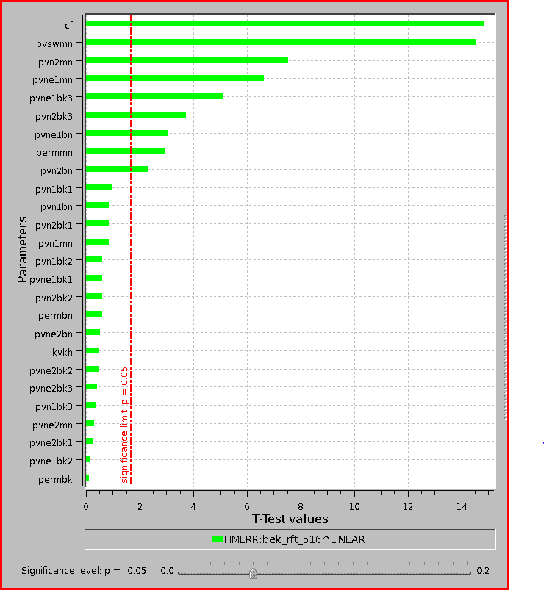
Development of Multiple History-Matched Models - “Heavy hitters” for RFT Error
Pareto chart is sufficient to visualize “heavy hitters”.

Slide 13
Development of Multiple History-Matched Models - “Heavy hitters” for Cumulative Oil Production at the End of History
“Heavy hitters” can and do change for different variables.

Slide 14
Development of Multiple History-Matched Models - Proxy Equation Adequacy Check for RFT Error
Did you note an “extreme” test data point? Have a large enough “test” data set.

Slide 15
Development of Multiple History-Matched Models - Proxy Equation Adequacy Check for Cumulative Oil Production at the End of History
Unbiased assessment of proxy equation adequacy is important.

Slide 16
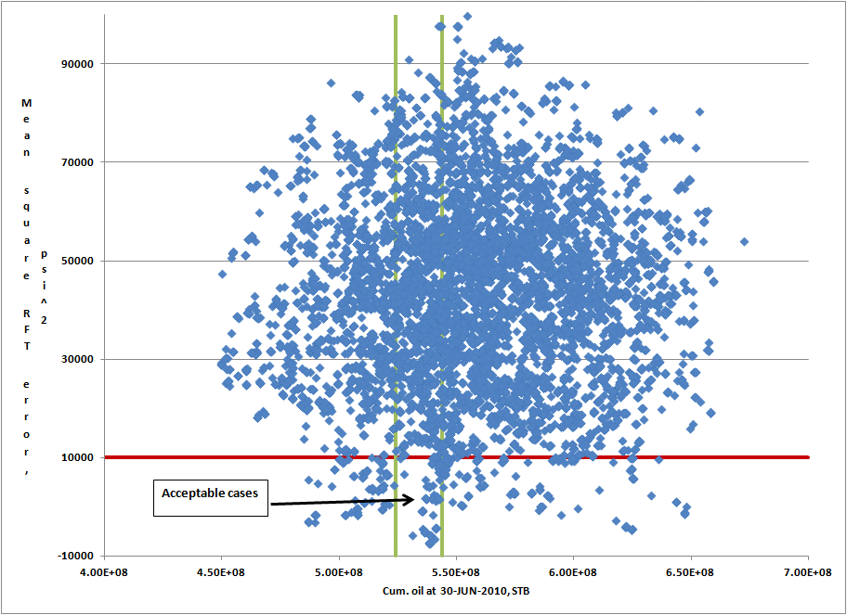
Development of Multiple History-Matched Models - Filtering of Monte Carlo Simulation Cases
84 cases
Filter, but verify. Run actual simulation and analyze results again!

Slide 17
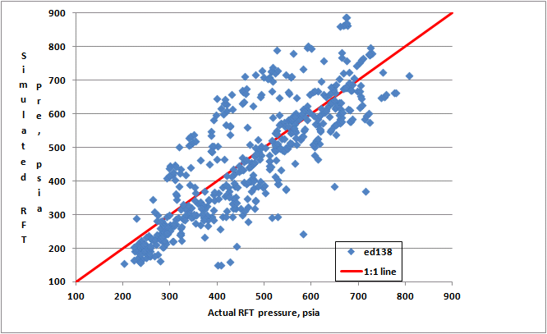
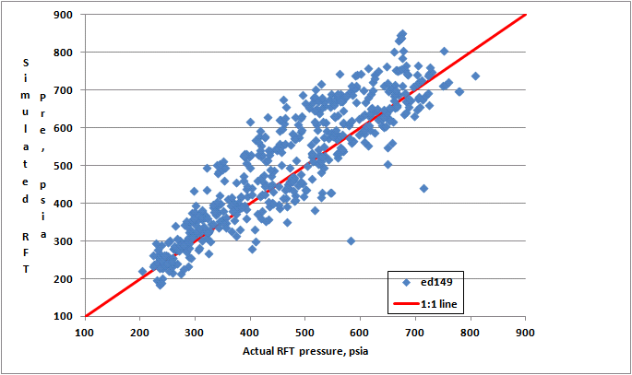
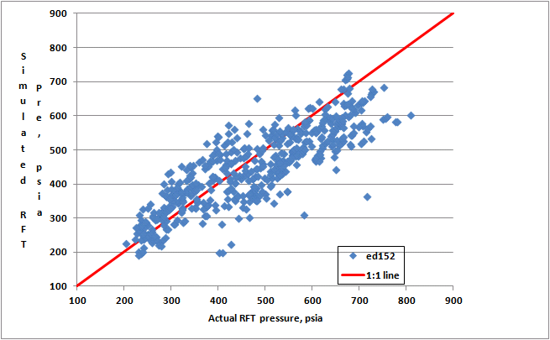
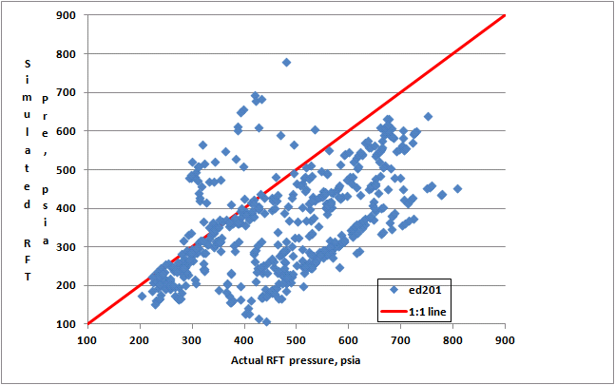
Development of Multiple History-Matched Models - Cross-Plots for RFT Errors
MSE = 9842 psi²
MSE = 6055 psi²
Rejected later
Acceptable
MSE = 6624 psi²
MSE = 29461 psi²
Acceptable
Example of an
unacceptable case
Full analysis makes your product robust.

Slide 18
Uncertainties for Forecasting Situations
Well – Constraints and limits, flow tables
Operations/Surface facilities – Constraints and limits, operational downtime, artificial lift, “put-on-production” schedule
Development opportunities – Workover timings, zone switch, infill wells, recovery mechanisms
Fields - Timing
Look at the BIG picture! Involve all stakeholders.

Slide 19
Concluding Remarks
Logical description of uncertainty assessment steps
Practical tips and guidelines
Always remember one thing – No matter how careful we are, we cannot assess the impact of “unidentified” uncertainty.

Slide 20
BACK-UP

Slide 21
Typical “Dynamic” Uncertain Parameters
Aquifer specifications (cells representing aquifer i.e., aquifer direction and extent, aquifer pore volume multipliers, and aquifer transmissibility multipliers)
Relative permeability parameters
Permeability multipliers
k_{v}/k_{h}
Transmissibility multipliers in x-, y- or z-direction to represent barriers/baffles/ “shale”/stratigraphic compartments
Regional (or local) adjustment parameters related to any property such as permeability, porosity, residual saturations, PI, skin, etc. (CAUTION – Ideally, minimize use of such parameters, especially local ones)
Fault parameters (length, vertical extent, transmissibility)
Formation compressibility
PVT
Initial reservoir pressure (sometimes)

Slide 22
Tornado Diagram for “Heavy hitters”
Tornado diagram can also be used to identify “heavy hitters”.

