Slide 1


Society of Petroleum Engineers Distinguished Lecturer Program
www.spe.org/dl

Slide 2



Fiber Optic Sensing Improves Unconventional Reservoir Development
Trey Lowe
Devon Energy
Society of Petroleum Engineers Distinguished Lecturer Program
www.spe.org/dl

Slide 3
Agenda
Unconventional wells and the field development challenges
Fiber optic sensing
Example data set
Using the data to improve models
Conclusions

Slide 4
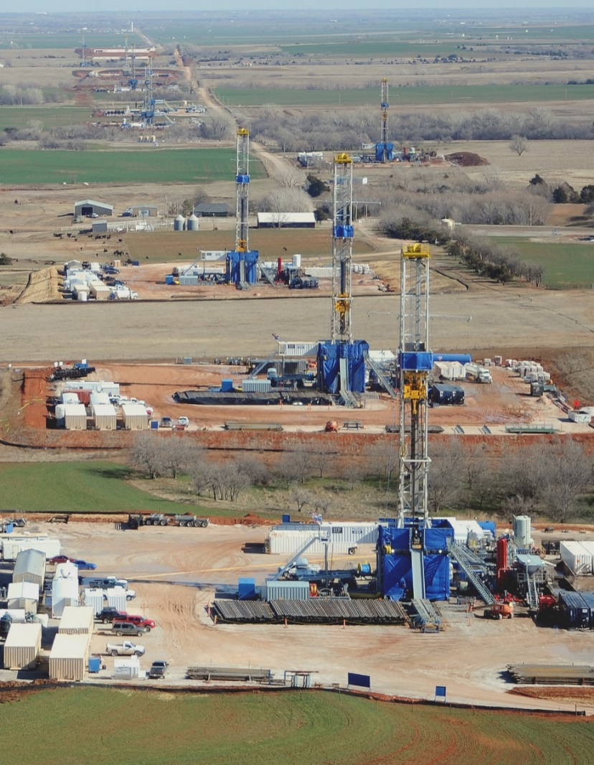
Unconventional Development
Tightly spaced horizontal wells
  Normally 5,000 to 10,000-ft (1500 to 3000-m) horizontals
  Well spacing between 150 to 900 ft (45 to 275m)
Multi-stage fracturing
  10 to 40 stages with 3-6 clusters

Slide 5

Need to Optimize Completions
What is our frac geometry?
How does the rock affect cluster efficiency (distribution of fluids into each cluster)?
How closely should we space our stages and clusters?

Slide 6


Planning Infill Development of Unconventional Reservoirs
H?
X_{L}?
Landing interval?
Well spacing?
Notes:
Another way to visualize it…

Slide 7
Setting Up an “Underground Laboratory”* to Measure Some of the Unknowns
Microseismic / Tiltmeters (X_{L}, H, and azimuth)
H?
X_{L}?
Fiber optic sensing (# of fracs, relative size of each frac)
Vertical well (H)
Offset pressure monitoring (X_{L}, azimuth)
*Source: D. Koskella, Noble Energy, 2014

Slide 8
Fiber Optic Sensing

Slide 9
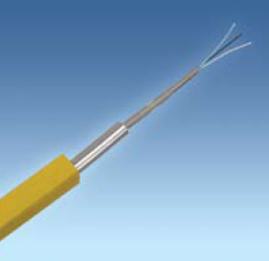
A Way to Answer the Questions: Fiber Optic Sensing
Complete an infill well with fiber optics sensing technology
Fiber optic sensing technology
  Distributed Temperature Sensing (DTS)
  Distributed Acoustic Sensing (DAS)

Slide 10
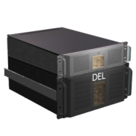
What is Fiber Optic Sensing?
The fiber is the sensor
Measurement every 3 feet (1m) along the fiber
T₁ T₂ T₃ T₄ ……….
T_{9,997}
T_{9,998}
T_{9,999}

Slide 11
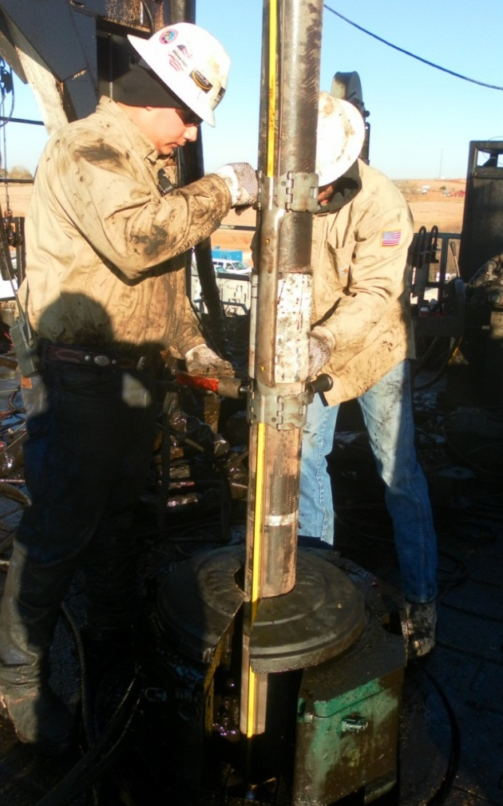
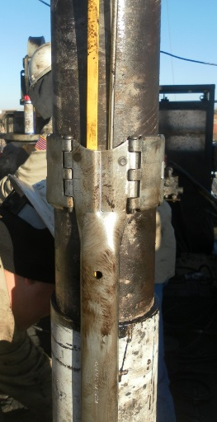
Installing Fiber Optic Cable
Attach fiber optic line to the outside of production casing
Take care when perforating!
  Options: sleeve system or oriented perforating

Slide 12
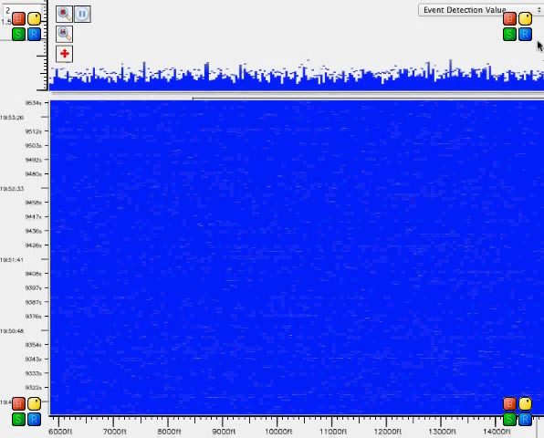
Fiber Optic Monitoring
Distributed Acoustic Sensing (DAS)
Notes:
This is an amazing movie file showing DAS data acquired in real time. This movie will be edited prior to final submission to take out about 30-seconds. It shows what DAS data looks like in real time. There is an example where a cluster is not taking fluid and also shows where a downhole sleeve failed, which can be seen in real-time.
I will have a back-up copy of this presentation which does not include a movie file.

Slide 13
An Example Data Set
Source: SPE 166295, 2013

Slide 14
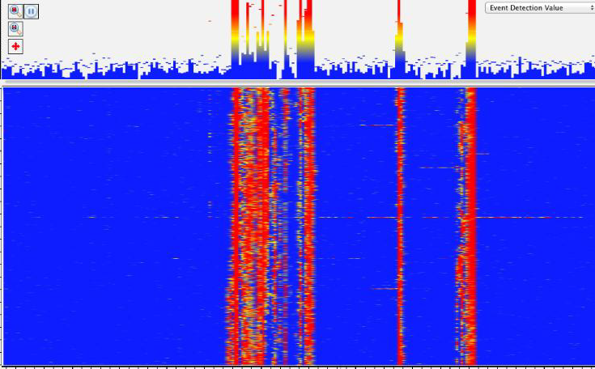
Distributed Acoustic Sensing (DAS)
Stage 5
-
Cluster #1 is dominant
Cluster #2 is not accepting any fracturing fluid
Time
Clusters
+
-
Depth
+

Slide 15
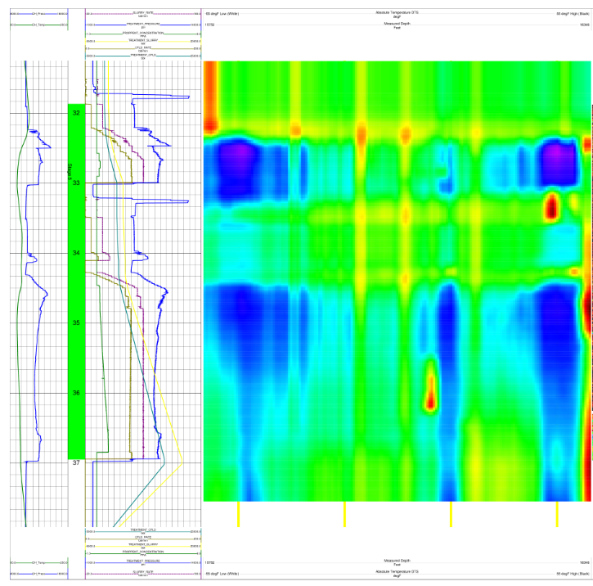
Distributed Temperature Sensing (DTS)
Stage 5
-
Blue is cool, Red is warm
Once again…
Cluster #1 is dominant
Cluster #2 is not accepting any fracturing fluid
Time
Clusters
+
-
Depth
+

Slide 16
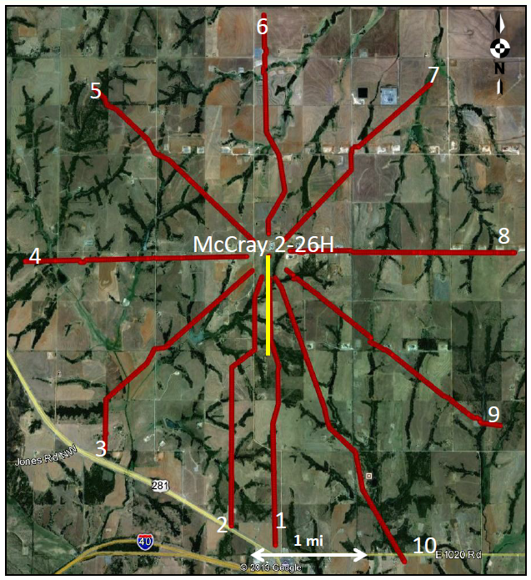
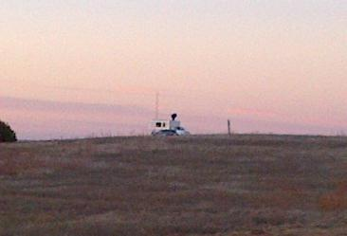
Surface Microseismic Setup
Star Pattern
10 runs of 2.5 mi (4km) each
26 mi² (65 km²) coverage
1476 geophone stations
Very useful real-time results

Slide 17
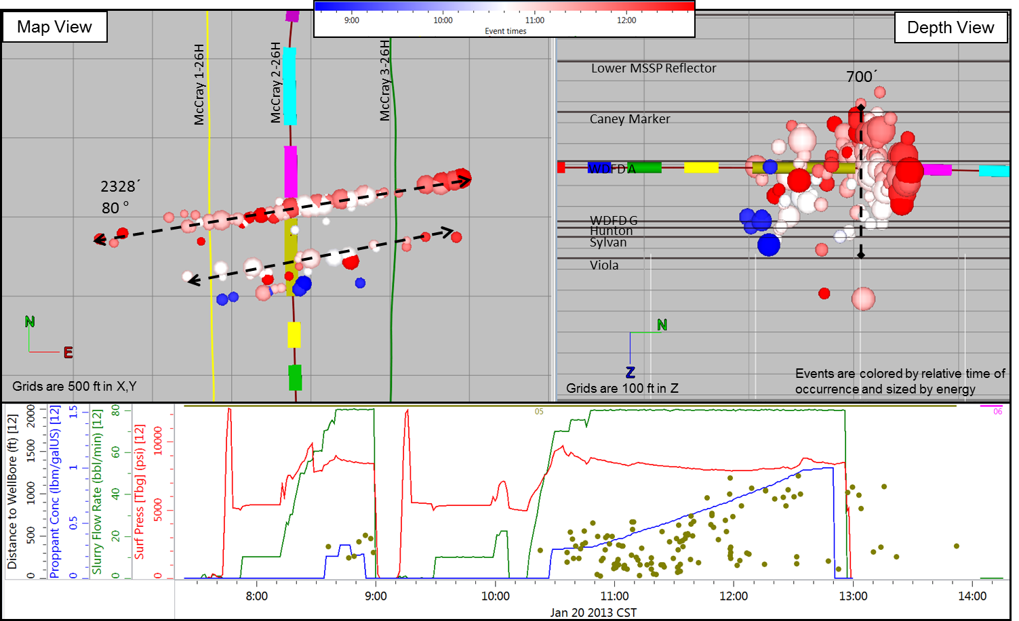
Surface Microseismic Data
Stage 5
Once again…
Cluster #1 is dominant
Cluster #2 is not accepting any fracturing fluid

Slide 18
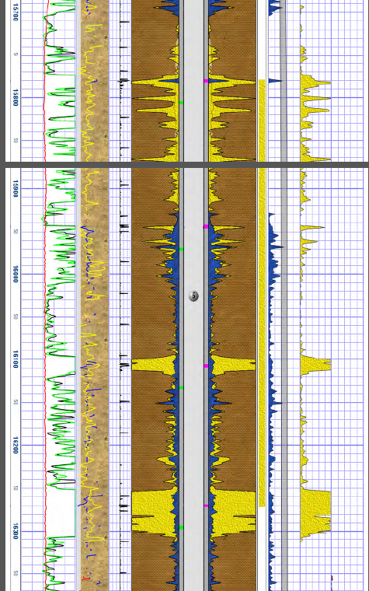
RA Tracer Log
Stage 5
Once again…
Cluster #2 is not accepting any fracturing fluid
Clusters

Slide 19
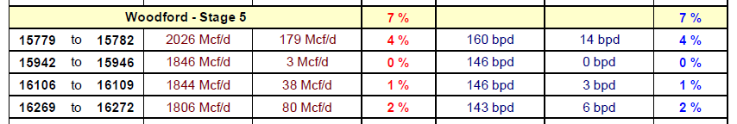
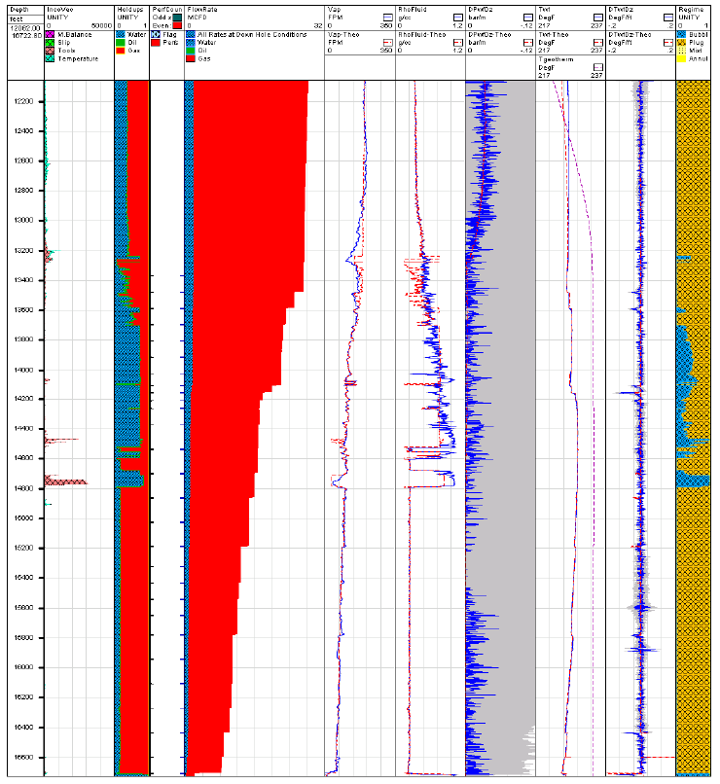
Production Log (PLT)
Stage 5
Production data corresponds to the fracturing monitoring
Cluster 1
Cluster 2
Cluster 3
Cluster 4

Slide 20
Using the Data to Improve Models
Notes:
Now that we have some faith in the measurements, let’s talk about how it can be used to improve our models.

Slide 21
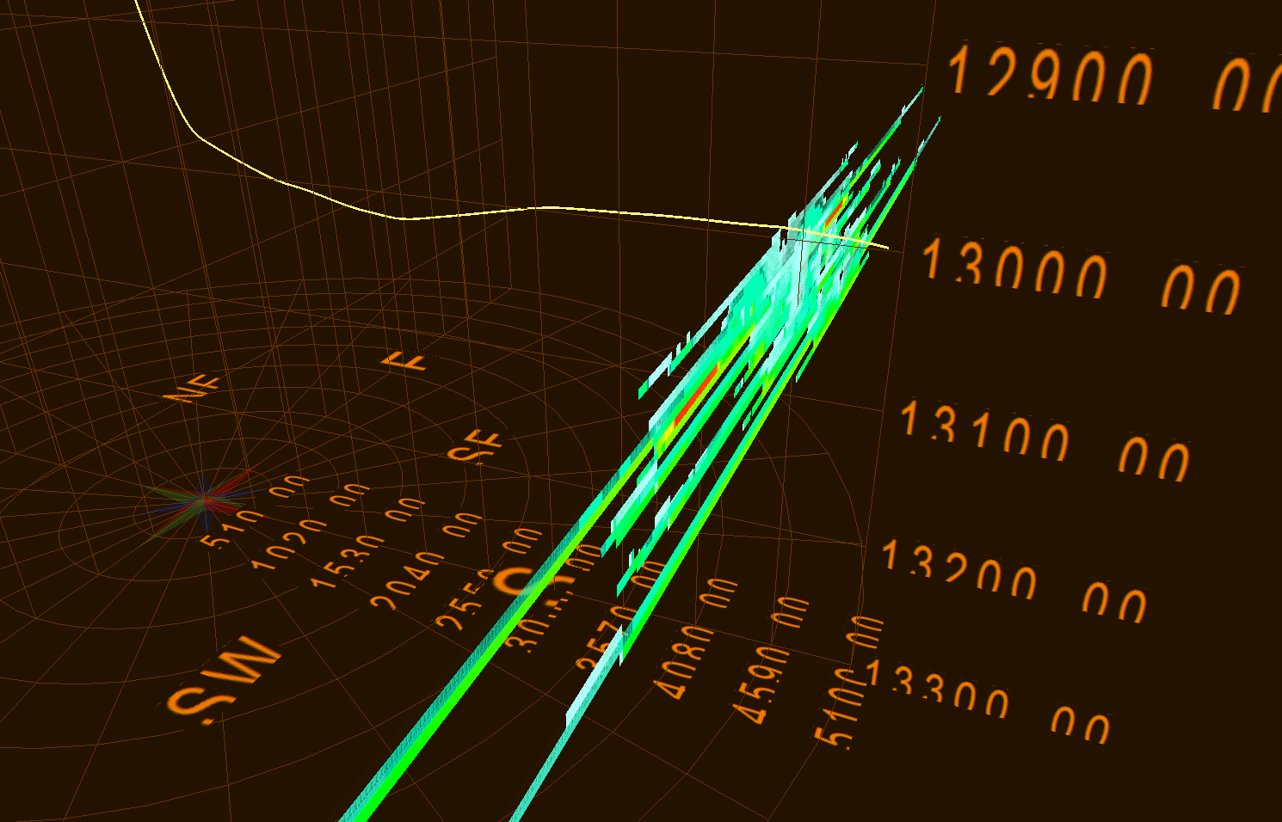
Improving the Fracture Model
using Fiber Optics
Engineers use advanced fracture models to understand frac H and effective X_{L}

Slide 22
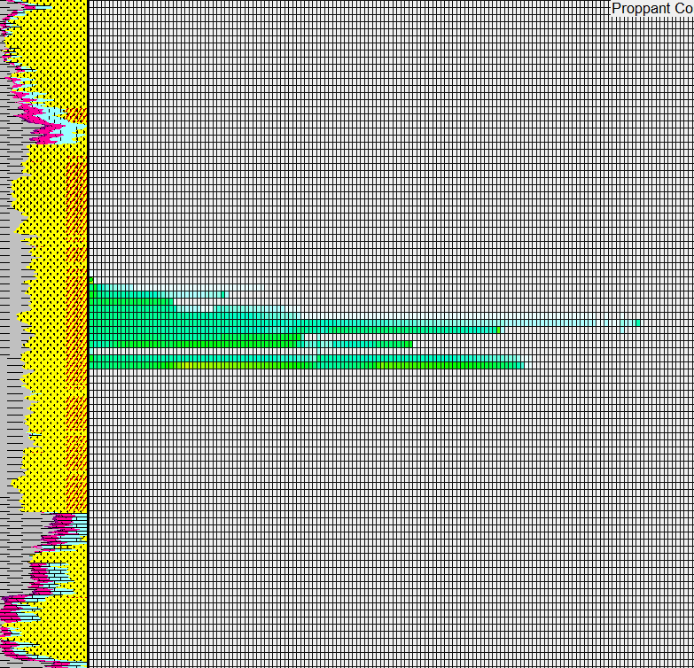
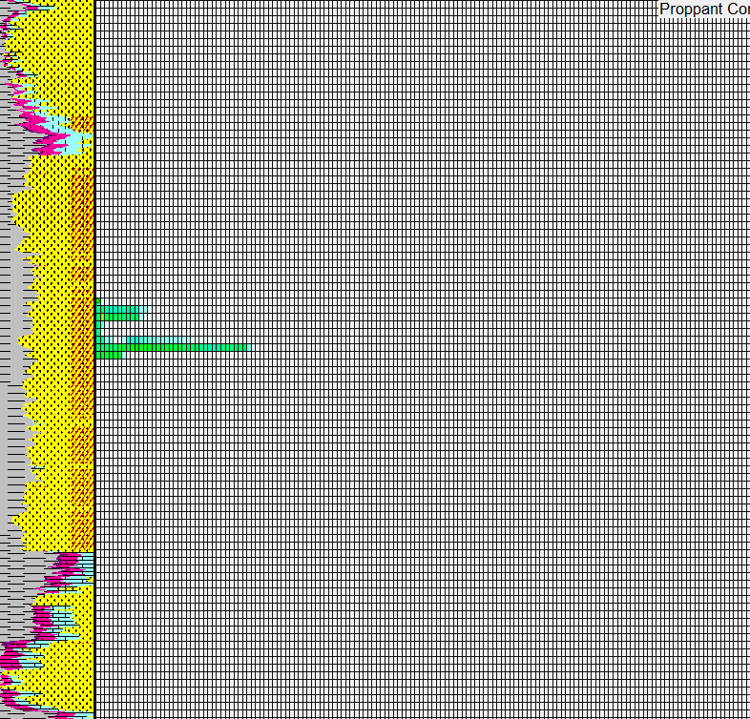
DAS Measurement Improves
Fracture Model
-
Use the data
Depth
+
-
+
-
+
X_{L}
X_{L}
The non-informed model predicts this cluster to have X_{L} of 2,500-ft
The improved model uses fiber optic DAS data to restrict the model – minimal H, X_{L} and proppant placement

Slide 23
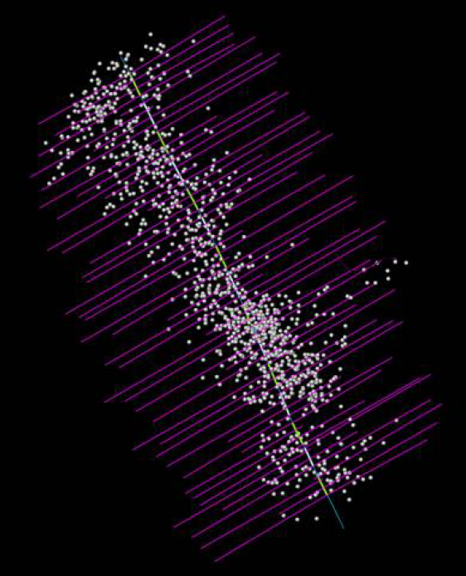
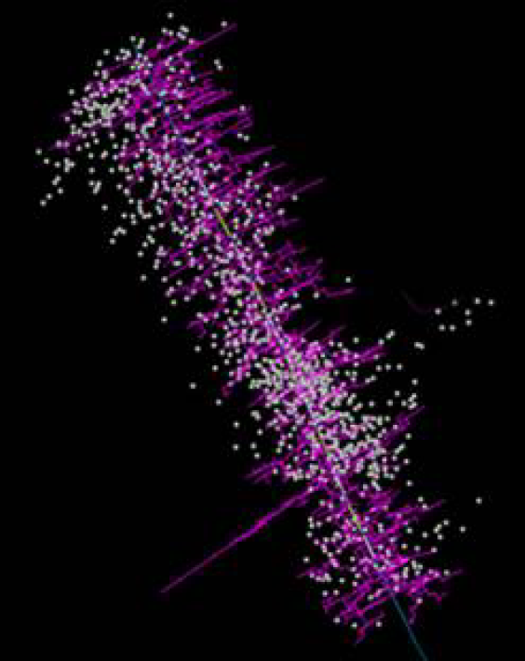
Microseismic Data Improves
Reservoir Simulation
Fracture area = 36MM ft²
Fracture area = 30MM ft²
Use the data
The above model uses assumed planar fracture geometry
The improved model uses microseismic events to constrain the DFN model
*Source: SPE 168596, 2014, Cipolla, et al. Hess

Slide 24
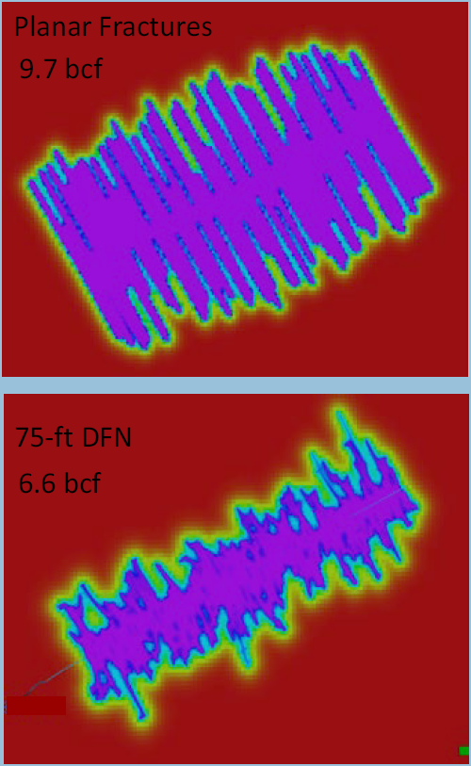
Microseismic Data Improves
Reservoir Simulation
Use the data
Pressure distribution after 10-years for a “text book” planar frac model
Pressure distribution with improved model
Now we can make better decisions about well and cluster spacing!

Slide 25
Conclusions
Fiber optic sensing is a powerful addition to the “underground laboratory” and is being used to optimize fracturing models
The integration of advanced fracture monitoring are a clear path to optimized well spacing, landing interval and completion design.

Slide 26
Acknowledgements
SPE Distinguished Lecturer Program
Devon Energy
My wife and children
My Devon family (Dan Wood, Breanne Kennedy, Mike Potts, Jim Heinze, and many others)
Industry friends and colleagues (J. Miskimins, A. Daneshy, K. Banks, H. Allen, B. Shroyer, and others)

Slide 27
Questions?

