Slide 1
Optimism in Reservoir Production Forecasting – Impact of Geology, Heterogeneity, Geostatistics, Reservoir Modeling, and Uncertainty
Dr. W. Scott Meddaugh
Midwestern State University
Wichita Falls, Texas

Slide 2
Personal Background for Interest in Forecast Accuracy – Some Examples
In 1985, participated in a technical “post mortem” of a pilot project that experienced technical failure due to an unexpectedly rapid steam breakthrough at a producing well. What was expected to take months occurred in less than three days.
  End result: technical failure; catastrophic well failure.
  Subsurface lesson learned: project team failed to incorporate high permeability core data in reservoir model.
In 2002, participated in a technical post mortem of a major capital project that failed to produce oil anywhere near that of the P50 forecast generated by the project team.
  End result: financial “incident” with significant impact on corporate bottom line
  Subsurface lesson learned: oil in place volumes considerably lower than that modeled by project team; project team’s complex geological model obscured geological data limits

Slide 3
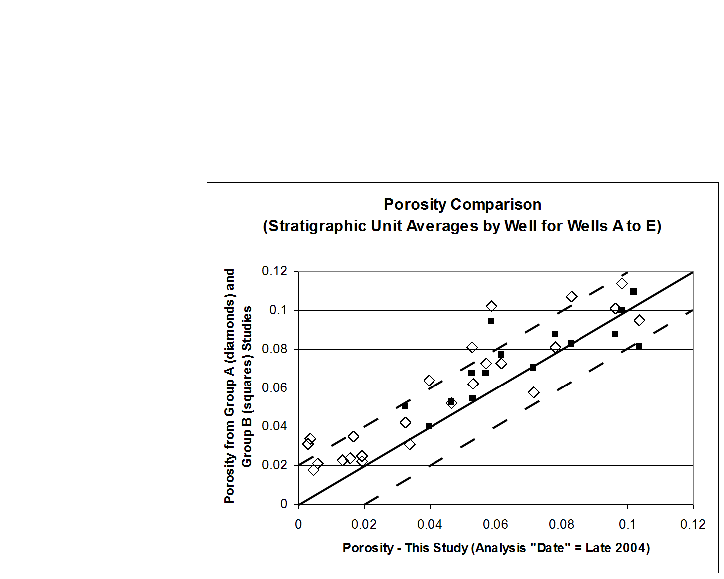
Some Key Terms
Forecast – Quantitative description of the oil, gas, and water production from a reservoir as a function of a defined development plan.
Uncertainty – A state of having limited knowledge where it is impossible to exactly describe the existing state, a future outcome, or more than one possible outcome. The lack of certainty.
Risk – A state of uncertainty where some possible outcomes have an undesired effect or significant loss.
How well do we really know even some of the most basic reservoir parameters?
Comparison of porosity values obtained by three independent project teams using the same well log and core data and the same well log processing software (after Meddaugh et al., 2011).

Slide 4
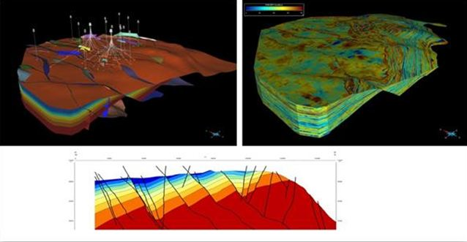
Typical Subsurface Project Workflow
Data
Static Model*
http://www.pennenergy.com/content/dam/Pennenergy/online-articles/2013/June/Paradigm%20reservoir%20modeling.JPG
*Many projects employ probabilistic workflows to assess/manage uncertainty in the static, dynamic, and/or economic models

Slide 5
Typical Subsurface Project Workflow
Data
Static Model*
Dynamic Model*
Dynamic Model Predictions
http://www.pennenergy.com/content/dam/Pennenergy/online-articles/2013/June/Paradigm%20reservoir%20modeling.JPG
http://www.pennenergy.com/content/dam/Pennenergy/online-articles/2013/June/Paradigm%20reservoir%20modeling.JPG
*Many projects employ probabilistic workflows to assess/manage uncertainty in the static, dynamic, and/or economic models

Slide 6
Typical Subsurface Project Workflow
Data
Static Model
Dynamic Model
Dynamic Model Predictions
Economic Model*
Reservoir Management Decision
http://www.pennenergy.com/content/dam/Pennenergy/online-articles/2013/June/Paradigm%20reservoir%20modeling.JPG
*Many projects employ probabilistic workflows to assess/manage uncertainty in the static, dynamic, and/or economic models

Slide 7
Typical Subsurface Project Workflow
Data
Static Model
Dynamic Model
Dynamic Model Predictions
Economic Model
Reservoir Management Decision
Field Performance

Slide 8
Typical Subsurface Project Workflow
Data
Static Model
Dynamic Model
Dynamic Model Predictions
Economic Model
Reservoir Management Decision
Field Performance
Field Performance
Is “Good”

Slide 9
Typical Subsurface Project Workflow
Data
Static Model
Dynamic Model
Dynamic Model Predictions
Economic Model
Reservoir Management Decision
Field Performance
Field Performance
Is “Poor”

Slide 10
Typical Subsurface Project Workflow
Data
Static Model
Dynamic Model
Dynamic Model Predictions
Economic Model
Reservoir Management Decision
Recycle/Rework
Field Performance
Field Performance
Is “Poor”

Slide 11
Are Forecasts Too Optimistic?
Public, quantitative information is sparse
Casual conversation and networking suggests that reservoir forecasts tend to be optimistic
  “Rumored” and no so rumored financial incidents
  “Rumored” frequency of model updates without significant new data because reservoir response is much lower than forecast
Increased focus on “risk”, “uncertainty”, “forecasting”, and “complexity” in SPE papers and forums
Reservoir models are generated using smaller grid sizes and/or larger numbers of cells to capture more reservoir detail and presumably lead to better forecasts

Slide 12
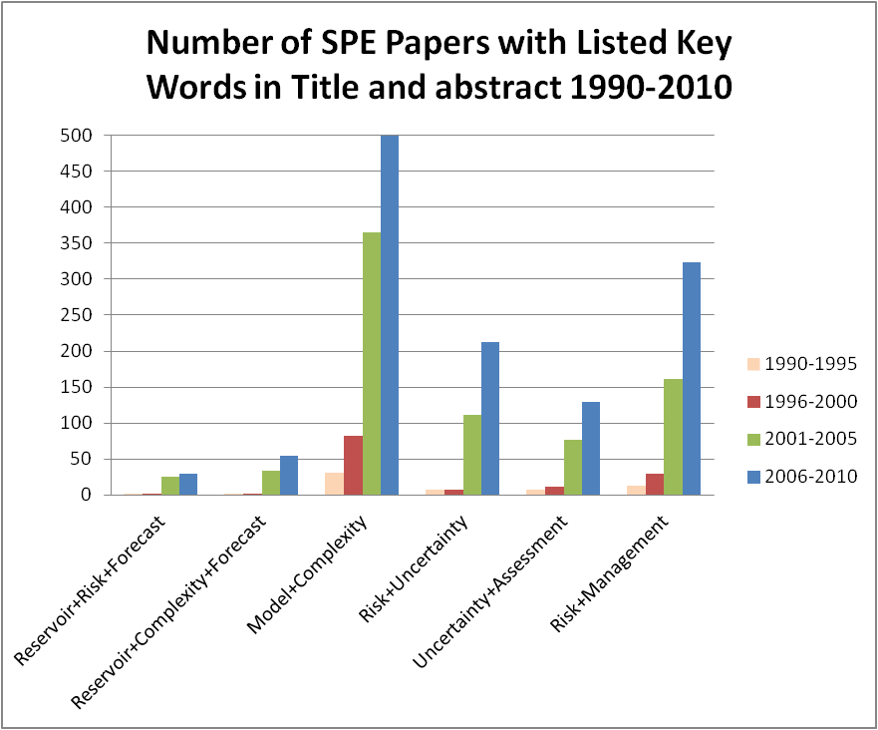
Are Forecasts Too Optimistic?
(from Meddaugh et al, 2011)

Slide 13
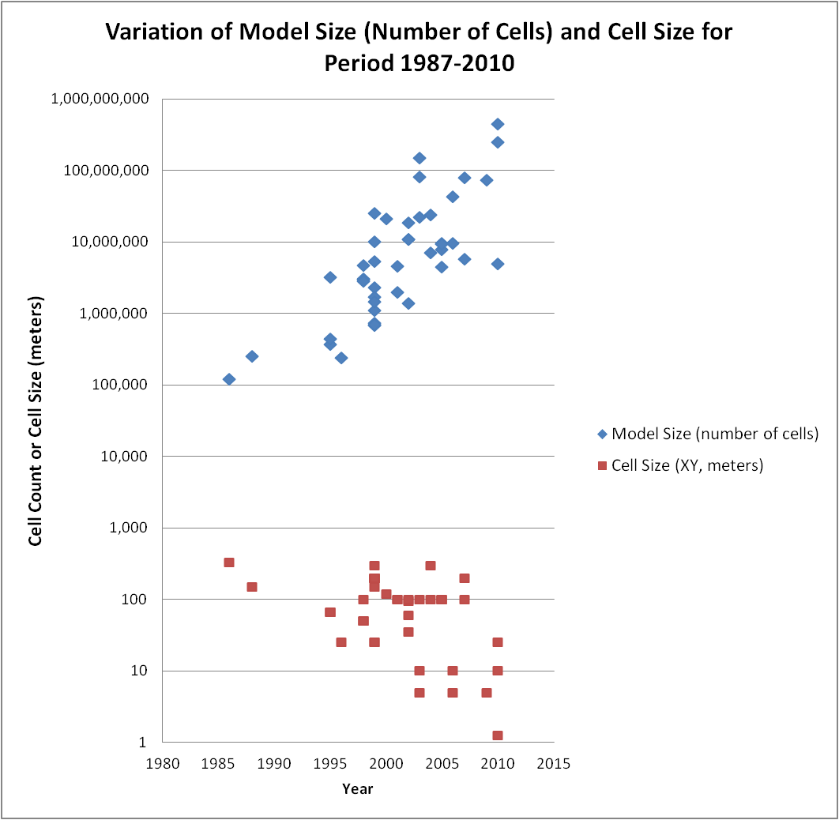
Are Forecasts Too Optimistic?
(from Meddaugh et al, 2011)

Slide 14
Are Forecasts Too Optimistic?
Some Recent Papers with General Industry Observations Highlighting Forecast Optimism
  Instilling Realism in Production Forecasting: Do’s and Don’ts (Rajvanshi et al., 2012, SPE Paper 155443)
  Reservoir Forecast Optimism - Impact of Geostatistics, Reservoir Modeling, Heterogeneity, and Uncertainty (Meddaugh, Champenoy, Osterloh, and Tang, 2011, SPE Paper 145721)
  Failure to Produce: An Investigation of Deficiencies in Production Attainment (Nandurdikar and Wallace, 2011, SPE 145437)
  Others including papers by S. H. Begg, Reidar Bratvold

Slide 15
Are Forecasts Too Optimistic?
IPA* reports that major capital projects today are delivering only 75% of planned production!
Why?
  Optimistic subsurface assumptions
  Failure of internal assurance processes
  Lack of accountability for production volumes including lack of look-backs or root-cause analysis on 70% of the projects
Study based on 145 oil and gas projects for which IPA had production forecasts at time of project sanction and 12-60 months of actual production history after project start up
  *IPA – Independent Project Analysis, Inc.
  Failure to Produce: An Investigation of Deficiencies in Production Attainment (Nandurdikar and Wallace, 2011, SPE 145437)

Slide 16
Are Forecasts Too Optimistic?
Also from the IPA* study
  Projects with production below forecast due to facility issues were able to eventually reach about 88% of forecast production
  Projects with production below forecast due to well construction issues were able to eventually reach about 75% of forecast production
  Projects with reservoir “issues” were only able to attain about 55% of forecast production
After Nandurdikar and Wallace, 2011
  *IPA – Independent Project Analysis, Inc.
  Failure to Produce: An Investigation of Deficiencies in Production Attainment (Nandurdikar and Wallace, 2011, SPE 145437)

Slide 17
Why Are Forecasts Too Optimistic?
Original or remaining hydrocarbon in place too high
  Sparse data
  Non-representative data; biased to better reservoir quality
  Inadequate or improperly used analogs
Underlying geological (static) models are inadequate
  Data limitations – quantity, quality
  Failure to adequately model heterogeneity – grid size , modeling parameters
    Reservoir vs. non-reservoir (optimistic net/gross distribution)
    Permeability contrasts – Barriers/baffles, thief zones
Underlying reservoir simulation (dynamic) models are inadequate
  Data limitations – quantity, quality
  Up-scaling from the generally finely gridded geological model to the coarser grids commonly used for history matching and forecasting – grid size
  Well location optimization
Improper use of uncertainty assessment tools and workflows

Slide 18
Why Are Forecasts Too Optimistic?
Original or remaining hydrocarbon in place too high
  Sparse data
  Non-representative data; biased to better reservoir quality
  Inadequate or improperly used analogs
Underlying geological (static) models are inadequate
  Data limitations – quantity, quality
  Failure to adequately model heterogeneity – grid size , modeling parameters
    Reservoir vs. non-reservoir (optimistic net/gross distribution)
    Permeability contrasts – Barriers/baffles, thief zones
Underlying reservoir simulation (dynamic) models are inadequate
  Data limitations – quantity, quality
  Up-scaling from the generally finely gridded geological model to the coarser grids commonly used for history matching and forecasting – grid size
  Well location optimization
Improper use of Uncertainty Assessment tools and workflows
Better and more consistent use of statistical tools and workflows can address aspects of some issues (as highlighted in white)

Slide 19
Why Are Forecasts Too Optimistic?
Original or remaining hydrocarbon in place too high
  Sparse data
  Non-representative data; biased to better reservoir quality
  Inadequate or improperly used analogs
Underlying geological (static) models are inadequate
  Data limitations – quantity, quality
  Failure to adequately model heterogeneity – grid size, modeling parameters
    Reservoir vs. non-reservoir (optimistic net/gross distribution)
    Permeability contrasts – Barriers/baffles, thief zones
Underlying reservoir simulation (dynamic) models are inadequate
  Data limitations – quantity, quality
  Up-scaling from the generally finely gridded geological model to the coarser grids commonly used for history matching and forecasting – grid size
  Well location optimization
Improper use of Uncertainty Assessment tools and workflows
Topics considered in this talk (as highlighted in white)

Slide 20
Impact of Grid Size
Geological models typically now have tens or hundreds of million of cells. Routine construction of multi-billion cell (giga-cell) models is now possible.
Reservoir simulation models typically have hundreds of thousands to a few million cells at most due to real or “imagined” run-time limitations
Geological models are generally up-scaled vertically and areally to reduce number of cells so that reservoir simulator run times are reasonable
Possible impact of up-scaling is loss of “geology”, particularly the permeability contrasts (e.g. barriers/baffles, ultra-high permeability thief zones)

Slide 21
Impact of Grid Size -Vertical Up-scaling Waterflood Example
Permian Basin carbonate reservoir
Vertical up-scaling has little or no effect on fluid flow characteristics over the range studied: from 400 to nine layers, total up-scaling factor of 25% to 0.1%)
The recovery factor (RF) for the various levels of vertical up-scaling are summarized in the table below.
These results suggest that the critical “geological” issue in up-scaling is not the vertical dimension although clearly there must be a point at which vertical scale-up does create a “tank-like” reservoir with “average” rock properties.
From Meddaugh 2006

Slide 22
Areal Up-Scaling Effects on Waterflood Forecasts
Areal scale-up may have significant effects on fluid flow characteristics. Figure at right shows same initial Permian Basin reservoir model up-scaled from 25’ areal cells to 150’ areal cells.
As areal scale-up (cell size) increases reservoir flow characteristics become more optimistic (e.g. less water injection for same oil recovery).
This may have a significant impact on the number of cells needed between wells in finite difference fluid flow simulation.
This study suggests that 3-5 cells between wells may not be sufficient. (Typical reservoir simulation areal grid size is ~300 ft.) A likely minimum number of cells between wells is 10-15 or more for waterflood forecasts
From Meddaugh 2006

Slide 23
Impact of Grid Size on Waterflood Recovery without Model Up-Scaling

Slide 24
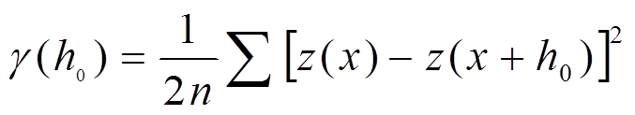
A Key Term – The Semivariogram
Statistical parameter (γ) that is a measures spatial continuity
Defined by Matheron in the 1960’s and is represented by the equation
Where z(x) represents the value of a property (z) at location (x) and z(x+h0) the value of (z) at a distance (h0) from (x) and n = number of data pairs at that separation distance (h0)
The range parameter is a function of the spatial continuity of the property of interest. Small values for the range indicate more heterogeneity than large values for the range parameter

Slide 25
Semivariogram Range Parameter for Porosity in Carbonate Reservoirs – What Value to Use?

Slide 26
Impact of Semivariogram Range Parameter on Recovery - Waterflood
After Meddaugh et al., 2011

Slide 27
Impact of Semivariogram Range Parameter on Recovery - Steamflood
For steamflood – no difference between models generated using SVM and LVM (after Meddaugh et al., 2012)
2.5 acre patterns 5-acre patterns

Slide 28
Initial Observations from the Wafra First Eocene Large Scale Steamflood Pilot (LSP)
Injection began in mid-2009
Some TOW wells show 5-45° F temperature increase as of March 1, 2010
Some producing wells have shown increased tubing temperatures (map at right) as well as increased fluid production within days of steam injection – suggest that some very high permeability paths exist in reservoir
LSP map showing producing well and TOW temperatures. Map shows eight producing wells have responded to steam injection (probably hot water at the time this map was generated). Small circles are TOW locations. Note different temperature scales; Delta TOW temperature is change from base line temperature .
Single well history showing response (tubing temperature increase) to steam injection with days!
After Meddaugh et al., 2012

Slide 29
Possible Reasons for Rapid Well Response to Steam Injection
High permeability pathways
  Fractures
  Karst zones
  Stratigraphy or diagenesis-related (connected vugs)
  Connected very high permeability not due to any of the above
Small Fractures in Core
Small Karst Zone in Core
Open and Filled Vugs in Core
After Meddaugh et al., 2012

Slide 30
Possible Reasons for Rapid Well Response to Steam Injection
High permeability pathways
  Fractures
  Karst zones
  Stratigraphy or diagenesis-related (connected vugs)
  Connected very high permeability not due to any of the above
Small Fractures in Core
Small Karst Zone in Core
Open and Filled Vugs in Core
After Meddaugh et al., 2012

Slide 31
Micro-CT Images and Calculated Porosity and Permeability from Pore Network
After Meddaugh et al., 2012

Slide 32
Impact of Grid Size on Forecast Steamflood Breakthrough Time
Plots below shows mean steam breakthrough time for a 40 acre, 16 pattern continuous steam injection pilot project in the First Eocene dolomite reservoir Wafra Field, Partitioned Zone, Saudi Arabia and Kuwait.
Smaller cells = more rapid breakthrough.
After Meddaugh et al., 2012

Slide 33
Impact of Well Optimization
Well Optimization Workflows
  Automated process used to refine well locations to maximize recovery for a given recovery process (e.g. waterflooding)
  May be based on a particular dynamic model, usually the P50 probabilistic model but occasionally also the P10 and P90 models
  Newer well optimization workflows consider multiple uncertainties simultaneously

Slide 34
Impact of Well Optimization
Although the evaluation of well optimization impact is still in progress, well optimization generally yields optimistic forecasts.
Why? The P50 model used to optimize wells is but one “possible” P50 model. There are an infinite number of P50 realizations that honor the data values and statistics!
Thus, it is very likely that the reservoir response obtained from a particular set of “optimal” well locations for a given P50 reservoir model will be optimistic compared to the response obtained from other P50 realizations given the same “optimized” well locations.
Furthermore, although not yet proven, the amount of forecast optimism will increase as reservoir heterogeneity increases due to permeability contrasts, for example.

Slide 35
Another Key Term
Realization – Stochastic techniques such as Gaussian Sequential Simulation (GSS) may be used to generate an infinite number of realizations that honor:
  The constraining data (typically at wells)
  The statistics of the data (mean, standard deviation, semivariogram)

Slide 36
Some Porosity Realizations
20 Equally Probable Porosity Realizations that Honor the Same Well Data (255 Wells, 500m spacing) and Statistics.
Red = high porosity
Blue = low porosity

Slide 37
Well Optimization Impact
Evaluation workflow
  Build multiple realizations (e.g. 25) of static model
  Randomly choose one of the 25 realizations to optimize development well locations – producers and injectors
  Evaluate forecasts for all 25 realizations using the same optimized well locations
Average porosity maps for two of the 25 realizations generated for the hypothetical reservoir used for the well optimization study. Note the significant difference in the porosity distribution in the two realizations. Hypothetical well locations with data used to build models shown by black circles (after Meddaugh et al., 2011).
Realization #3 Realization #17

Slide 38
Well Optimization Impact
Evaluation workflow
  Build multiple realizations (e.g. 25) of static model
  Randomly choose one of the 25 realizations to optimize development well locations – producers and injectors
  Evaluate forecasts for all 25 realizations using the same optimized well locations
Initial and final locations of well optimization methodology. Black circle = active producer, red diamond = active injector, white square= shut in producer/injector based on cumulative oil/EUR (after Meddaugh et al., 2011).

Slide 39
Well Optimization Detail
Initial Wells After Optimization
Black circle = active producer, Red diamond = active injector

Slide 40
Well Optimization Impact
Evaluation workflow
  Build multiple realizations (e.g. 25) of static model
  Randomly choose one of the realizations to optimize development well locations – producers and injectors
  Evaluate forecasts for all 25 realizations using the same optimized well locations
If well optimization does not result in forecast optimism, the forecast from the model should be close to midpoint of the forecast distribution obtained from the 25 realizations

Slide 41
Well Optimization Impact - Oil
Expectation
Actual
Delta cumulative produced oil compared to Case 1 (reference case; highlighted by arrow). Note that most of the forecasts (19 of the 25 realizations) give less oil using the same “optimized” well locations as Case 1 (after Meddaugh et al., 2011). Thus, suggesting that well location optimization “forces” an optimistic recovery estimate.

Slide 42
Well Optimization Impact - Oil
Expectation
Actual
Delta cumulative produced oil compared to Case 1 (highlighted by black arrow). Note that most of the forecasts (19 of the 25 realizations) give less oil using the same “optimized” well locations as Case 1 (after Meddaugh et al., 2011). Thus, suggesting that well location optimization “forces” an optimistic recovery estimate.

Slide 43
Well Optimization Impact - Gas
Expectation
Actual
Delta cumulative produced gas compared to Case 1 (highlighted by black arrow). Note that the forecasts for 23 of the 25 realizations give less gas using the same “optimized” well locations as Case 1 (after Meddaugh et al., 2011). Again, well location optimization may “force” an optimistic recovery estimates.

Slide 44
Conclusions
Static and dynamic modeling parameter choices such as grid size or semivariogram model may add 1-3 recovery factors units (RFUs) to forecasts
Well optimization may add an additional 1-3 RFUs to forecasts
Although not discussed in this talk, human factors such as the common “pressure” to provide a technical justification to move a project forward in the approval process also increases the likelihood of an optimistic forecast. Use of analogs should reduce human factors but study and experience has shown that typical optimistic “filtering” of analogs may increase forecast optimism by 2-4 RFUs or more.
Although much more work is needed, common workflow procedures may result in 5-10 RFUs or more of optimism to forecasts.

Slide 45
Key Take Home Message
Human, workflow, and software choices appear to drive forecasts towards optimism
Although additional studies are needed, many of the optimism “sources” may be mitigated by:
  Better use of statistics
  Wider knowledge of the impact of modeling parameters on output forecasts
  Enhanced use of peer teams and assurance processes to reduce “human” induced optimism in forecasts

Slide 46
A Not So Final, “Final” Reminder
The oil and gas industry continues to move away from an “honor the data” paradigm of the 1980s to an “honor the data and respect uncertainty” paradigm.
Improved tools and assurance processes (e.g. independent project reviews) are needed to reduce the “inherent bias” in workflows and produce more accurate forecasts.
Bottom line (literally!)
  Better forecasts = Better use of capital
  Better use of capital = Improved company financial performance

