Slide 1
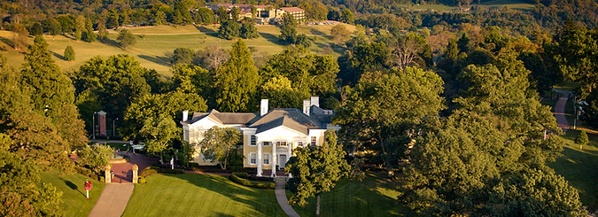
ERM 2022
Oglebay Resort

Slide 3
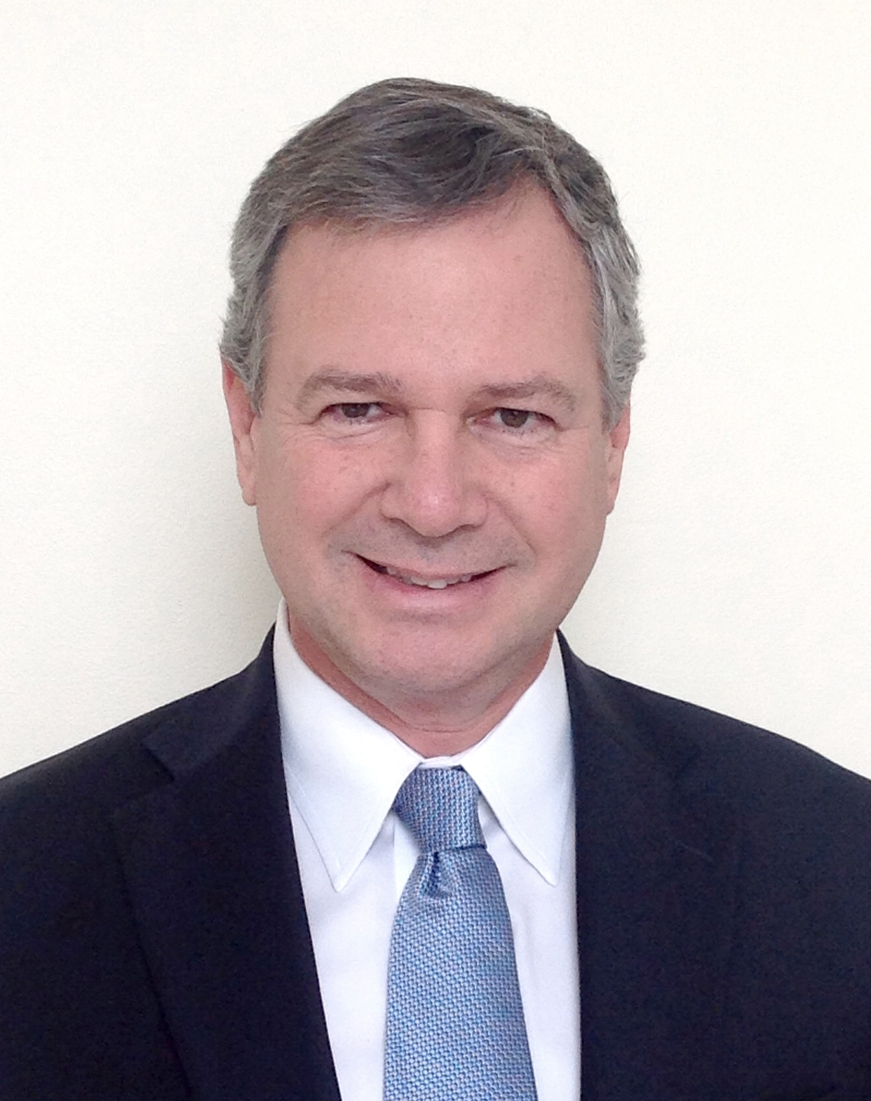
Completions Optimization and Technology
Joseph H. Frantz Jr is CEO of Frantz & Associates, a consulting company working in the upstream oil and gas sector. His two primary customers are ResFrac and Deep Well Services where he is a Senior Executive Advisor. From 2009-2019 he worked at Range Resources as the VP of Engineering and Technology in the Marcellus and Utica plays. Prior to Range, he was President and CEO of Unbridled Energy, a startup oil and gas company. Joe started working on shale reservoirs in 1984 with Getty Oil and has been involved with completion and reservoir simulation projects for many decades. Joe also worked as a consultant for 16 years with S.A. Holditch and Schlumberger DCS and managed offices in PA and OK. He has authored or co-authored more than 45 publications and taught several industry courses. Joe served on numerous Technical Committees within SPE and recently completed a term as Regional Director for the SPEI Board. He is a two-time Distinguished Lecturer with SPE. He earned a BSc in Petroleum and Natural Gas Engineering from Pennsylvania State University in 1981.
Joseph Frantz
Deep Well Services

Slide 4
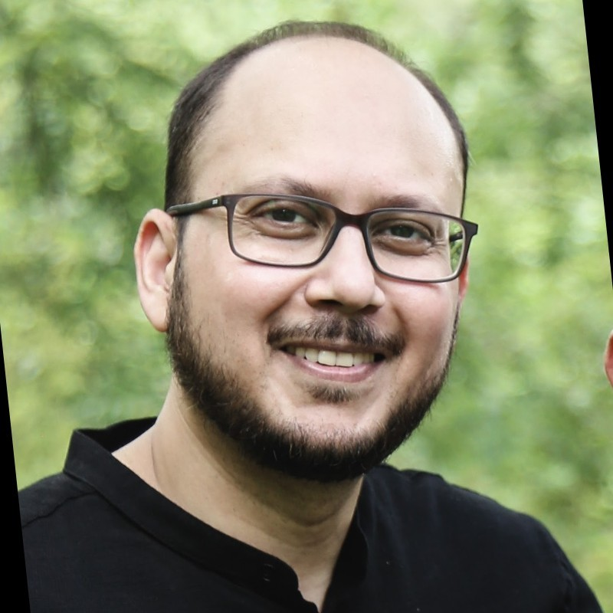
Data Science and Engineering Analytics
Nominator Said:
Dr. Molla had developed the first of kind automated workflow that utilize the machining learning technique for estimating reservoir fluid properties using advanced mud-gas data while drilling. The developed workflow delivers the earliest information about the fluid composition and variability in the reservoir, which provides key elements for planning formation evaluation jobs. The workflow has been commercialized recently to improve the operation efficiency.
Dr. Molla is a research scientist with extensive experiences in fluid characterizations. He is an expert in microfluidic technologies and had developed rapid PVT measurements to characterize the state of reservoir fluid in the oilfield. With these experiences, Dr. Molla had recently developed a new digital solution, combining the machine learning technique and his insights in fluid characterization, that transform existing data to create an automated workflow delivering information of fluid composition while drilling. I hence feel that Dr. Molla is a strong and deserving candidate for the award.
Shahnawaz Molla
Schlumberger

Slide 5
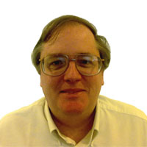
Drilling Engineering
Jon Benesch retired from ExxonMobil as a technical advisor in 2017 with his assignments related to drilling, completion and testing of oil and gas wells around the world. During industry service his travels took him to over 80 countries while working in over 30 of them and living in 20. His areas of expertise include the planning and execution of exploration wells in frontier areas, complex wells, and floating drilling endeavors. He has been a key contributor working in areas as diverse as the highlands of Papua New Guinea, Western China, The Black, Caspian and Kara Seas and efforts in the high arctic, rainforests, deserts and urban environments. His efforts supporting the development of the North Gas Field in Qatar were part of the largest single industrial project in history. Throughout his career he authored many technical papers, was a speaker at numerous conferences and received a number of achievement awards. On his last assignment before retirement, he moved for ExxonMobil to Guyana in their foray into that new province and involved with the initial deepwater exploration drilling there. These efforts helped lead to discoveries reaching over 11 billion barrels of oil reserves and in which is now a major basin of industry focus. He is a registered petroleum engineer in multiple US states.
Jonathan Benesch
Exxon Mobil Corporation

Slide 6
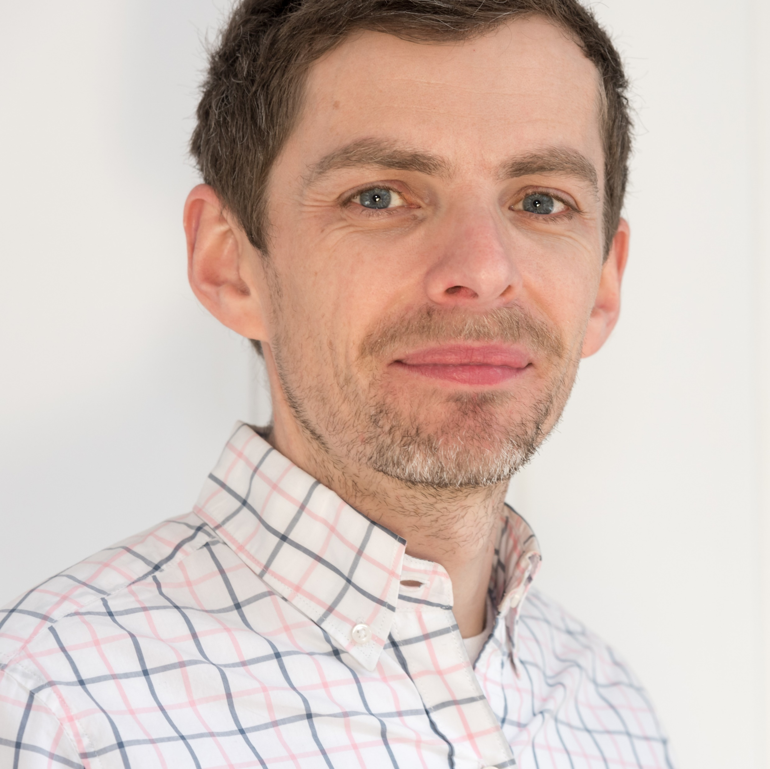
Formation Evaluation
Paul Craddock is a geochemist and Senior Research Scientist in the Modeling & Interpretation Department at Schlumberger-Doll Research Center, Boston, Mass. His research addresses oilfield petrophysics using nuclear, X-ray, infrared spectroscopy, and most recently machine learning methods. He has developed methods to: derive resistivity-independent saturation from spectroscopy logs; indicate zones for favorable well placement and production in shale (Reservoir Producibility Index, RPI); combine cuttings and logs for enhanced petrophysics in data-poor shale wells; and optimize kerogen properties for global shale evaluation (Thermal Maturity-Adjusted Log Interpretation, TMALI). Paul received a Ph.D. in chemical oceanography from Massachusetts Institute of Technology in 2009 and has co-authored 50+ journal and conference publications. His paper “Thermal maturity-adjusted log interpretation (TMALI) in organic shales” was awarded Best Paper at the SPWLA 60th Annual Logging Symposium. Paul is twice a SPWLA Distinguished Speaker (2016-17, 2019-20) and a SPE Distinguished Lecturer (2020-21).
Paul Craddock
Schlumberger - Doll Research

Slide 7
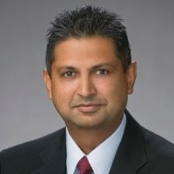
Management
Nominator Said:
Surya has used his technical knowledge and background in petroleum engineering throughout his career to advance data analytics and management strategies. Over the past decade or so, he has applied his management strategies for asst evaluations, mergers and acquisitions, economic modelling and much more.
Surya has Expertise in formulation of strategic view of commodities and markets through modeling and analysis of fundamentals.
Local, regional, and global outlooks prepared for and presented to a broad spectrum of audiences including internal and external C-suite decision-makers, third party analysis/research firms, private equity and investment banking clients, external communications/PR and investor relations, and other business stakeholders through a variety of platforms such as position papers, executive briefs, market reports, board presentations, CERAWeek and other conference keynotes.
Surya Rajan
Element Logix Venture Partners

Slide 8
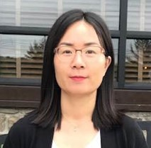
Distinguished Achievement Award for Petroleum Engineering Faculty
Qin He, associate professor of Petroleum and Natural Gas Engineering at Saint Francis University, Loretto, PA. She Received the B.Sc degree (Petroleum and Natural Gas Engineering) from China University of Geosciences, Wuhan, China in 2006, M. Sc degree (Geochemistry) from Guangzhou institute of geochemistry, China in 2009, M. Sc degree and Ph.D. degree (Petroleum and Natural Gas Engineering) from West Virginia University, Morgantown, WV in 2016. Dr. Qin He joined Saint Francis University in Fall 2016 after she received her Ph.D. degree. Her research area focuses on reservoir simulation, especially real time reservoir simulations using Artificial Intelligence and Data Mining techniques.
During her time with Saint Francis University, she carried out a demonstrative role in the development of the Petroleum and Natural Gas engineering program, working in tandem with her colleagues to perfect a transformational curriculum for Petroleum Engineering focused on environmental responsibility, and then carry it through successful ABET accreditation.
Qin He
Saint Francis University

Slide 9
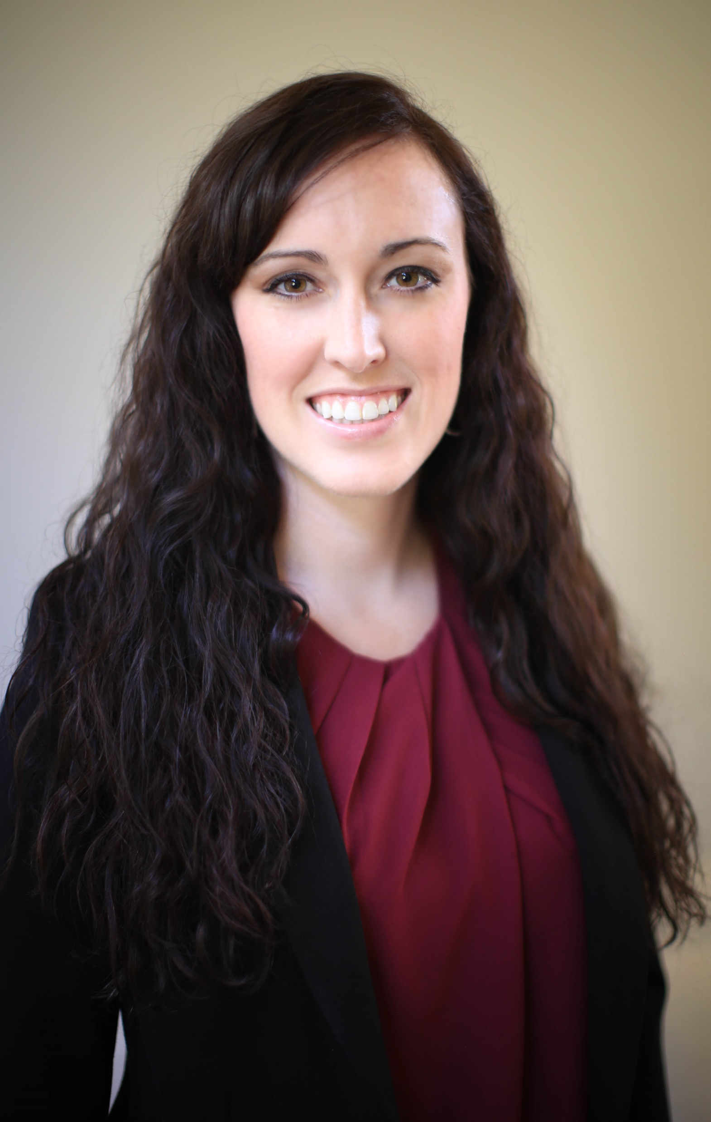
Regional Service
Kimberly Ayers is a reservoir engineer and is considered an established expert in subsurface identification of oil and gas reserves, development, and optimization in the Appalachian Basin, providing reserve estimations, statistical evaluations/modeling, and strategic planning to small to mid-sized operators.
Apart from growing up in the oil & gas industry in West Virginia, Kimberly has held positions at several successful E&P companies operating in the Appalachian Basin including Northeast Natural Energy, Tenaska Resources, Inflection Energy, Lola Energy, and Beech Resources. She is the founder of Ayers Petroleum Consulting, which has been successfully operating in Canonsburg, PA for five years, and currently serves a wide variety of clients in multiple basins across the country.
In 2020, Ayers was recognized as an “Energy Innovator” by Hart Energy’s E&P magazine. Ayers was also named one of the “Top Women in Energy” by the Denver Business Journal in 2015. She has authored several professional articles published by the Society of Petroleum Engineers and the American Oil & Gas Reporter.
Kimberly Ayers
Ayers Petroleum Consulting LLC

Slide 10
Distinguished Corporate Support Award
Universal is a full-service, Tier 1 fracturing company willing to push boundaries, test limits, and question yesterday’s orthodox solutions so that we can develop new ideas that help our customers succeed. From conception to execution and chief executive to field technician, Universal supplies a complete suite of custom engineered solutions to manage your most challenging projects. Our commitment to creative thinking, operational excellence, and service quality sets Universal apart.

