Slide 1
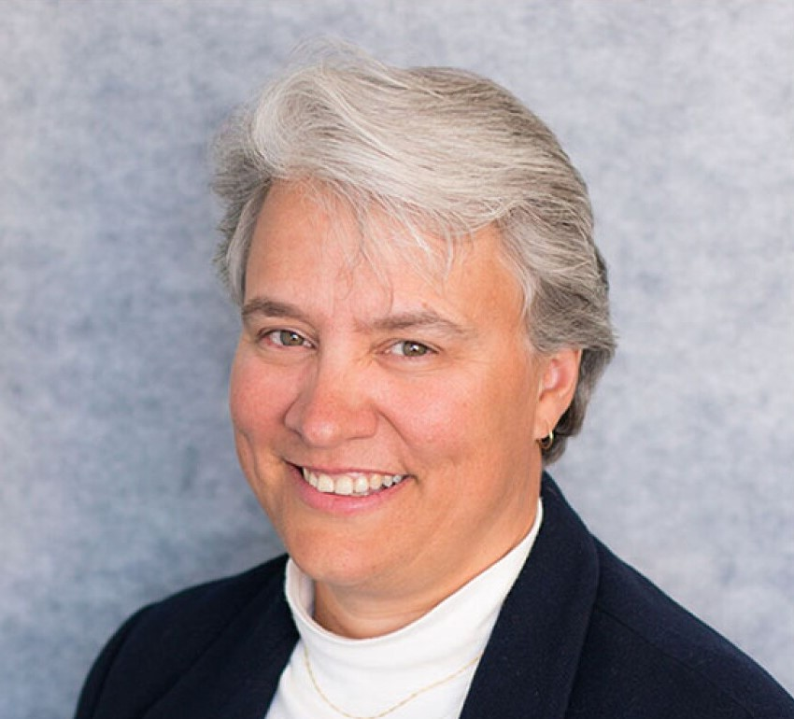
SPE Board of Directors Meeting, October 2026
Sharing highlights from the following board committees:
  Membership and Engagement
  Technical Content
  Finance
  Audit
Coordination meetings held for:
  Regional Directors
  Technical Directors
Please send feedback to president@spe.org
Dr. Jennifer Miskimins
2026 SPE President

Slide 2
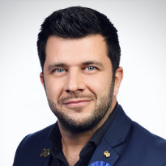
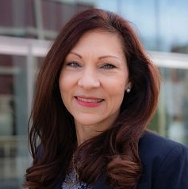
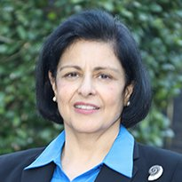
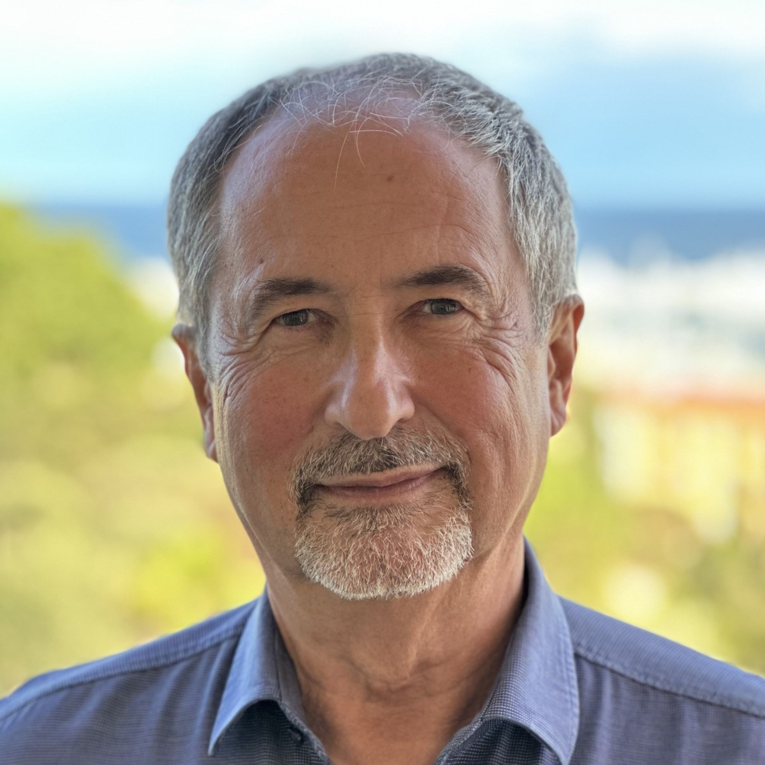
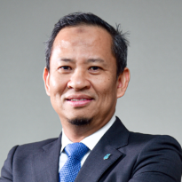
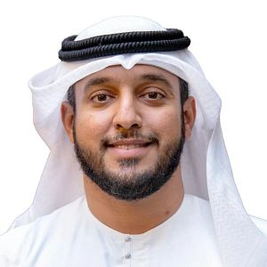
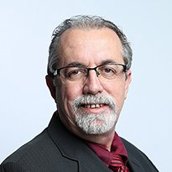
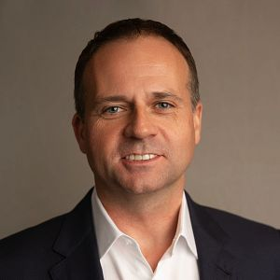
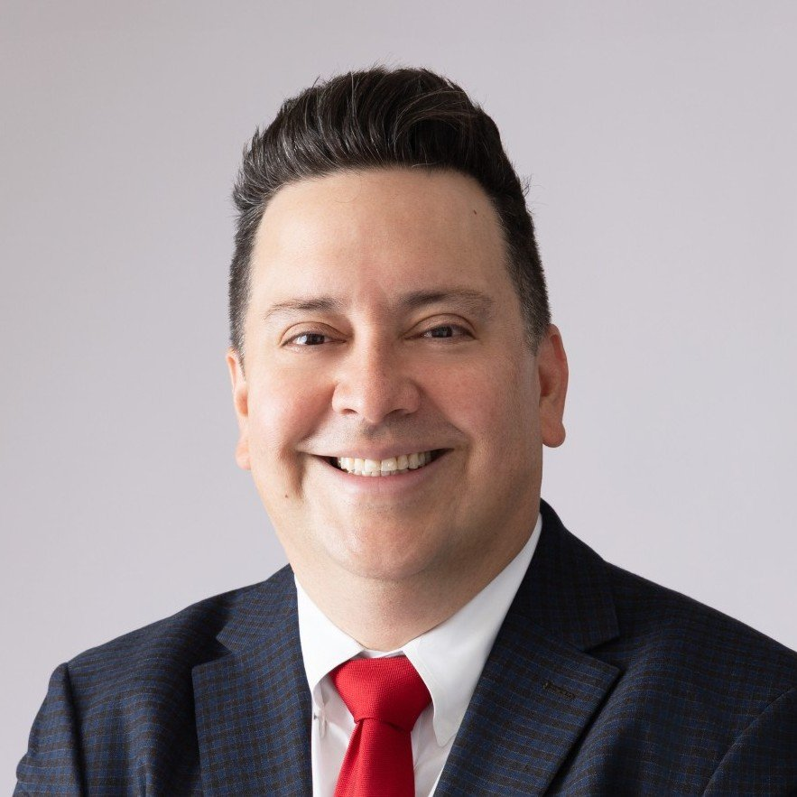
Membership & Engagement Committee – October 2026
Recommendations from the Board Committee on Membership and Engagement taken to the full board for approvals:
Approved:
The Stephen A. Holditch Visionary Leadership Award is sunset.
One year USD 0 dues exceptions were approved for the Central Ukraine Section and Syria Section.
The Regional Director qualification requirement was updated to: This position should be filled by someone with experience serving as a Section Chairperson (preferred) or Section Officer from any section globally, not necessarily in the region of the Regional Director position to be filled.
Other topics reviewed/report/updates:
Award Committees will complete their work by 15 May each year (previously 1 June) and will propose the international award candidate recipient slate directly to the Board of Directors, with an online review/approval process in May/June.
SPE is actively updating the sanctions policy, which requires updates to the SPE website and relevant resources. SPE will complete a review of all ongoing activities and programs. SPE Officers will review all findings and make recommendations (if applicable) from the review findings.
The committee is adopting a Member Program Proposal Form to assist with evaluating program ideas and sustainability.
Updates were shared by the Young Professionals Committee, Diversity & Inclusion Committee, Net Gen Early Career Lecture Program, Geographic Sections & MOUs, and section compliance.
Standing Committee Action Items:
Recommended for the Membership Standing Committee to review the Section Operating Regulations to consider term limits for Section Officers.
Recommended for the Technical Directors to discuss Technical Director qualifications similar to Regional Director qualifications and bring to M&E for 2028 nomination cycle, if needed.
Pierre Emmanuel d’Huart
(Chair)
Linda Battalora
Sushma Bhan
Olivier Houze
Hazli Sham Kassim
Maged Mabrook
Carlos Pedroso
Gregory Stephenson
Carlos Torres

Slide 3
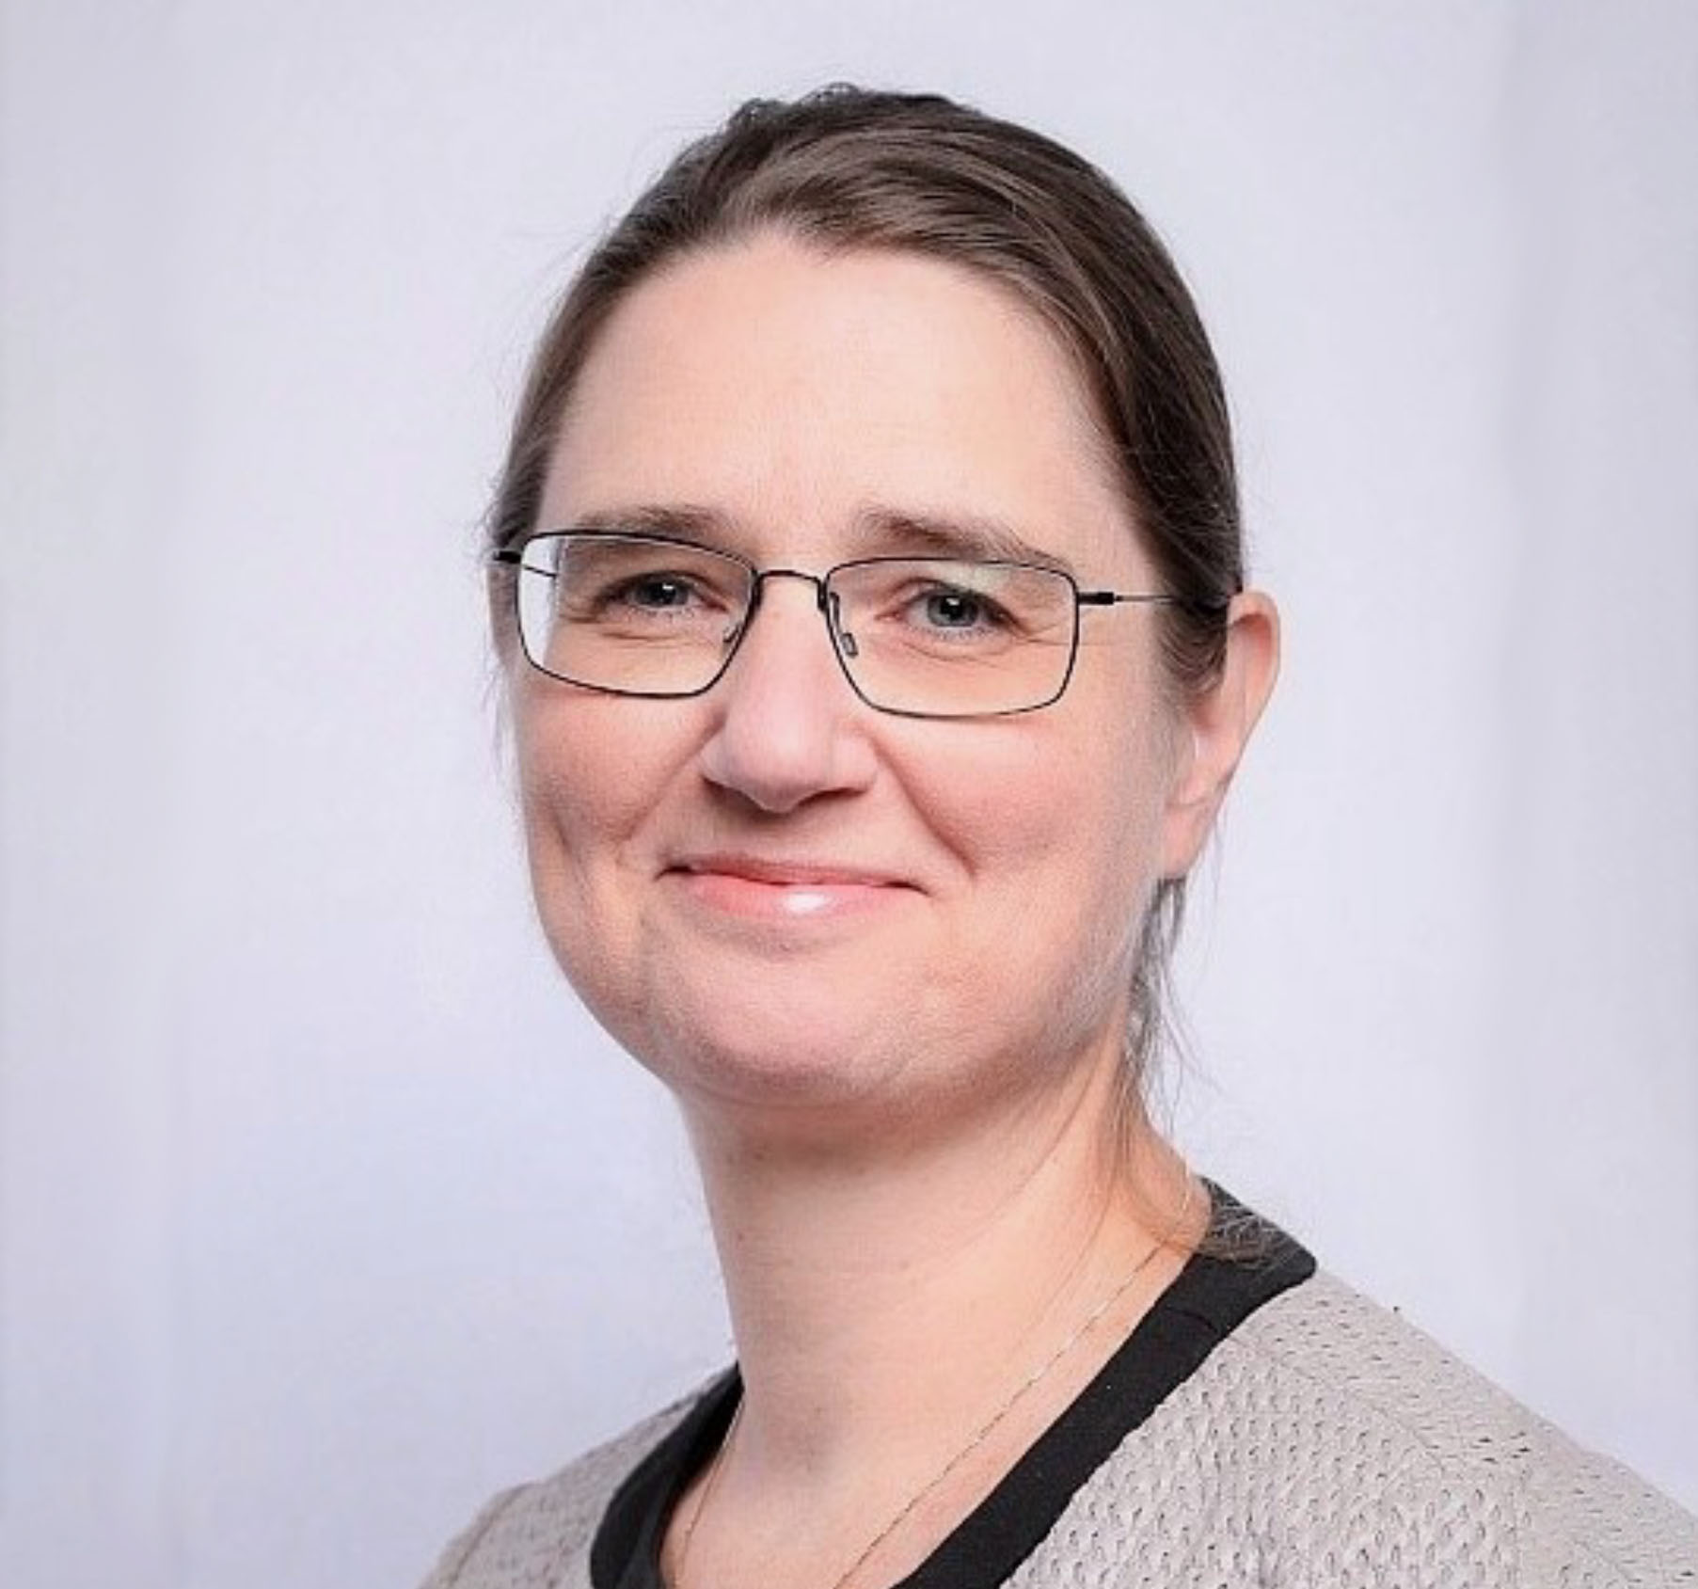
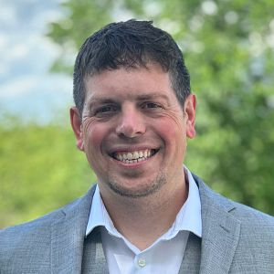
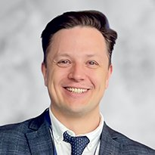
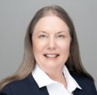
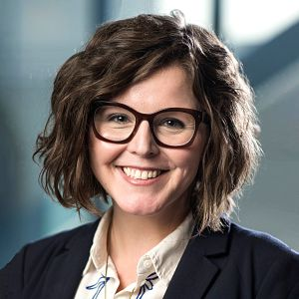
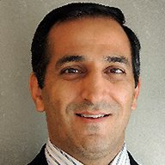
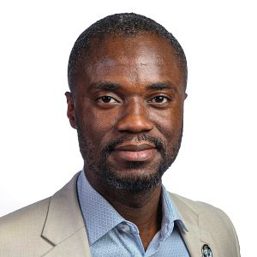
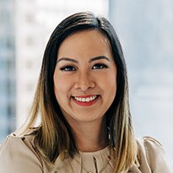
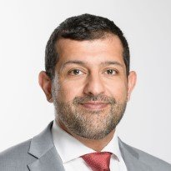
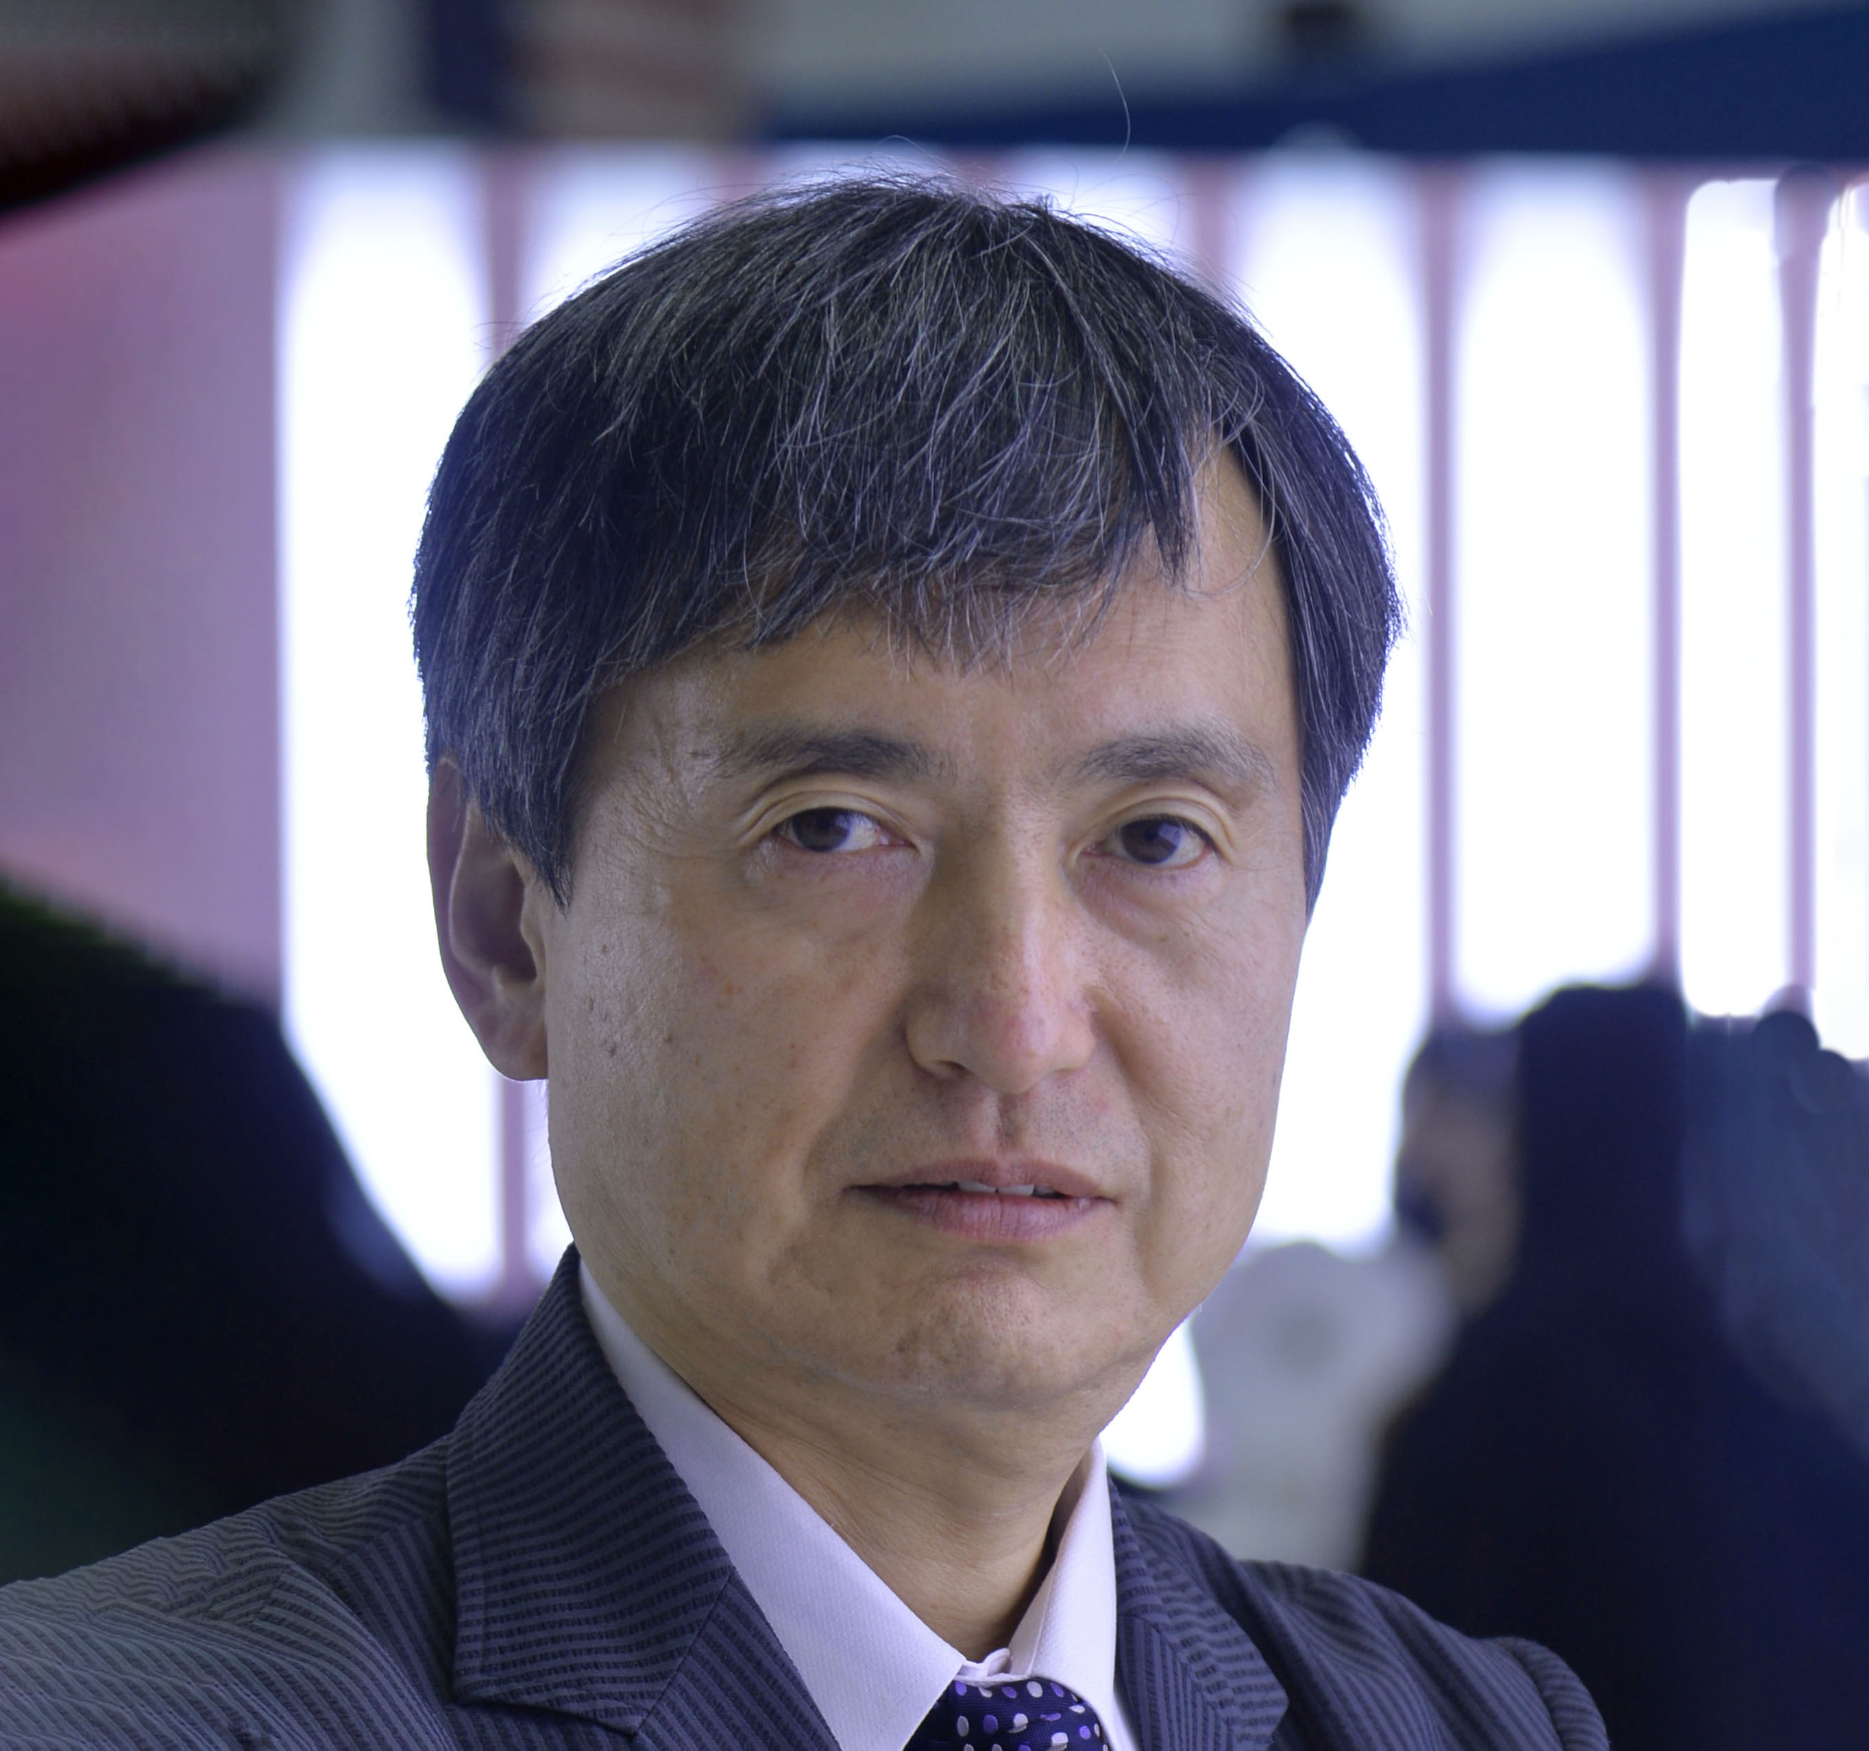
Technical Content Committee – October 2026
Committee approved:
  The July 2026 TC Committee meetings minutes
  1 ERF – URTeC East Symposium, Abu Dhabi, UAE
  1 Section-Managed Conference –
  Conference on Hydrocarbons and Energy: 70 Years of the SPE Caracas Petroleum Section
  Conditionally approved this 1-time conference and paper publication in OnePetro barring any Sanction concerns.
  The publication of the Geothermal Resources Management System 2026 (first edition).
  Sunsetting the SPE Connect Technical Discipline Communities
Received updates on:
  Operations and Flagship Event Reports
  Update of the 6 Paper Quality Workgroup initiatives
  Status of the 2 Project InnerSpace/SPE grant agreements
  Update to the Global Events Portfolio Plans, including OTC and ATCE Next Steps
  Annual Standing Committee and Flagship Events Reports
  2026 Technical Content Committee Goals
  .
Peggy Rijken
Chair
Neil Boyer
Alexey Borisenko
Susan Howes
Sarah Kern
Rahim Masoudi
Riverson Oppong
Kim Oracheski
Abdullatif Al-Omair
Koji Yamamoto

Slide 4
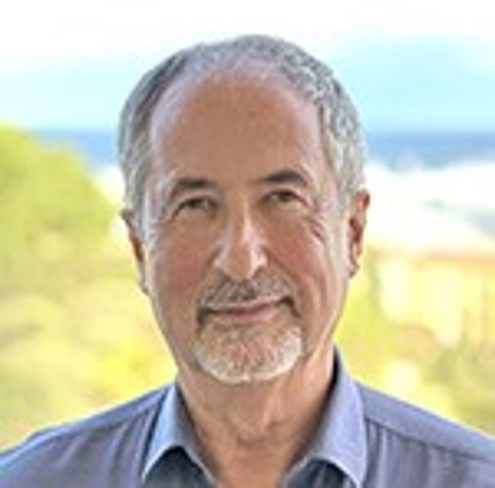

Finance Committee – October 2026
Received an update on SPE’s investment portfolio, reporting global investments of $36.7 million as of 30 September 2026.
Reviewed KPIs and opportunities for the newly approved strategic plan to deliver clarity on SPE’s long-term financial position.
Reported on the ELLM / API & MCP Data License Pipeline.
Approved the transfer and management of SPE Foundation assets to the SPE.
Approved sunsetting the Richardson Building Committee as the Richardson building was sold to NexPoint on 30 September 2026.
Olivier Houzé
Chair
Jennifer Miskimins
Susan Howes
Hazli Kassim
Peggy Rijken
Pierre Emmanuel d’Huart

Slide 5
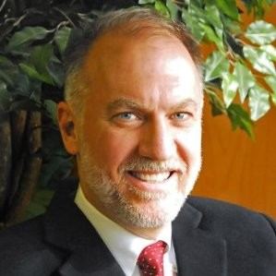
Audit Committee – October 2026
Received an update on the Cybersecurity Improvement Program, noting that five of six high-risk findings have been remediated, resulting in an overall medium-high risk profile, with the remaining finding under active remediation.
Received an update from RSM regarding the FY2026 audit communications, including the audit timeline, management and auditor responsibilities, and the overall audit strategy.
Reviewed the external audit timeline and discussed potential firms to serve as SPE's external auditor going forward.
Hazli Kassim
Chair
Alexey Borisenko
Carlos Torres
Olivier Houzé
Ford Brett

Slide 6
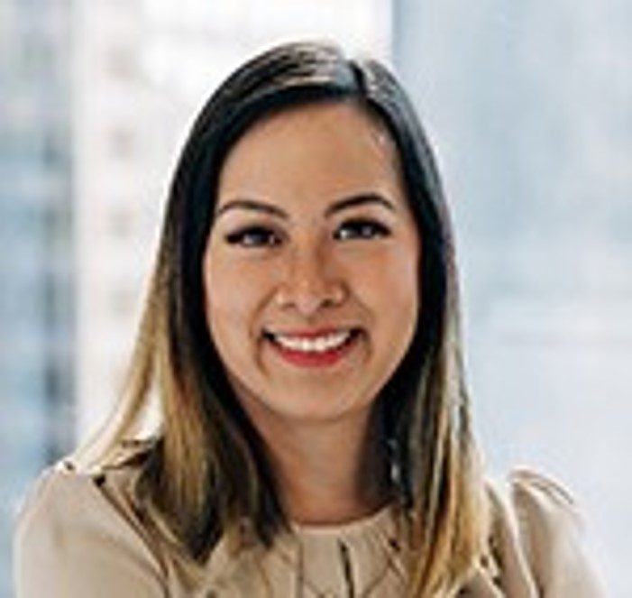
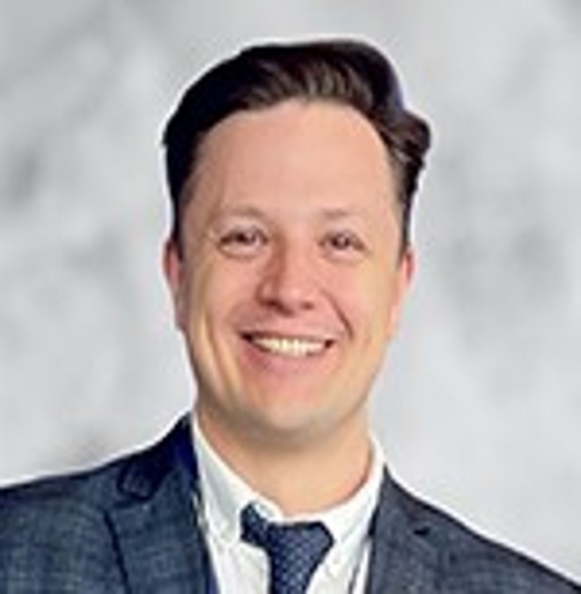

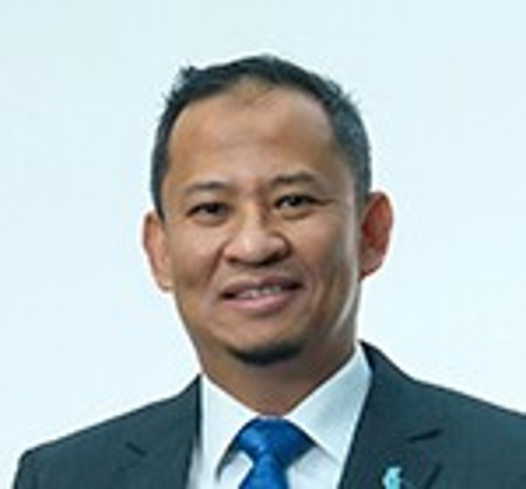
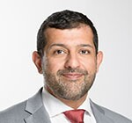


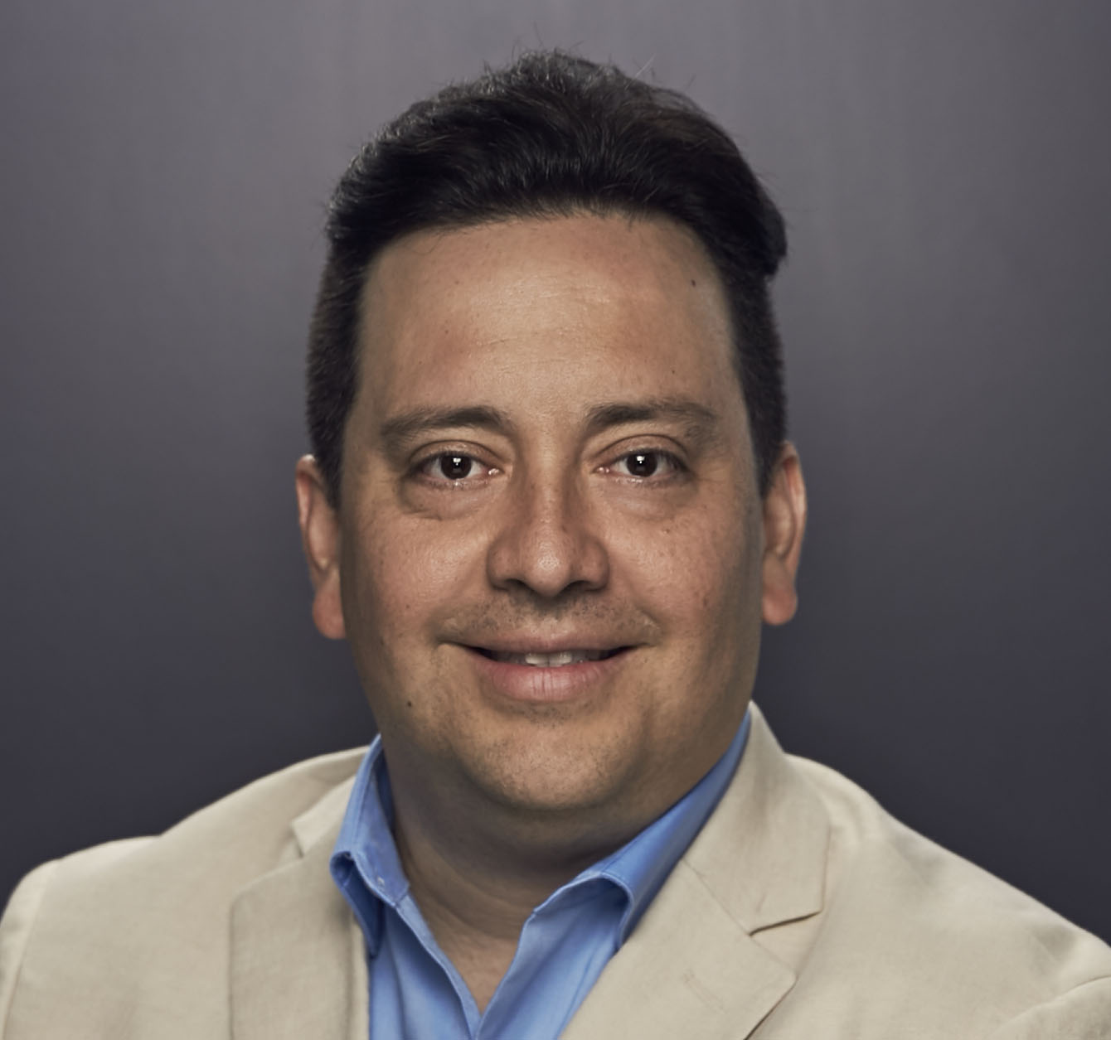
Regional Directors – October 2026
Discussed the Regional Director Resource Center.
Regional Directors were invited to participate in the 2027 SPE Live series.
Discussed the minimum 25-student member requirement for student chapters. RDs request the Membership Standing Committee to review the average number of student members per chapter/region and determine a recommendation regarding the minimum requirement.
Regional PetroBowl recipients will be recognized during the Young Member Event and 1st place winners will be shared at the President’s Luncheon.
2027 SPE President Susan Howes and the RDs discussed regional Section Officers meetings and the opportunities/challenges.
RDs provided regional updates.
Kim Oracheski
Lead
Alexey Borisenko
Neil Boyer
Pierre-Emmanuel d’Huart
Hazli Kassim
Maged Mabrook
Abdullatif Al-Omair
Riverson Oppong
Carlos Pedroso
Carlos Torres
Koji Yamamoto

Slide 7
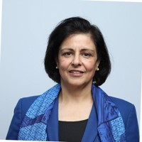
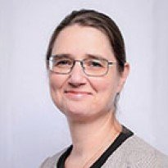
Technical Directors – October 2026
Technical Section Updates
  Total of 26 Technical Sections; new reporting and 6 Technical Section awards implemented
  New: Acid Stimulation Technical Section and Asset Integrity Technical Section
  Merged: Drilling Uncertainty Prediction converged with Drilling System Advancement Technical Section
  Increased student and professional members growth with interactive and F2F events
Cross-Discipline Collaboration & Innovation
  Continued global collaboration on technical multidisciplinary industry events, publications, competitions, and webinars
  Rapid growth of Critical Minerals Technical Section
  Upcoming Drillbotics revamp
  Two new Completions Best Practices published
  DSEA Ai4Energy and Energython competitions successfully completed
Project InnerSpace Geothermal Update
  Drilling: Integration of geothermal into revamped Drillbotics program
  P&O/PFC: Paper and presentation on critical aspects of geothermal production systems
  Completions: Paper and presentation on current state of well completions
  DSEA: Three-phase program includes 6 learning webinars, upcoming capstone geothermal business plan competition, and award winners’ innovation spotlight
  Reservoir/HSES: GRMS principles translated into application case studies toward GRMS practical application guidelines
Sushma Bhan
Lead
Linda Battalora
Sarah Kern
Rahim Masoudi
Peggy Rijken
Gregory Stephenson

