Slide 2
REGIONAL AWARDS RECOGNIZE MEMBERS WHO CONTRIBUTE EXCEPTIONAL SERVICE AND LEADERSHIP WITHIN SPE, AS WELL AS MAKING SIGNIFICANT PROFESSIONAL CONTRIBUTIONS WITHIN THEIR TECHNICAL DISCIPLINES AT THE SPE REGIONAL LEVEL.

Slide 3
Technical Awards Winners

Slide 4
THE SPE REGIONAL TECHNICAL AWARDS ACKNOWLEDGE EXCEPTIONAL CONTRIBUTIONS TO THE SOCIETY OF PETROLEUM ENGINEERS AT THE SECTION OR REGIONAL LEVEL AND RECOGNIZE SINGULAR DEVOTION OF TIME AND EFFORT TO THE PROGRAMS AND DEVELOPMENT OF TECHNICAL EXPERTISE IN EIGHT DISCIPLINES.

Slide 5
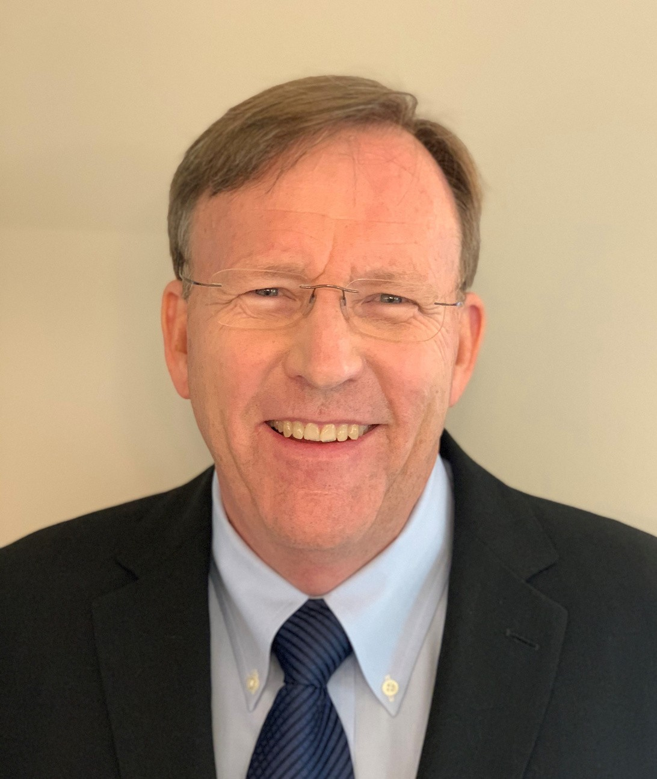
Completions Optimization and Technology Award
Robert Shelley RF Shelley LLC
ROBERT F (BOB) SHELLEY has more than 40 years of well completion, hydraulic fracturing, reservoir evaluation and operations experience with horizontal and vertical well projects. Currently he is President of RF SHELLEY LLC, Well Performance Evaluation based in Houston. During his career he has authored more than 30 technical papers, 8 patents, served as the ATCE Completions Committee Chairperson and SPE Distinguished Lecturer. Bob holds a BS degree in Civil Engineering from Colorado State University and is a Registered Professional Petroleum Engineer in Texas and Colorado. Prior to starting his own consulting company, Bob worked for Halliburton, RTA LLC, Landmark and StrataGen Engineering.

Slide 6
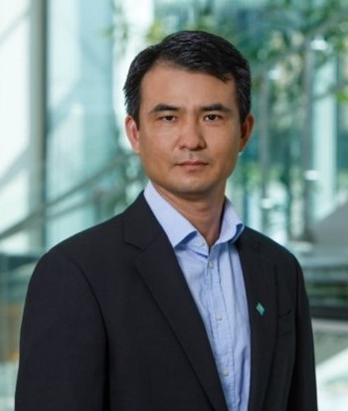
Data Science and Engineering Analytics
Chicheng Xu Aramco Houston Research Center
Dr. Chicheng Xu joined Aramco Houston Research Center as a research petrophysicist in Oct 2017. He obtained his PhD degree from UT Austin in 2013 and have previously worked for Schlumberger, BP, and BHP to support USA asset operations and reservoir characterization in deepwater turbidite fields as well as onshore unconventional fields.
His research focus is on petrophysical reservoir characterization using advanced computational techniques and data analytics for interpretation and modeling based on multi-scale data integration. He is leading several petrophysics data analytics related projects that utilize AI/machine learning to accomplish challenging petrophysical tasks.

Slide 7
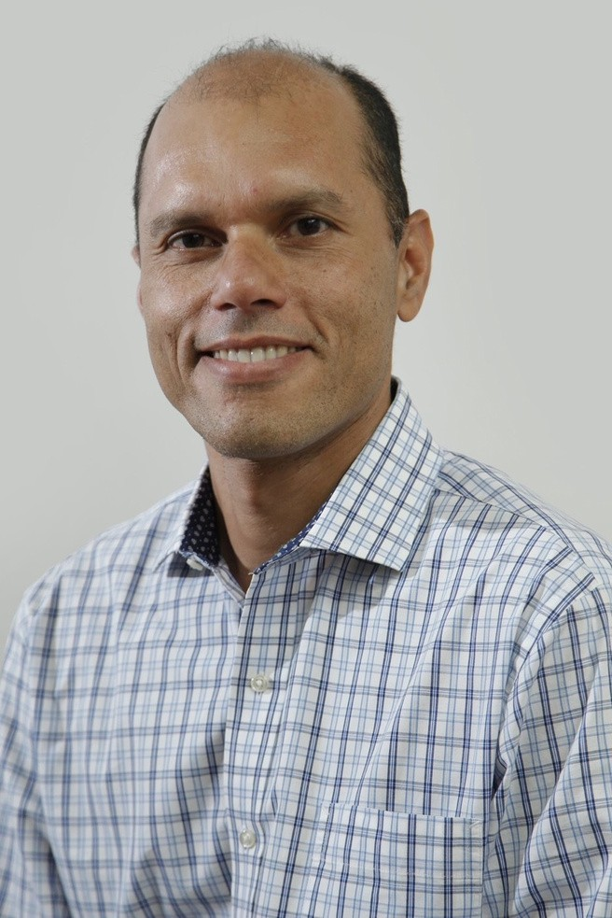
Drilling Engineering
Jesus Capo Hokchi Energy
Jesus Capo received a B.S. degree in mechanical engineering from the University of Tachira, Venezuela, and an M.S. degree in petroleum engineering from the University of Tulsa.
Jesus C. has worked in the O&G industry for 25 years, gaining experience in Drilling, Completion, and Remedial in onshore and offshore operations at the different US and international locations. He started his career with the technology department at PDVSA for new drilling and completions applications, implementing the use of bitumen-in-water emulsion and cuttings transport in highly inclined angles with multiphase fluids.
As a seasoned Drilling Engineer, he is passionate about advancing project engineering, operations, and risk mitigations for uncommon applications connecting the dots to make a sound plan.He is passionate about transforming project visions into reality, creating a robust program that translates into an efficient operation that delivers tangible results in line with client expectations.

Slide 8
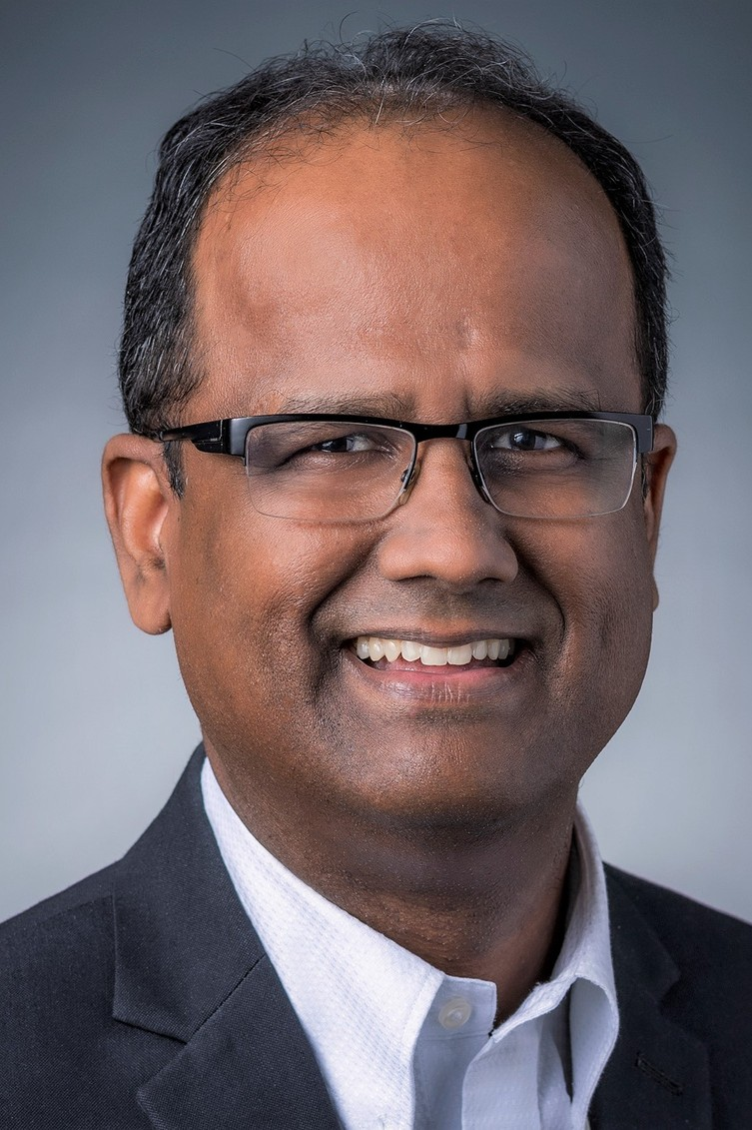
Management
Shree Vikas ConocoPhillips Co
Shree Vikas is Director, Market Intelligence & Business Analysis at ConocoPhillips, where he is responsible for market and competitor analysis, energy transition/new energies monitoring, and assessing business implications. He regularly serves as a top-level sounding board and thought- partner for strategy development, operational cost/economics planning and analysis, as well as for procurement decisions. Prior to ConocoPhillips, he led a myriad of market analysis, financial due-diligence, technology evaluation, and modeling projects for governmental agencies and energy companies. He was also invited by the Council of Economic Advisers (CEA) of President Bush’s White House in deliberations to shape governmental responses to high natural gas prices.

Slide 9
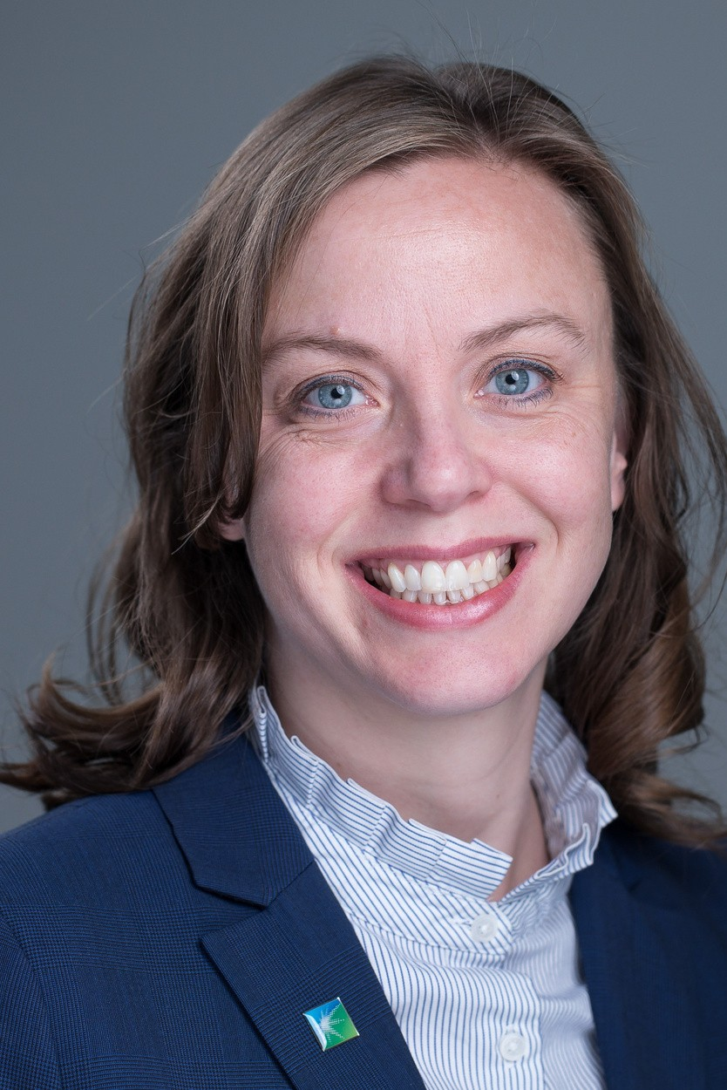
Production and Operations
Katherine Hull Aramco Services
Dr. Katherine Hull is an applied research scientist who develops new technology for stimulating unconventional formations. She joined Aramco Americas in Houston in 2013 after working as a process chemist in a start-up chemical company and receiving her Ph.D. in Chemistry in 2009. Dr. Hull has 41 granted US patents, 21 filed patent applications, 22 journal publications, 4 book chapters, and 36 conference presentations. She currently serves as Chair of the 2023 SPE Oilfield Chemistry Program Committee while also playing an active role in mentoring students and publishing her work. She was the recipient of the 2019 SPE Gulf Coast Regional Service Award.

Slide 10
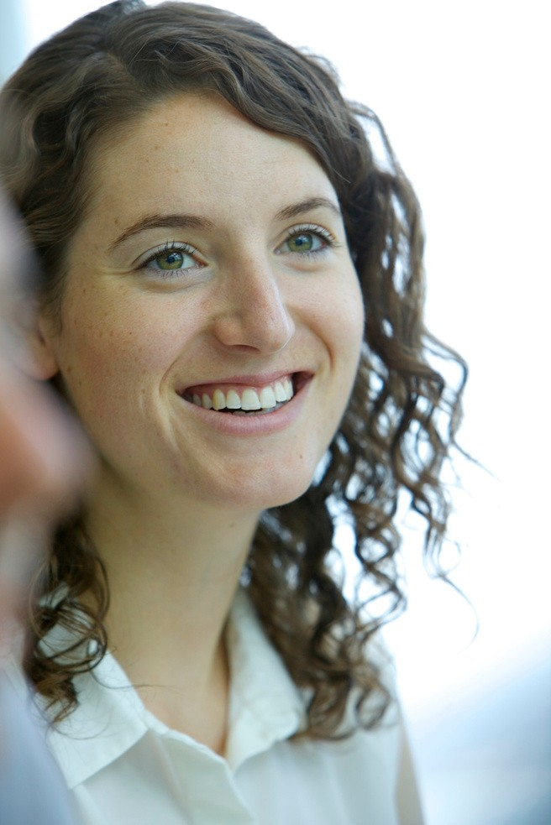
Reservoir Description and Dynamics
Jody Mahoney BHP Petroleum
Jody Mahoney is currently the Head of Gulf of Mexico Assets at Woodside Energy. Prior to this, Jody has managed several Subsurface teams across the Gulf of Mexico and Trinidad, Operated and Non-Operated assets. As leader of integrated teams, Jody thrives on bringing people together to realize a common goal, adding value to the business through technical excellence, compelling reasoning, and vision for the future.
Jody joined BHP over 10 years ago in Perth Australia and has worked in various Reservoir Engineering and Planning roles in Australia and the US. Jody holds a Bachelor Petroleum Engineering (Hons.) from The University of New South Wales

Slide 11
Service Awards Winners

Slide 12
THE SPE REGIONAL SERVICE
_{EX} AWARDS ACKNOWLEDGES CEPTIONAL CONTRIBUTIONS TO
_{E}THE SOCIETY OF PETROLEUM _{RE} NGINEERS AT THE SECTION OR
_{SI} GIONAL LEVEL AND RECOGNIZES
NGULAR DEVOTION OF TIME AND
EFFORT TO THE PROGRAMS AND
DEVELOPMENT OF THE MEMBER’S SECTION.

Slide 13
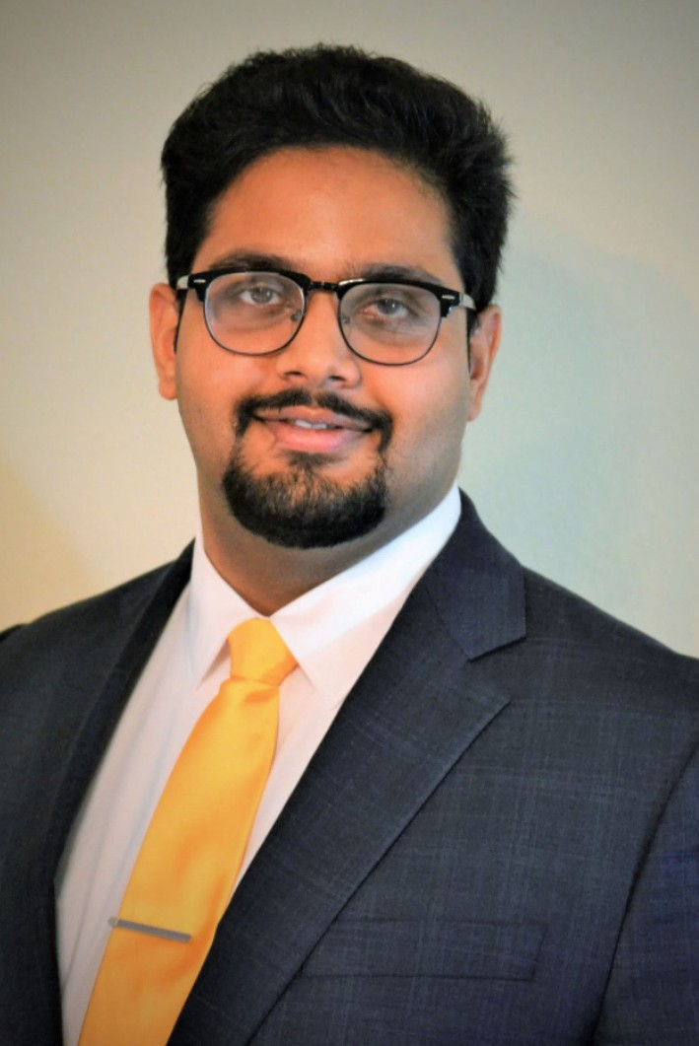
Regional Public Service
Vikrant Lakhanpal Proline Energy Resources
Vikrant’s volunteer work is dedicated towards mentorship and helping the next generation of thinkers and doers. At Society of Petroleum Engineers (SPE), he volunteers as lead content creator for the technical topics section for The Way Ahead magazine, Director at Drilling Uncertainty Prediction Technical Section, and Ambassador lecturer for the Energy4Me program. In addition to SPE, Vikrant has also worked as a mentor for first generation college students at Project GRAD Houston and volunteers as a business development mentor at The BD School.
Apart from the oil and gas industry, Vikrant has started his entrepreneurial journey at 1010 Coding, where he is working on bridging the gap between the educational opportunities available in the United States and Nigeria.

Slide 14
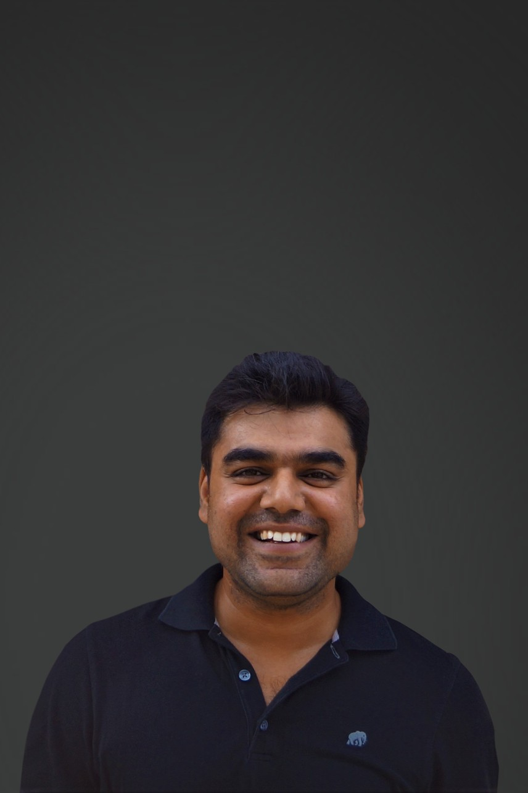
Young Professional Member Outstanding Service
Pushpesh Sharma AspenTech
Pushpesh is Sr. Product Manager at Aspentech responsible for HYSYS Petroleum Refining. In this role he is enabling the energy industry in digital transformation and sustainable energy transition. He is focused on creating solutions for energy optimization and renewable energy such as digital twins and biofuels modeling for refining. Pushpesh finished his PhD in Chemical Engineering with focus on enhanced oil recovery and carbon capture methods. He has authored several articles related to enhanced oil recovery, CCUS, and geothermal energy. Pushpesh is actively involved with SPE, he is part of SPE Data Science and Engineering Analytics Advisory committee, and he is the Membership Chair for the SPE Geothermal Technical Section.
Pushpesh was selected as the SPE TWA Energy Influencer in 2020.

Slide 15
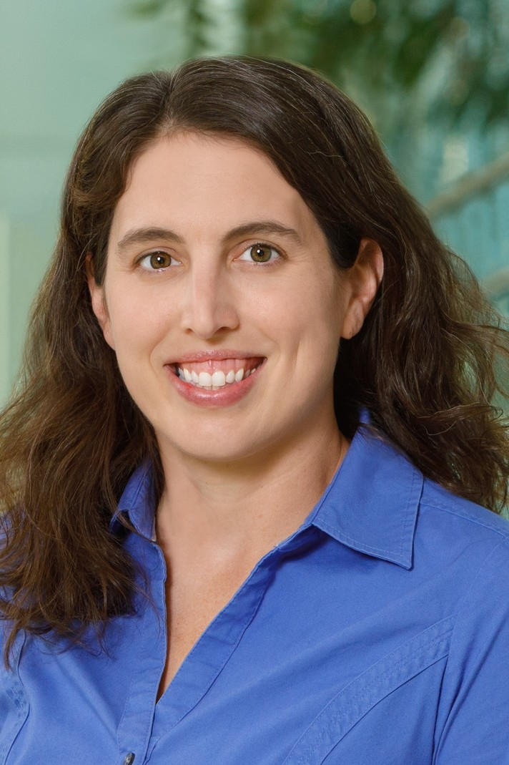
Young Professional Member Outstanding Service
Stacey Althaus Aramco Americas
Stacey Althaus is a Lab scientist at Aramco Americas on the Houston Reservoir Engineering Technology team. Her focus is the use of NMR measurements in the study of unconventional reservoirs. With the RET team she has worked on the development of a high spatial resolution NMR system, NMR permeability transforms, advances in cutting logs and NMR imbibition measurements for fluid flow properties in unconventional reservoirs.
Stacey holds a B.S. in Chemistry from Winona State University and a Ph.D. in Physical Chemistry with a specialization in instrumentation from Iowa State University where she studied the application of Solid State NMR in mesoporous catalysts. She is a member of SPE, SPWLA and the American Chemical Society. She was recipient of the ACS Younger Chemist Leadership Development award in 2019 and SPWLA Distinguished Speaker in 2019.

Slide 16
Regional Service
Jose Moreiras Reynaga Schlumberger

Slide 17
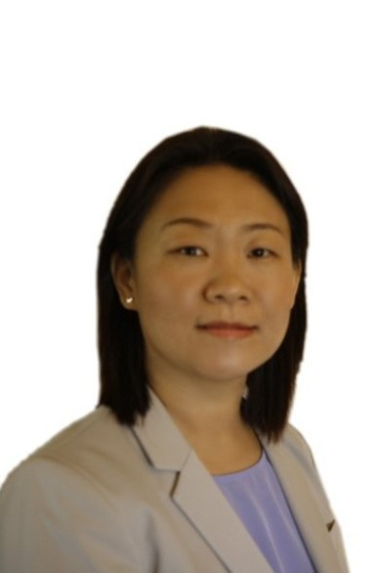
Regional Service
Xia Wei Schlumberger
Anna Wei got her PhD in Chemistry from Texas Tech University. After graduation, she has been working as a Research Scientist in Ebonite International on polymer development. Then she joined Schlumberger Fluids New Product Development group in 2014. Since then, she is actively working on the development of various drilling and completion fluids systems, such as zinc-free high density brine and FluxDril drilling fluids. Now she is a Senior Chemist in Schlumberger and focus on the study of cementing technology to reduce the carbon footprint.

Slide 18
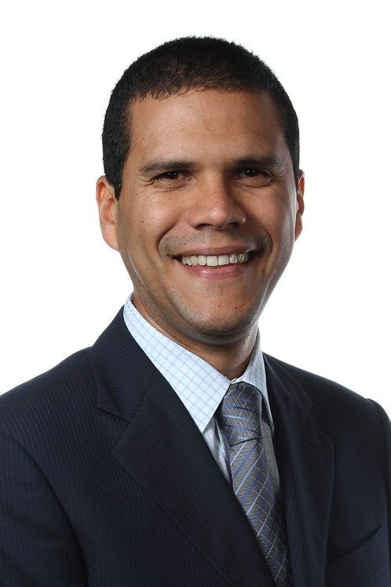
Regional Service
Johannes Alvarez Chevron Corporation
Johannes Alvarez is the EOR and CO2 Advisor in the Mid-Continent Business Unit at Chevron North America Exploration and Production. He is a Senior Reservoir and Production Engineer with more than 20 years of industry and R&D experience. Previously, he worked in Petroleos de Venezuela S.A. (PDVSA) were he held leadership positions in Production Engineering and Strategic Planning. Dr. Alvarez’s technical expertise involves asset development, production, facilities and process engineering, cross functional pilots, improved-oil-recovery (IOR) and EOR processes in Unconventional, Heavy Oil and Conventional reservoirs. He is the Author of several journals and technical papers on IOR/EOR in Unconventional Reservoirs and Heavy Oil. Dr. Alvarez currently serves as the Unconventional Resources Technology Conference (URTeC) SPE Co-Chair, SPE Midland Basin Energy Conference Co-Chair, SPE ATCE Reservoir Engineering Chair, SPEi Young Member Outstanding Award Subcommittee member, SPE RTA/PTA Workshop committee member and SPE LACPEC Technical Committee Member.

Slide 19
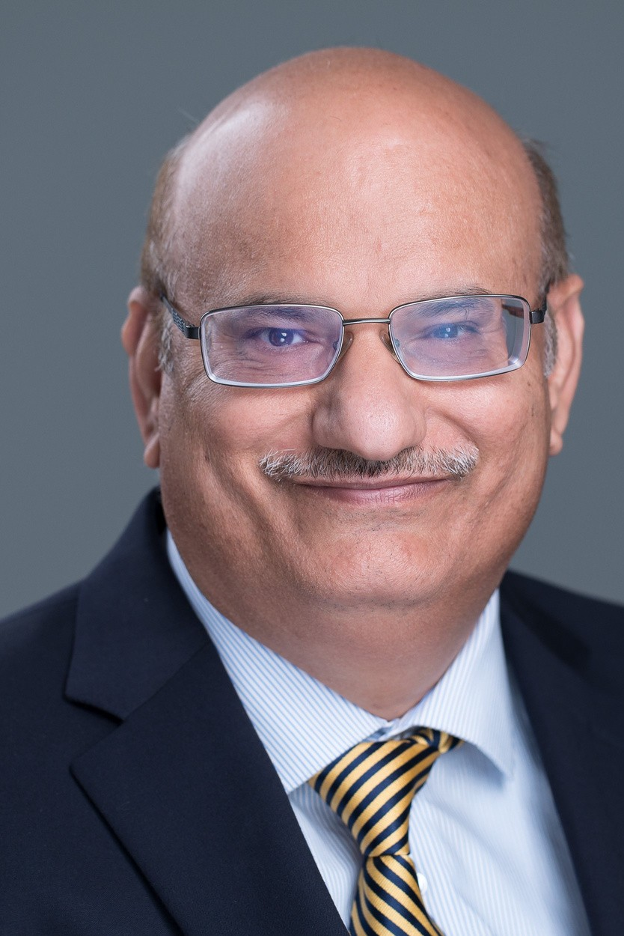
Regional Service
Rajesh Saini Aramco Services Company
Dr. Rajesh Saini is a Research Science Specialist in Production Technology Team at Aramco Research Center—Houston. He has more than 26 years of experience in oil and gas industry, and chemical research. He is a subject matter expert in the areas of oilfield stimulation, production and operations. He specializes in product development, scaling up, IP, sales, and commercialization of new products/processes for hydraulic fracturing, sand control, acidizing, production technology, oilfield chemicals and water conformance. Prior to joining Aramco Americas in 2017, he has played critical roles at Halliburton, Weatherford, and Lubrizol in the capacity from research scientist to R&D manager.

Slide 20
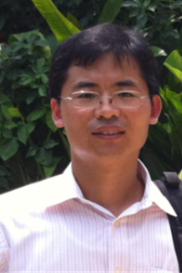
Regional Service
Baosheng Liang Chevron N America Upstream
Baosheng Liang is a Senior Reservoir Engineering Advisor in Mid-Continent Business Unit, Chevron, leading technical efforts in modeling, surveillance and machine learning for shale and tight asset development. He has served as technical editor, committee member, session chair in many SPE conferences, workshops and forums for about 15 years. He has co-authored 20+ SPE/URTeC papers on shale and tight reservoirs. He received Professional Achievement Award by the Society of Asian Scientists and Engineering (SASE) in 2020. Baosheng has bachelor's and master's degrees from Southwest Petroleum University, and a PhD degree from The University of Texas at Austin, all in Petroleum Engineering.

Slide 21
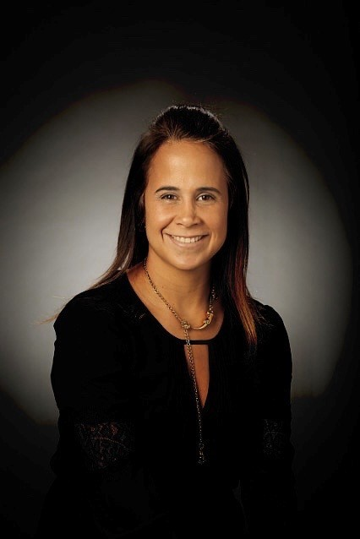
Regional Service
Lissett Barrios Shell
She is originally from Venezuela and hold a Bachelor’s degree in Chemical Engineering and a Master’s degree in Gas Engineering both from the University of Zulia in Venezuela. She also holds a Doctorate degree in Petroleum Engineering from the University of Tulsa (TU) US. She works for Shell since 2008 as an Senior Artificial Lift/Production Engineer. she is a Subject Matter Expert in Electrical Submersible Pump Artificial Lift system for design, deployment, and operation. Have published multiples SPE, ASME and Shell internal papers about ESP Performance in multiphase conditions and viscous operation. She is the author of a Book in Electrical Submersible Pumps (ESP). Lissett volunteers and serves as a reviewer in different journals for Artificial Lift systems. She is married to Maurizio and they have 4 girls with identical twin girls.

Slide 22
Distinguished Corporate Support
Award
SparkCognition's award-winning AI solutions allow organizations to predict future outcomes, optimize processes, and prevent cyberattacks. We partner with the world's industry leaders to analyze, optimize, and learn from data, augment human intelligence, drive profitable growth, and achieve operational excellence. Our patented AI, machine learning, and natural language technologies lead the industry in innovation and accelerate digital transformation. Our solutions allow organizations to solve critical challenges
—prevent unexpected downtime, maximize asset performance, optimize prices, and ensure worker safety while avoiding zero-day cyberattacks on essential IT and OT infrastructure. To learn more about how SparkCognition's AI solutions can unlock the power in your data, visit www.sparkcognition.com.

