Slide 1
SPE Program Committee
Social Media Guide
Simple ways to amplify program visibility, strengthen connection, and extend SPE’s reach
May 2026

Slide 2
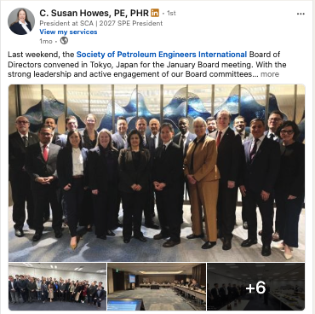
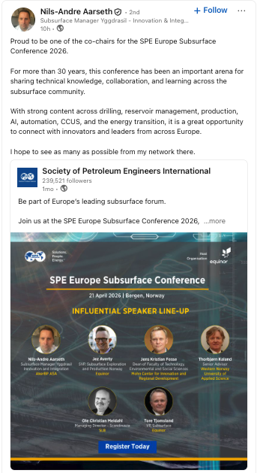
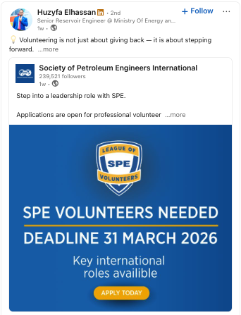
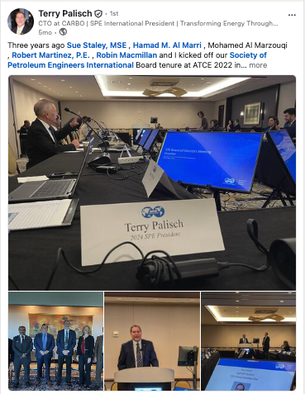
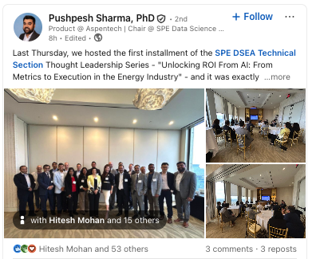
Your Committee Voice Matters
Why Your Voice Matters
As an SPE Program Committee member, your voice helps bring greater visibility, credibility, and connection to SPE’s programs, technical content, and global community. When you share moments, insights, or SPE content on LinkedIn, you help extend SPE’s reach across trusted professional networks, reinforce SPE’s mission, and highlight the value of our global community.
You do not need polished or highly produced content to make an impact. Often, the strongest posts are simple, timely, and genuine.
Easy Social Moments to Share
Program Committee meetings and discussions
Share a photo or short reflection from a meeting or discussion.
SPE activities, meetings, or visits
Highlight a visit, activity, or interaction with members.
Member and volunteer recognition
Recognize members, volunteers, or initiatives making an impact.
Program or industry reflections
Share a quick takeaway connected to SPE, leadership, or the energy industry.
Sharing SPE posts and updates
Repost an SPE post and add a short personal perspective.

Slide 3

Simple Tips for Posting on Social Media
For Program Committee members, social media can be a simple and effective way to share leadership perspectives, industry engagement, and moments that reflect SPE’s impact. LinkedIn is often a natural place to start, but the same principles can apply across platforms.
Keep it simple
A short caption is enough.
Use a photo when possible
A meeting photo, visit photo, or event photo can help make a post feel more engaging.
Add your perspective
A sentence or two on why the moment mattered can go a long way.
Tag when relevant
Consider tagging SPE International, local sections or chapters, or members featured in the post.
Use hashtags sparingly
When relevant, #WeAreSPE is a good option.
Helpful reminder:
You do not need to post often for your support to be meaningful. Even occasional sharing can help amplify SPE stories, member impact, and the visibility of the organization.

Slide 4
The Easiest Way to Post: Share SPE Content
One of the simplest ways to stay active on social is to share content that SPE has already published.
1
2
3
4
Find an SPE post, article, or update
Add one or two sentences with your perspective
Publish
Repost or share it
Short perspective examples
Glad to share this update from SPE.
Important conversations continue across our community.
Proud to help amplify the technical knowledge and volunteer work happening across SPE.
This is a strong example of how knowledge sharing helps move our industry forward.
Helpful angle:
You can mention why the content stood out to you, why it matters to members, or why others in your network may find it valuable.

Slide 5
Ready-to-Use Social Post Examples
These can be copied as-is or adjusted to fit the moment.
Program Committee meeting/discussion
Great conversations with fellow SPE Program Committee members on upcoming programs, technical topics, and ways we can continue supporting our global community. #WeAreSPE
Recognition post
Proud to see the continued work of SPE members and volunteers making a meaningful impact. Thank you to @[Member Name] and @[Section/Chapter Name] for your leadership. #WeAreSPE
Section or chapter visit
Great to connect with members at [Section/Location]. It is always encouraging to see the ideas, energy, and commitment across SPE. Thank you to @[Section/Chapter Name] for the opportunity. #WeAreSPE
Tag when relevant
To help extend reach and connect the right audiences, consider tagging:
SPE International (@society-of-petroleum-engineers)
Local sections or chapters
Members, speakers, or volunteers featured in the post
Use tags only when they are directly relevant to the content.
To tag, type the @ symbol followed by the company or profile name.
Program promotion
Looking forward to this upcoming SPE program. It’s a great opportunity to hear from technical experts, connect with peers, and engage in important conversations across our industry. #WeAreSPE

Slide 6

A Quick Reminder on Sensitive or Negative Posts
While negative or sensitive posts about SPE are rare, how we respond can make a difference in how widely they spread and how they are perceived.
Pause Before Engaging
If you come across a post involving negative sentiment or concerning commentary about SPE, please avoid reacting, commenting, or reposting it.
Why It Matters
Most social media posts peak within 24–72 hours, and engaging too early can unintentionally increase visibility.
What To Do Instead
Please forward the post to Louise and team for review so it can be assessed and handled thoughtfully, if needed.
A measured response helps protect visibility, tone, and long-term reputation.
5

Slide 7
A Simple Way to Strengthen SPE’s Reach
Program Committee voices help bring greater visibility to the people, programs, stories, and progress
happening across SPE.
Thank you for helping amplify SPE programs and our global community.

