Slide 1
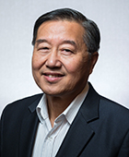

Slide 2
TECHNICAL AWARD WINNERS!

Slide 3
Allie P. Garcia
Regional Completions Optimization and Technology

Slide 4
Allie Garcia is a passionate problem solver with over ten years of experience in Completion and Production Engineering roles. Her career has allowed her the opportunity to apply her expertise at multiple organizations including a large independent energy company, a major global E&P, and a small private equity operator. Allie has also applied her knowledge as an independent engineering consultant.
Allie’s experience has built a solid foundation for her current role with Reveal Energy Services where she advises operators in the Permian Basin and across North America on how to optimize their completion designs and well spacing using surface pressure data.
Allie holds a BS in Petroleum Engineering and a Master of Energy Business, both from the University of Tulsa. She currently spends most of her time outside of work chasing a rambunctious toddler.
NOMINATOR STATEMENT
Allie has experience in many facets of the oil and gas industry. She has worked for large majors and smaller E&P companies as well as on the services side assisting and advancing the evolution of completions. By leveraging a well-rounded and unique skill set, she’s able to not only understand the need and value in data collection but also the justification required to underwrite value-based decisions with fundamentally strong economics. She will keep our industry progressing for decades to come.

Slide 5
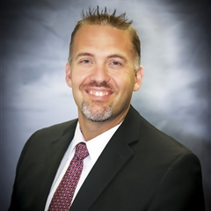
Scott A. Rovira
Regional Drilling
Engineering

Slide 6
Scott Rovira joined Endeavor Energy Resources, LP as the Drilling Manager in October of 2016 and served in this capacity until his promotion to Vice President of Well Construction in March of 2018. In his current capacity, Mr. Rovira leads the companies development drilling and completion activities in the Midland Basin focused on the core 6 counties of the basin. Prior to joining Endeavor, Mr. Rovira served as the General Manager of Well Construction – Rockies Region for Anadarko Petroleum Corporation. While at Anadarko, Mr. Rovira held roles of increasing responsibility in engineering and operations management spanning petroleum basins in Texas, Louisiana, Mississippi and Pennsylvania. Mr. Rovira holds a Bachelor of Science degree in Petroleum Engineering from Louisiana State University.
NOMINATOR STATEMENT
Scott has demonstrated extensive leadership in drilling at a top tier and most active horizontal well company in the Midland Basin, Endeavor Energy Resources. He does this every day while encouraging and promoting his team expertise.

Slide 7
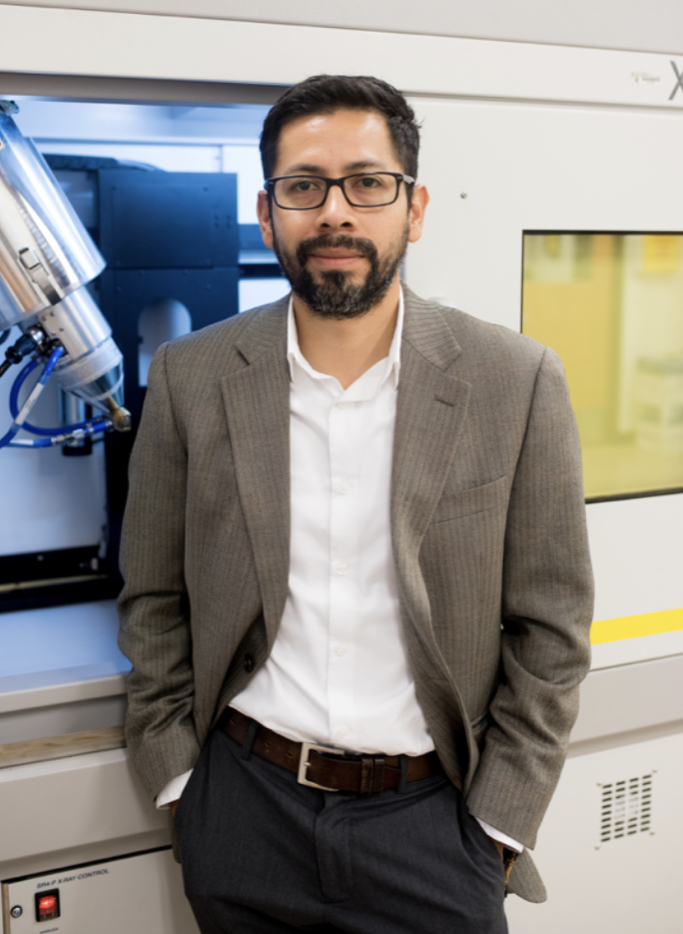
D. Nicolas Espinoza
Regional Formation Evaluation

Slide 8
Dr. D. Nicolas Espinoza is an Associate Professor in the Hildebrand Department of Petroleum and Geosystems Engineering at The University of Texas at Austin. Dr. Espinoza earned his Civil Engineering diploma from Universidad Nacional de Córdoba in 2006, and his MS and PhD degrees from the Georgia Institute of Technology in 2008 and 2011. His primary research interests include mechanics and physics of natural porous solids and granular media, including applications to advanced completion techniques, reservoir geomechanics, geophysics and formation evaluation.
Dr. Espinoza has made several contributions to the Formation Evaluation community including: development of new acoustic methods to reveal the presence of fractures in shale formations, development of new methods to measure rock intrinsic mechanical anisotropy in a single tight rock plug, measurement and publication of petrophysical data of emerging unconventional formations, and identification and measurement of petrophysical of reservoir and seal rocks for safe CO2 geological storage.
In addition to technical contributions, Dr. Espinoza has helped the Formation Evaluation community indirectly by training undergraduate and graduate students in geophysics applied to Petroleum Engineering.
NOMINATOR STATEMENT
Dr. Espinoza has contributed in many aspects to the SPE and Formation evaluation communities for the last 6 years, including the following: developed new geophysical methods to characterize shale formations, graduated doctoral students in geophysics and geomechanics for formation evaluation, submitted, published and presented scientific papers to SPE conferences and journals, and served as reviewer for SPE conferences and journals.

Slide 9
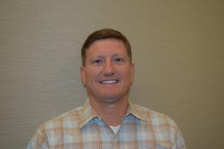
Bryan Michael Montgomery
Management and Information

Slide 10
Received a BS in Petroleum Engineering from Oklahoma University in 1984, and an MBA from the University of Texas at Tyler in 1992.
Employed most of his career at Mewbourne Oil Company in Tyler Texas and is currently at Concho Resources in Midland Texas. Worked in the Anadarko and Permian basins in NA with a current focus on the economic horizontal development of reserves.
Past president of the East Texas SPE chapter.
Married with 3 children and 3 grandchildren.
NOMINATOR STATEMENT
Bryan Montgomery is a Professional Engineer who has mentored dozens of young engineers and aided them to be better reservoir engineers, and all-around better people.

Slide 11
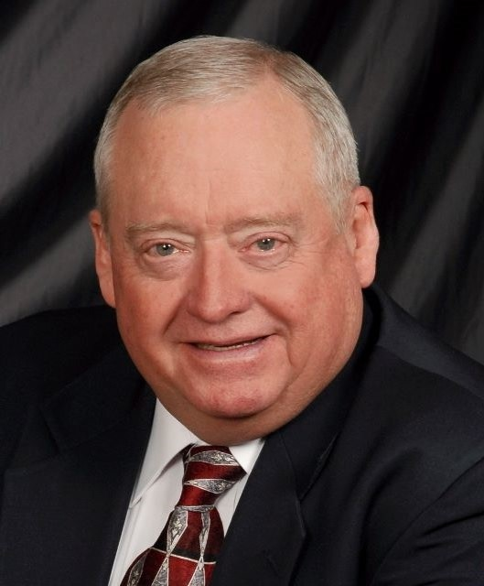
David L. Divine
Production and Operations

Slide 12
David Divine has a Bachelor of Science degree in Electrical Engineering from Texas Tech University and is a Registered Engineer in the State of Texas.
Mr. Divine has over 40 years’ experience in the oil industry. His experience includes service with Texaco Inc. where he developed the first practical variable speed submersible pumping system and is the author of several papers on this topic.
He co-founded Submersible Oil Systems, a company that designed and manufactured a variable speed controller for submersible pumping. After SOS was acquired by Centrilift-Hughes, he served as Vice President over the Systems Division of Centrilift-Hughes.
He was a co-founder of Electric Submersible Pumps, Inc. (ESP, Inc.) As Vice President of Engineering he helped develop many of the current standards for testing used submersible equipment and has improved many of the standards for the testing of new equipment.
In 1997 he became an independent consultant.
Mr. Divine began working for Baker Hughes Incorporated as a Technical Representative at the Educational Development Center in Claremore, Oklahoma for Centrilift in September of 2002.
In July of 2007 Mr. Divine began work with Wood Group ESP, Inc. as a Principle Engineer. His duties included improving the method and equipment used for varnishing new ESP motors. In 2009 he became the team leader for the development of “Solutions”, the ESP sizing software for the Wood Group ESP.
Wood Group ESP was acquired by GE Oil and Gas in May of 2011 and Mr. Divine continued in the position of Solutions development team leader until his retirement from GE Oil and Gas in 2016.
Shortly thereafter, Mr. Divine began working for Valiant Artificial Lift Solutions as a Principal Engineer.
Mr. Divine has been presenting seminars and schools on submersible pumping for the past 40 years. He is the co-author of a Manual and software on the subject of electric submersible pumping.
NOMINATOR STATEMENT
With over 40 years’ experience in the oil and gas industry, David Divine developed the first practical variable speed submersible pumping system for optimized well production and designed proprietary ESP Sizing software used to analyze and configure downhole equipment to deliver extended run life in dynamic production environments.

Slide 13
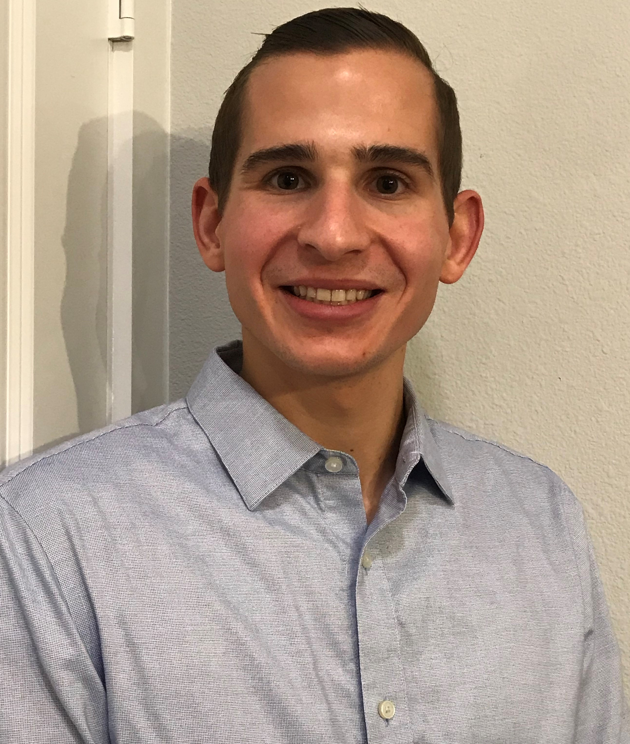
Ryan Matthew Yarger
Projects, Facilities and Construction

Slide 14
Ryan Yarger is a Facilities Engineer for EOG Resources in the Midland Division, where he focuses on field development and mobile infrastructure. Ryan came to EOG in 2018 after working as a Field Engineer in the Haynesville Shale for FTS International and in production for Hathaway LLC out of Bakersfield, CA. Ryan is active in the SPE Permian Basin Section, with roles on both the board and the Completions & Operations Study Group committee. Ryan is a 2016 graduate of the University of Wyoming, where he earned a B.S. in Petroleum Engineering with a minor in Geology.
NOMINATOR STATEMENT
Ryan's recent experiences in EOG as a facilities engineer and his SPE involvement in the Permian Basin Section are what qualify him for this award.

Slide 15
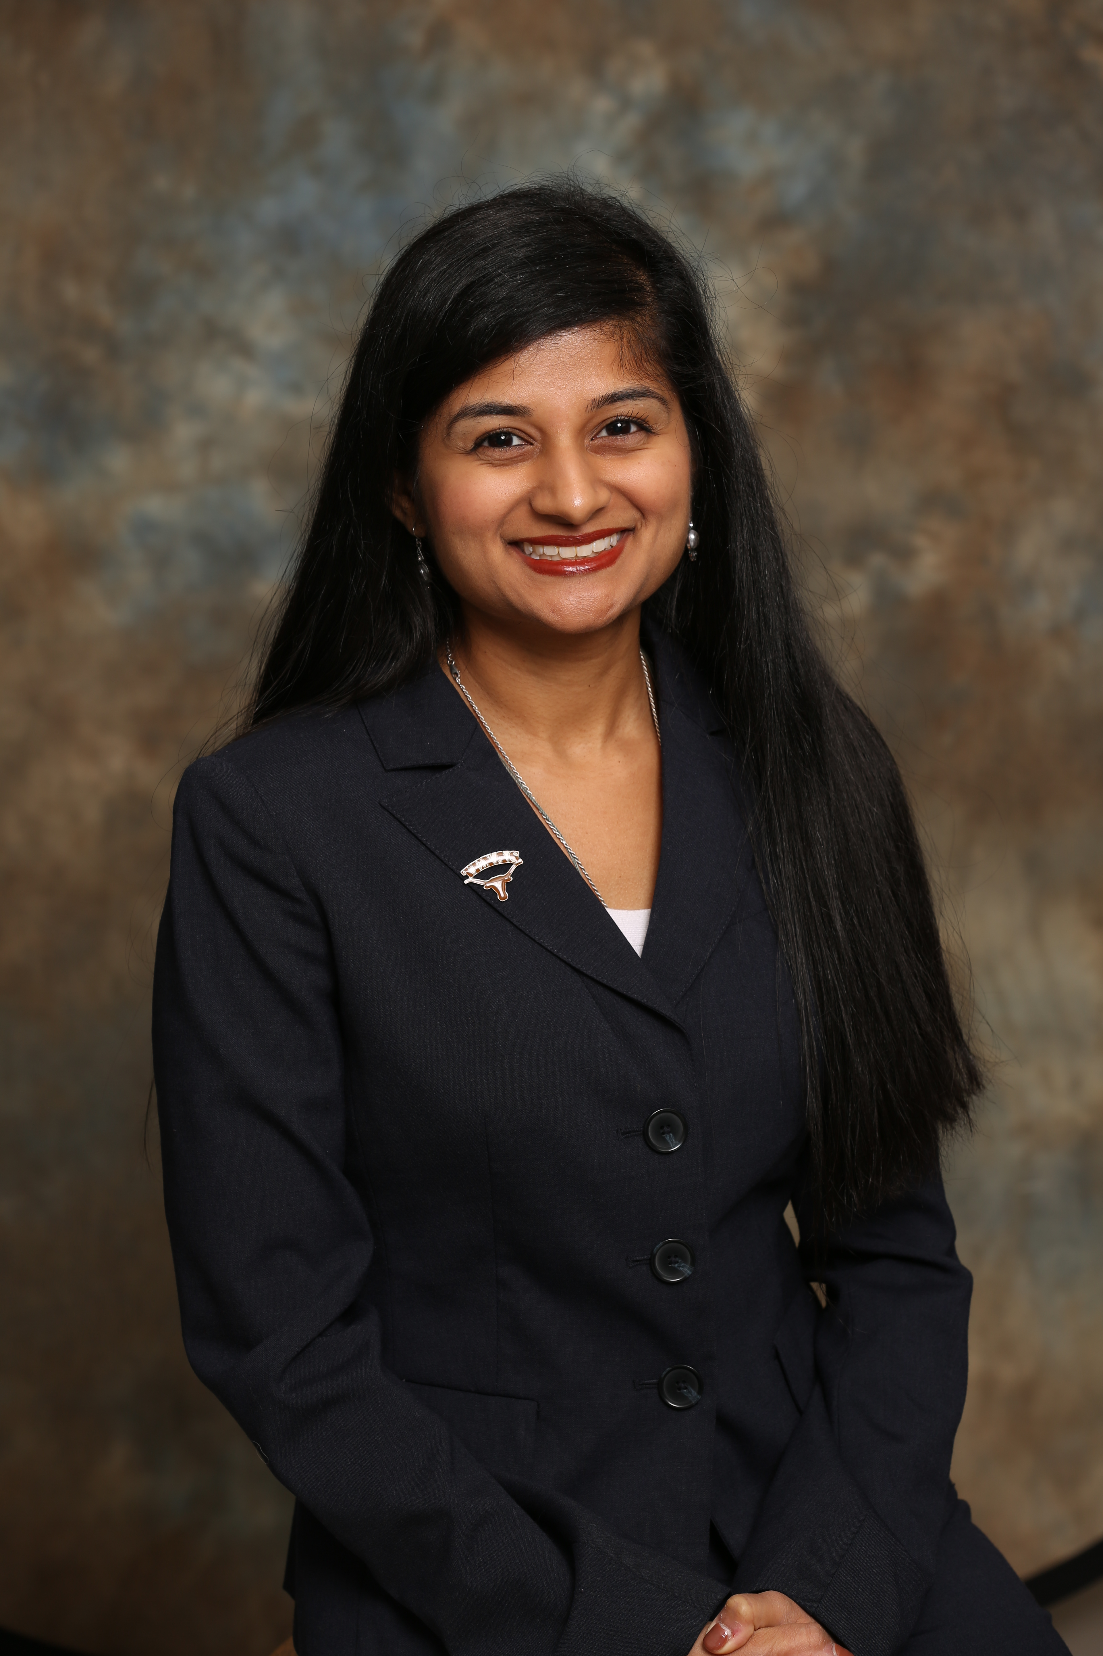
Yogashri Umesh Pradhan
Reservoir Description and Dynamics

Slide 16
Yogashri Pradhan is a senior reservoir engineer for Endeavor Energy Resources. At Endeavor, she is involved with field development planning for unconventionals in the Midland Basin. She's also worked as a senior production engineer for Texas Oil and Gas Institute and Devon Energy, overseeing various production optimization studies and field operations in the Permian Basin.
Yogashri is an active SPE member at the local and international levels through technical conference committees, study groups, authoring/co-authoring seven technical publications, and community service initiatives. She is the recipient of Houston Engineers Week Young Engineer of the Year representing SPE-Gulf Coast Section for 2018 and the International Young Member Outstanding Service Award from SPE in 2018.
Yogashri graduated from the University of Texas with a Bachelor's in Petroleum Engineering in 2015 and is pursuing her Masters in Petroleum Engineering at Texas A&M University. She is a registered Professional Engineer in the state of Texas.
NOMINATOR STATEMENT
Yogashri is active in SPE on a local, regional, and international level. At under five years of work experience, she is a recipient of the 2018 International Young Member Outstanding Service Award, Young Engineer of the Year Award, will chair the Permian Basin Section in 2020, co-founded SPE Cares, chairs SPE Women in Energy, chaired the Liquids Rich Basins Conference, founded and chaired the Permian Basin Section Production Management Symposium, is a member of various SPE and URTEC committees

Slide 17
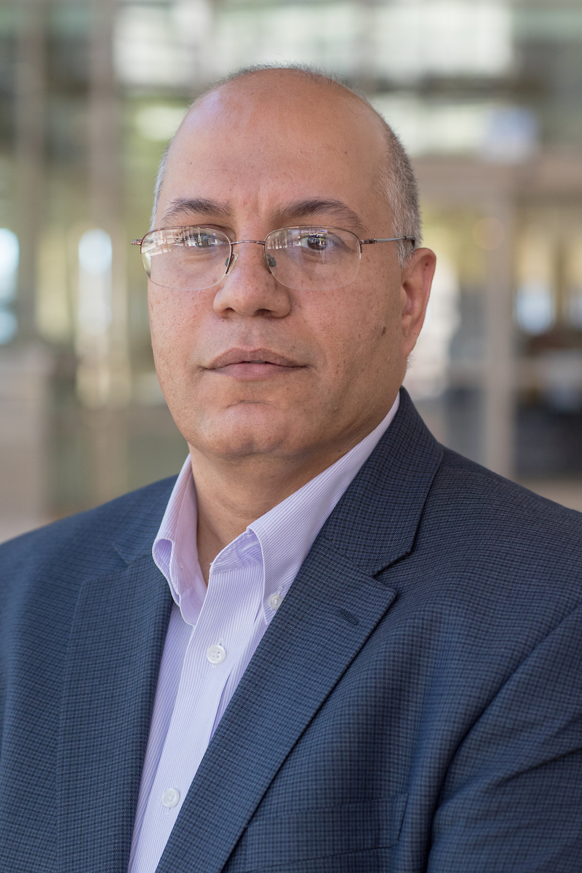
Dr. Ahmed H. Kamel
Distinguished Achievement Award for Petroleum Engineering Faculty

Slide 18
Dr. Kamel is an associate professor in the Petroleum Engineering Department at the University of Texas Permian Basin and hold the Ellen and Bill Noel Distinguished Fellowship for Energy Research. Previously, he was an assistant professor at the University of Alaska Fairbanks.
Kamel has been extensively involved teaching, research, and service with wide experience in USA and Middle East. Kamel’s research interests include drilling, completion, and stimulation of oil and gas wells, with a focus on characterization and flow properties of fluids in straight and coiled tubing. He has authored or co-authored more 50 technical papers.
Kamel holds a Bachelor and Master degrees in Petroleum Engineering from Al-Azhar University, Cairo, Egypt, and A Ph.D. in Petroleum Engineering from The University of Oklahoma, OK, USA. He is an active member of SPE, AADE, and many other professional organizations.
NOMINATOR STATEMENT
Dr. Kamel is involved in university, college, department, professional, and community service activities. He is serving as an academic advisor for both SPE and AADE student organizations and an editor and reviewer for several peer-reviewed journals. He is going above and beyond what a human can do to support the students and the entire Permian Basin.

Slide 19
REGIONAL SERVICE AWARD WINNERS!

Slide 20
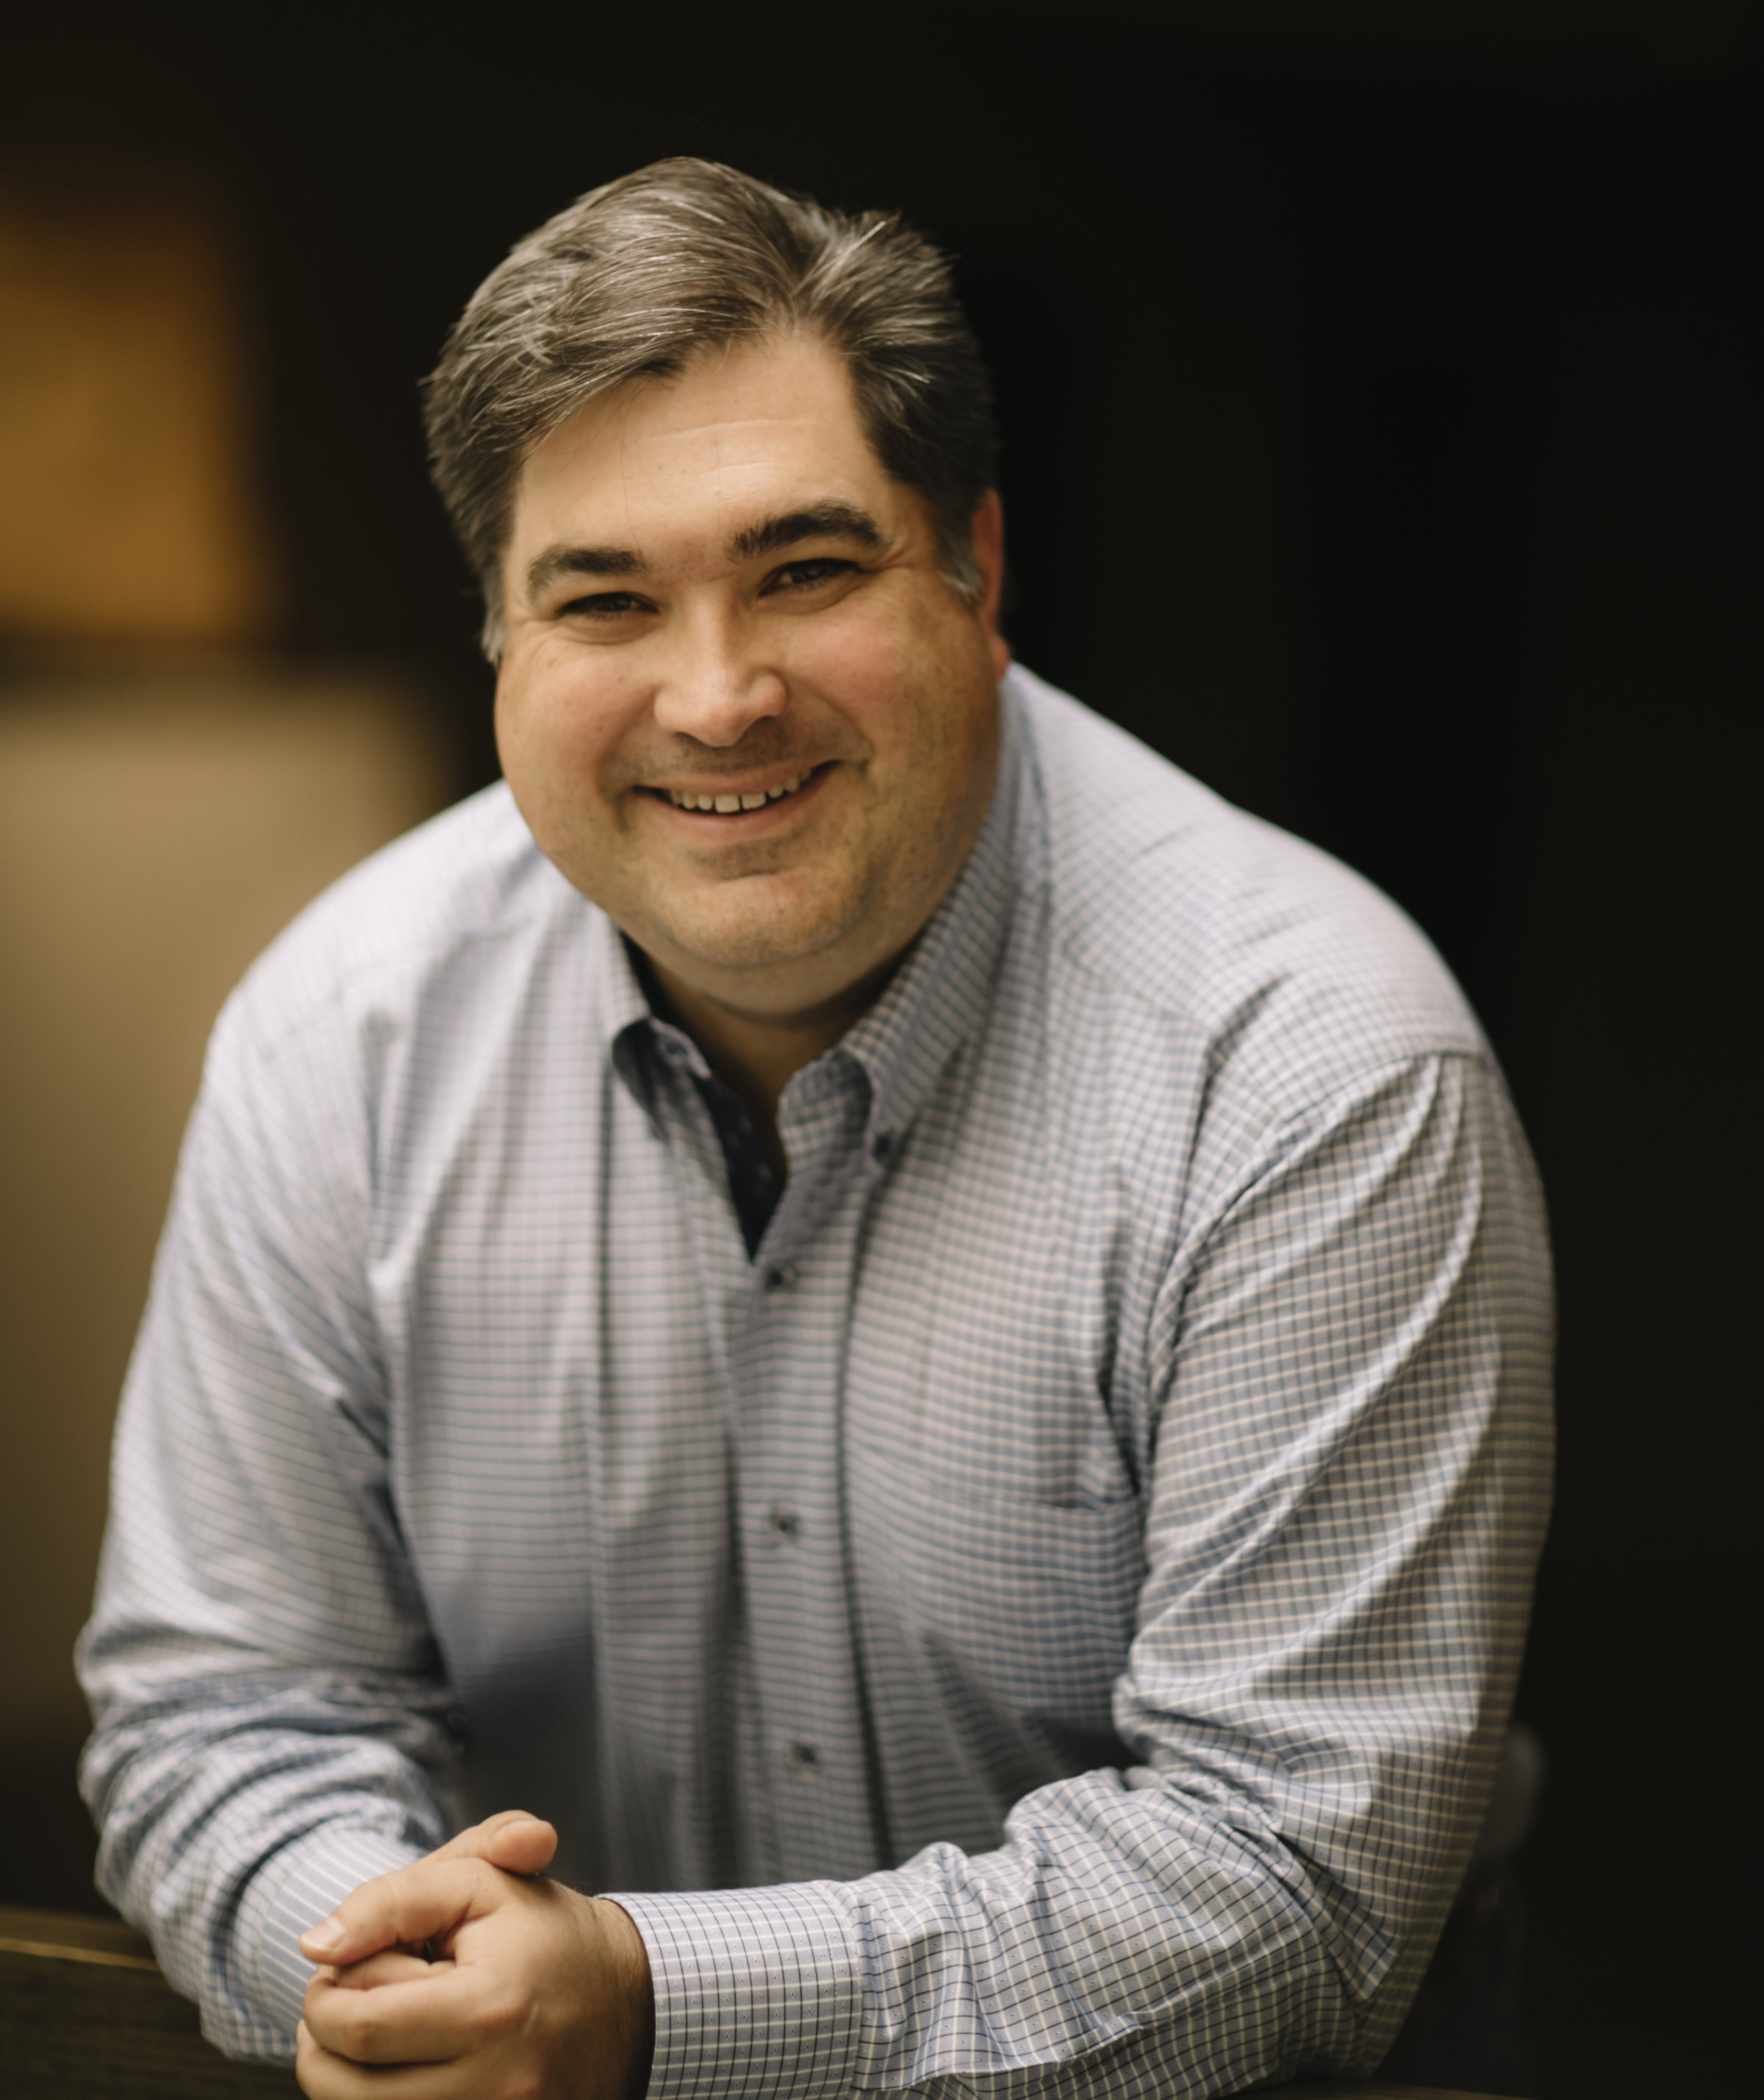
Jason S. Herrick
Regional Public Service

Slide 21
Jason Herrick is the president of Pantera Energy Company. Prior to Pantera Energy Company, Jason helped start e2i, a small consulting firm based in Amsterdam, The Netherlands. He established business offices in Amsterdam and London while working with large banking clients ING and BBL on procurement management systems. Early in his career he worked for Andersen Consulting (now Accenture) in Dallas, TX where he specialized in procurement and materials management. He worked for clients such as CITGO in Tulsa, Minyards in Dallas, and Mrs. Smith’s Bakery in Atlanta. Jason graduated from Texas A&M University with a Bachelor of Science in Industrial Engineering.
Jason is very active in our Amarillo community. He currently serves as an executive member of the Amarillo Area Foundation and Don Harrington Discovery Center boards. He has previously served terms as president of Center City of Amarillo, the Panhandle Producers and Royalty Association, Society of Petroleum Engineers and the Texas Panhandle Regional Economic Development Corporation as well as leadership roles in several other area non-profits. He is also a Sunday School teacher at Hillside Christian Church.
He has been recognized as the Top Twenty Under 40 by the Amarillo Chamber of Commerce and the 2011 Boss of the Year by the Panhandle Desk and Derrick.
NOMINATOR STATEMENT
Mr. Jason Herrick is president of Pantera Energy Company one of the largest operators in The Texas Panhandle. Mr. Herrick continues to not only devote time and finances to SPE but is a strong advocate in the community thru his significant presence in supporting the Amarillo Area in various civic volunteer roles. Mr. Herrick embodies what a true SPE Member's service role should be in a local community.

Slide 22
Yogashri Umesh Pradhan
Regional Service

Slide 23
NOMINATOR STATEMENT
Yogashri Pradhan is a senior reservoir engineer for Endeavor Energy Resources. At Endeavor, she is involved with field development planning for unconventionals in the Midland Basin. She's also worked as a senior production engineer for Texas Oil and Gas Institute and Devon Energy, overseeing various production optimization studies and field operations in the Permian Basin. Yogashri is an active SPE member at the local and international levels through technical conference committees, study groups, authoring/co-authoring seven technical publications, and community service initiatives. She is the recipient of Houston Engineers Week Young Engineer of the Year representing SPE-Gulf Coast Section for 2018 and the International Young Member Outstanding Service Award from SPE in 2018. Yogashri graduated from the University of Texas with a Bachelor's in Petroleum Engineering in 2015 and is pursuing her master’s in petroleum engineering at Texas A&M University. She is a registered Professional Engineer in the State of Texas.
Yogashri has been dedicated to enrich the life of petroleum engineers and women on energy fro 5 years now. She is part of the following technical committees: (Co-Chair) of Liquids Rich Basins Conference, Permian Basin Section Production Management Symposium (Chair), Sand Management Workshop, URTEC, SPE Hydrocarbon Economics and Evaluation Symposium, Production and Facilities Advisory Committee
Professional committees (optional): Will chair Permian Basin Section, SPEI Women in Energy (Chair),

Slide 24
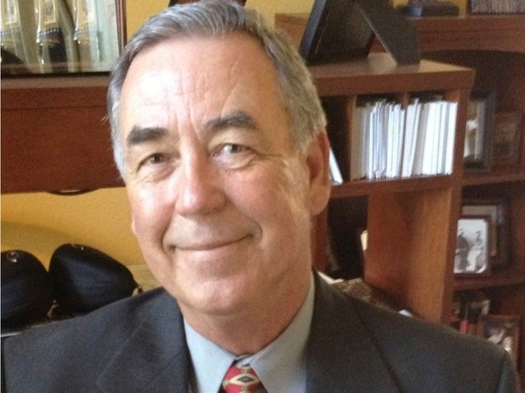
Dennis A. Scott
Regional Service

Slide 25
Born in Pampa Texas, Oilfield Country, my heritage came from the Oilfield. Charles W. Tillerson, Great Grandfather from Wichita Falls, Texas, moved to Marlow Oklahoma where he establish Wildcat Oil & Gas Production in Stevens and Coal Counties. Mr. Charles Herrell, my Grandfather was one of the first Drilling Superintendents of Noble Oil out of Healdton, Oklahoma. During High School my career started as a Oilfield Roustabout, then working for Conoco Offshore Louisiana during College. Upon Graduation from Baylor University, my career started as a Valve Representative in Houston. Quickly expanded into Oilfield Tubulars, Well Head Production Units, Gas Plants, Booster Stations, Gas Gathering, and Crude Pipeline Process Measurement and Controls. Joined the SPE in 1984, became involved as an Officer and Board Member of the Amarillo Petroleum Section. Working with our Section we established the Mid-Continent Gas Symposium in 1989 for 10 years. George W. Bush, future President being a principal Keynote Speaker.
Our Section renamed our SPE Section Golf Tournament as the “Oilman's Golf Scholarship Tournament in 1989, and completed our 30th Oilman’s in August 2019. Over the 30 Years Amarillo Section funded a Section Petroleum Engineer Scholarship which continues to this day. Oilfield Technology expanded my career into Well Head Data Acquisition Systems, Refining, Petrochemical Processing, Distributive Control Systems, Emergency Plant and Unit Shutdown Process Controls, and complete Plant Instrumentation Systems. My Volunteer work with the Amarillo Section has been the most rewarding Service opportunity of my career having work with Oil Pioneers, and many successful Petroleum Engineering Volunteers who worked as a Team to benefit so many.
NOMINATOR STATEMENT
Mr. Dennis Scott is a 35 year member of SPE of which continues to serve in various capacities as a local board member, spearheads our annual SPE Golf Tournament, and is an integral member who organizes our scholarship funding and giving to our scholarship recipients. Mr. Scott continues this legacy beyond his 70 years of age and has done so for many years that I can count in the 6 years I have been involved in this local section. Mr. Scott is an integral member of SPE and our local section.

Slide 26
REGIONAL YOUNG MEMBER OUTSTANDING SERVICE
AWARD WINNER!

Slide 27
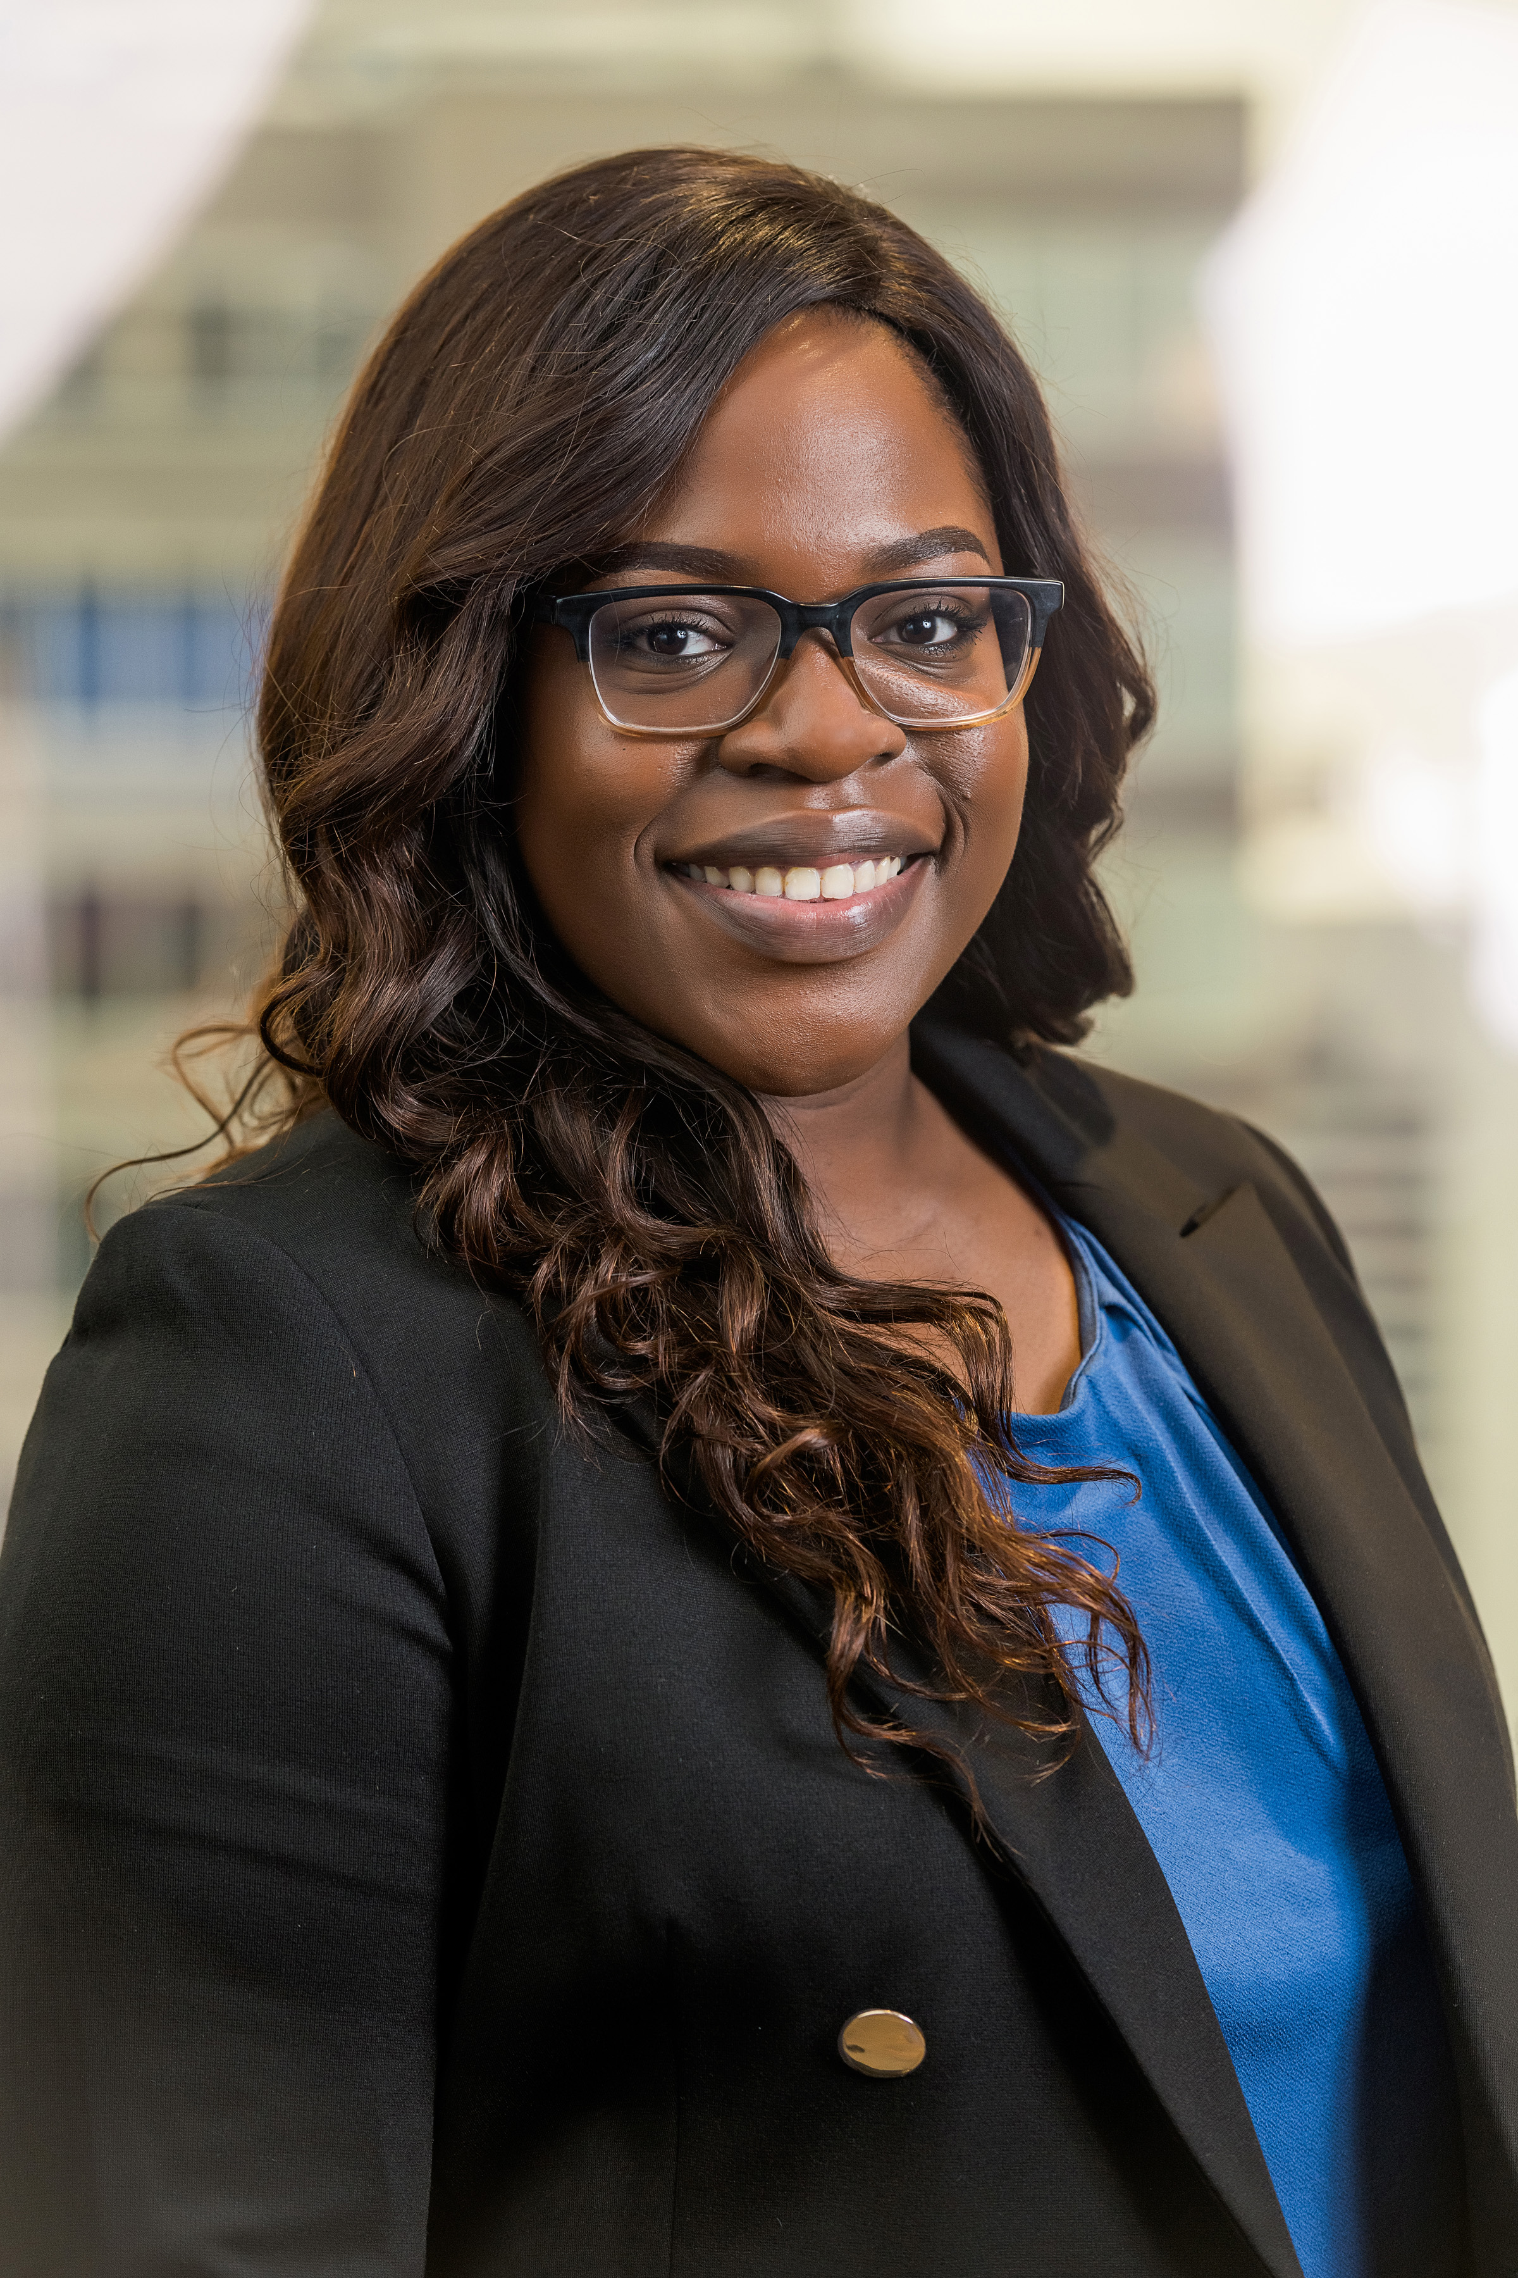
Rashidat Fumi Balogun
Young Member Outstanding Service

Slide 28
NOMINATOR STATEMENT
Fumi Balogun was born and raised in Houston, Texas and began her professional career in 2016. She has earned a B.S. in Petroleum Engineering from Louisiana State University. Since then, she has taken on challenging roles in the oil and gas industry from sales and operations to software implementation. Ms. Balogun has served as the Young Professionals Chair for the SPE Permian Basin Section for the past two years and will serve as the YP Advisor for the 2020-2021 term.
She is a hard-working individual who is passionate about digital transformation and the development of young professionals and students in transition. Ms. Balogun’s leadership skills developed early on from her many years of work experience in customer service and volunteerism through various organizations such as SPE, Habitat for Humanity, and local food banks. She believes this is what enables her to lead and perform well in dynamic teams composed of diverse backgrounds. Ms. Balogun enjoys traveling the world, connecting with new people, and sharing her reviews on local dining & experiences.
Rashidat Balogun,Fumi, is a dedicated member of the Permian Basin Chapter and in the Petroleum Community.

Slide 29
REGIONAL DISTINGUISHED CORPORATE AWARD WINNER!

Slide 30
Concho Resources
Distinguished Corporate Support

Slide 31
NOMINATOR STATEMENT
Concho Resources is one of the largest unconventional shale producers in the Permian Basin, with a deep legacy operating in the region. The Company is built on a strategy that focuses on hiring the best people and being a good business partner and member of our community, investing in high-quality assets, executing a returns-based capital program and maintaining a strong financial position. Concho is working today to deliver a better tomorrow for its shareholders, team and communities.
Concho Resources has been a constant supporter of the Permian Basin chapter in the Southwestern North America Region. Concho is consistently one of our top sponsors in our fall golf tournament (tied for our top sponsor this year with $5,000), has been the title sponsor of our spring clay shoot for the past several years ($5,225 this year), and they also sponsor events throughout the year (this year funding our Fall Energy4Me event). Not only does Concho support SPE with funds, but many employees are also involved in SPE, which Concho is great enough to support and encourage.

Slide 32
CONGRATULATIONS TO ALL THE WINNERS!

